Slide 1
Our vision and values

Slide 2
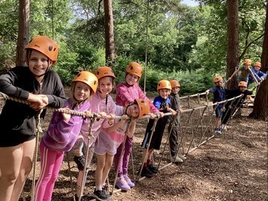
At Southway, we want We want all Southway children to be happy and confident, achieve personal success and develop a love for learning
Our vision
We have high aspirations for all children to make progress and reach their full potential
We aim to teach a creative and ambitious curriculum that enables academic achievement and readiness for secondary school.
We aim to develop a community of learners who understand the positive contribution they can make locally and globally
We aim to develop the “whole child” through teaching the importance of positive self-awareness, self-respect and respect the kindness for others.

Slide 3
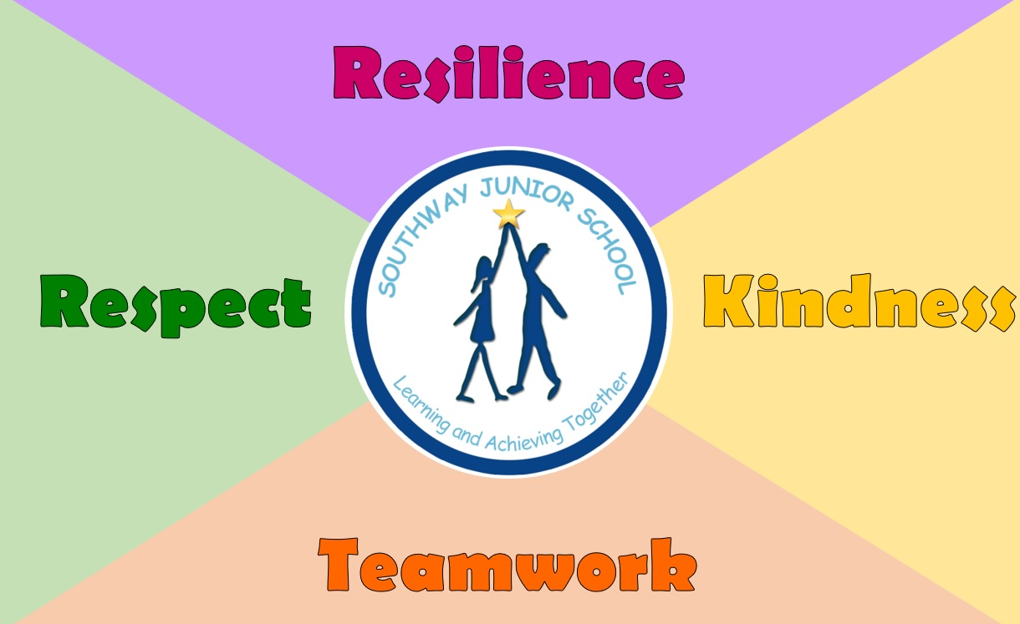
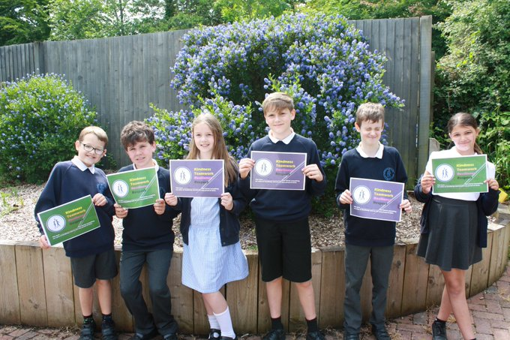
Our school values are

Slide 4
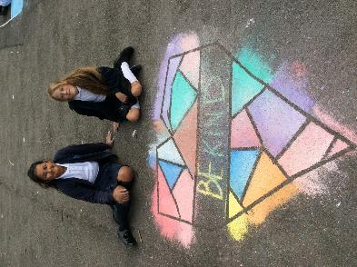
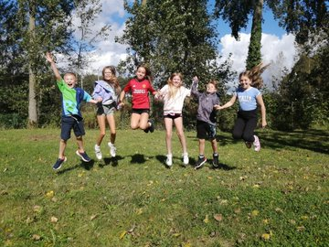
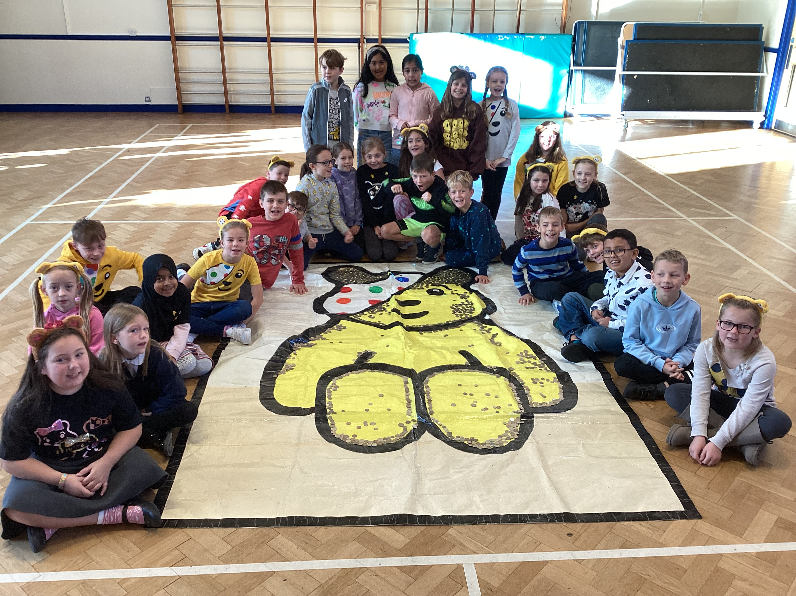
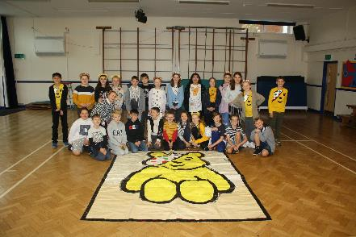
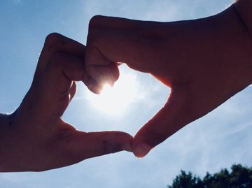
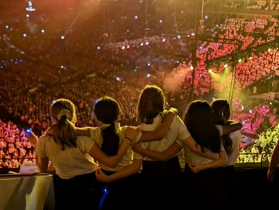
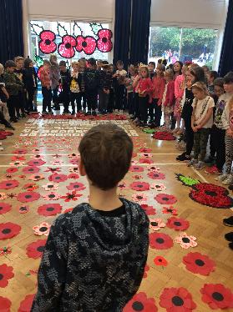
Kindness

Slide 5
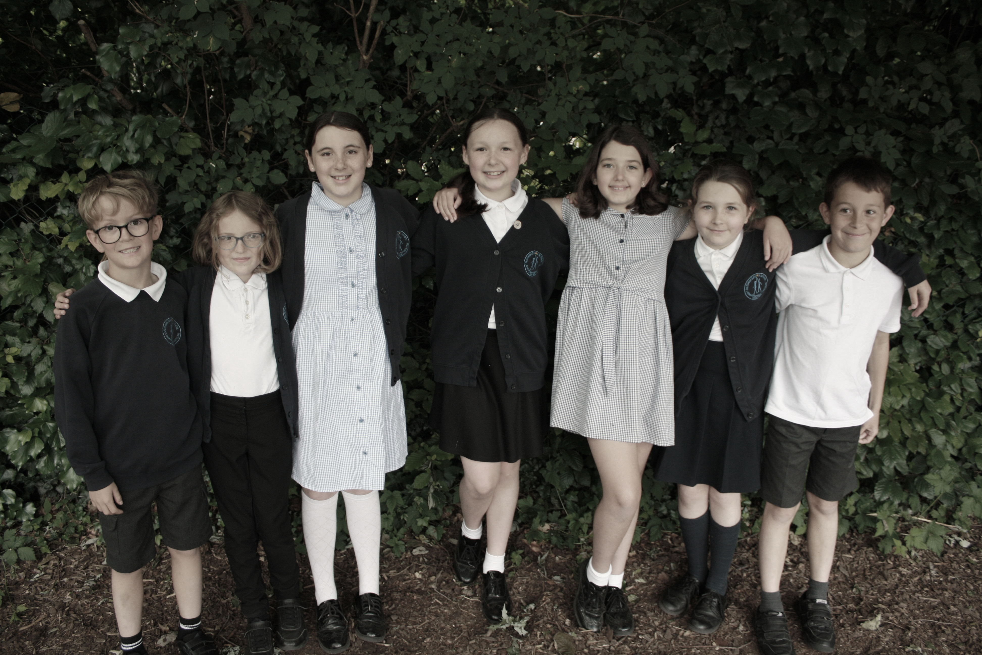
What is Kindness?
Kindness is being friendly, generous, and considerate to others and yourself. Being kind often requires courage and strength, as it involves the willingness to celebrate and give attention to someone else. It is also about giving honest feedback when doing so is helpful to the other person. Moreover, kindness includes acting and speaking in a compassionate way to others and yourself.
Why is Kindness important?
Each act of kindness is changes the way we see ourselves and others, as well as how others see us. As our kindness positively affects others, we feel more compassionate, confident, useful, and in control. We also find ourselves feeling more appreciative and optimistic. Furthermore, there is nothing as rewarding as giving back to others. Kindness and being generous can change the world. Moreover, one small act of compassion can make a significant impact on someone's life, including your own.
The Benefits of Kindness
From being kind to your partner, family, friends, and colleagues, as well as strangers, kindness has many benefits:
Brings happiness to others
Improves relationships
Enhances mental and emotional well-being
Releases feel-good hormones
Eases anxiety
Reduces stress
Is good for your heart
Can help you live longer
Can prevent illness
Can slow down the ageing process

Slide 6
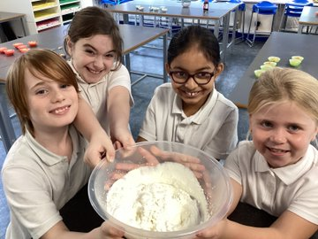
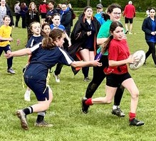
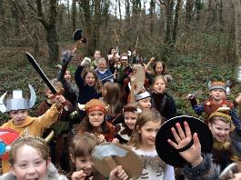
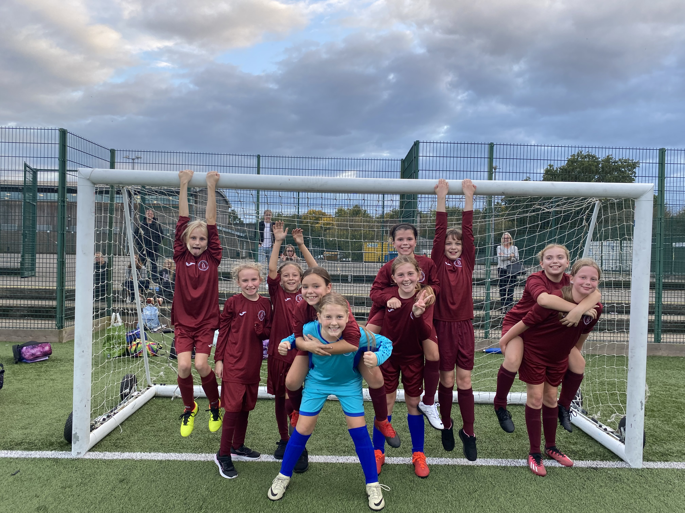
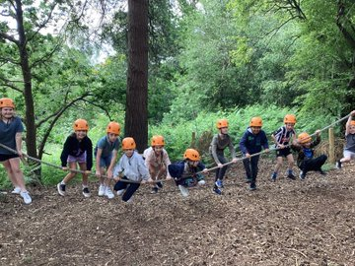
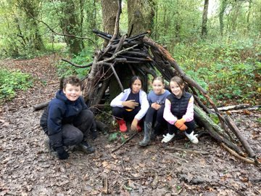
Teamwork

Slide 7
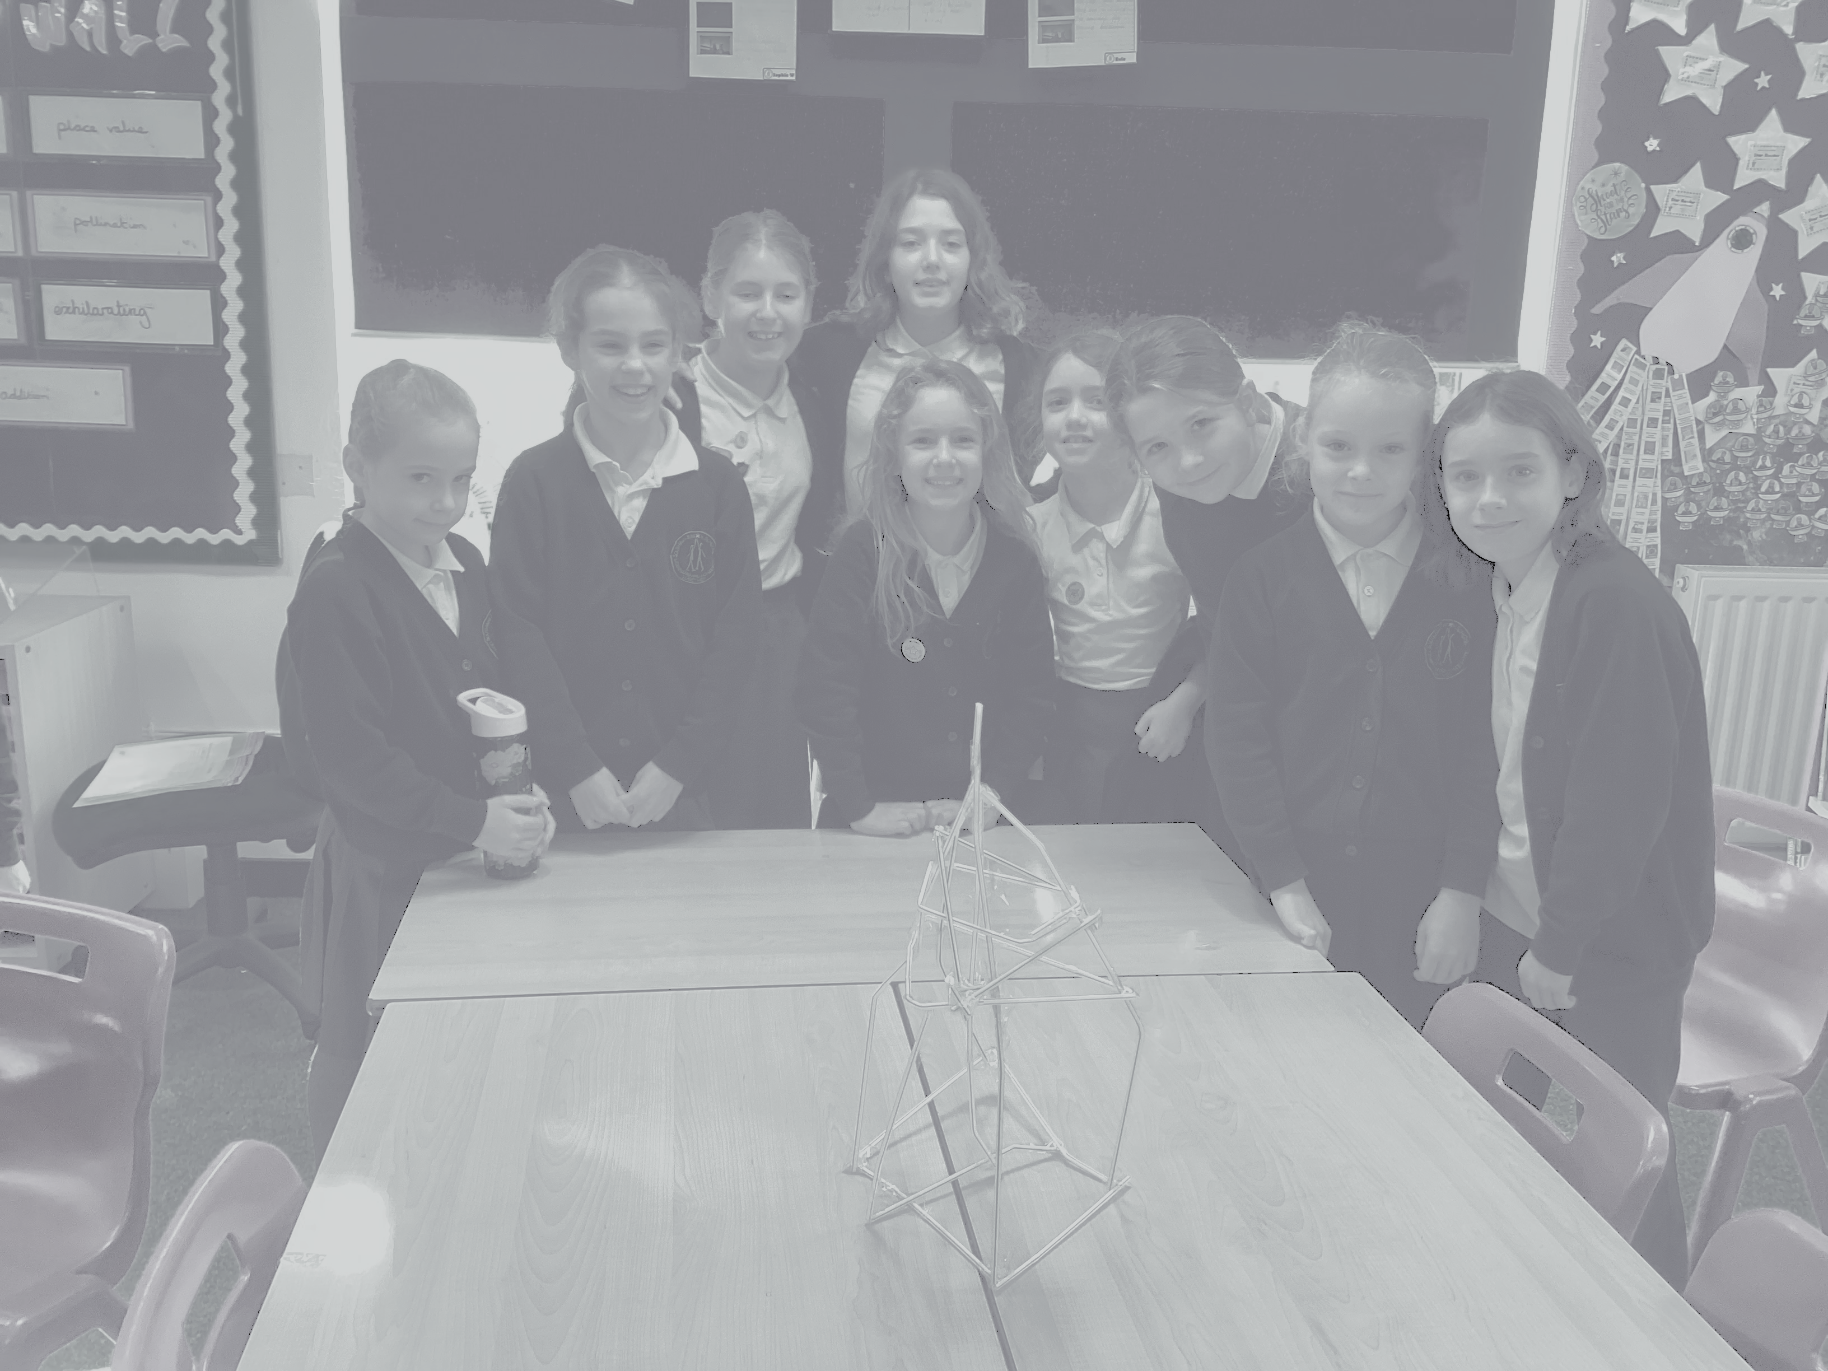
What is Teamwork? Teamwork is working collaboratively with a group of people in order to achieve a goal. Teamwork means that children will try to cooperate, using their individual skills and providing constructive feedback, despite any personal conflict between individuals.
Teamwork is selfless. Teamwork runs on the idea that the whole is greater than the sum of its parts.
Why is Teamwork important?
When children collaborate, they work together toward a common goal. The more teamwork fundamentals exhibited, the more opportunity exists for pupils to learn the vital skills of compromise and collaboration. Team or group work inside or outside the classroom teaches students the fundamental skills associated with working as a collective unit toward a common goal. Teamwork introduces a variety of skills that will be valuable for children later in the workforce, such as communication, compromise and collective effort. It also teaches time management, resource allocation and communication skills.
What are the benefits of Teamwork?
Teamwork teaches essential communication and social skills.
Children learn how to listen to one another.
Teamwork teaches children how to respectfully and confidently express their ideas and opinions effectively in a group setting.
Teamwork teaches children that their voices are respected and valued.
There are very few career paths that operate in isolation. As an employee in almost any industry, people are required to work closely with others.
It introduces children to collaborative environments early in their school experiences and presents opportunities for them to more productive and joyful as they work with others in a team-based environment.

Slide 8
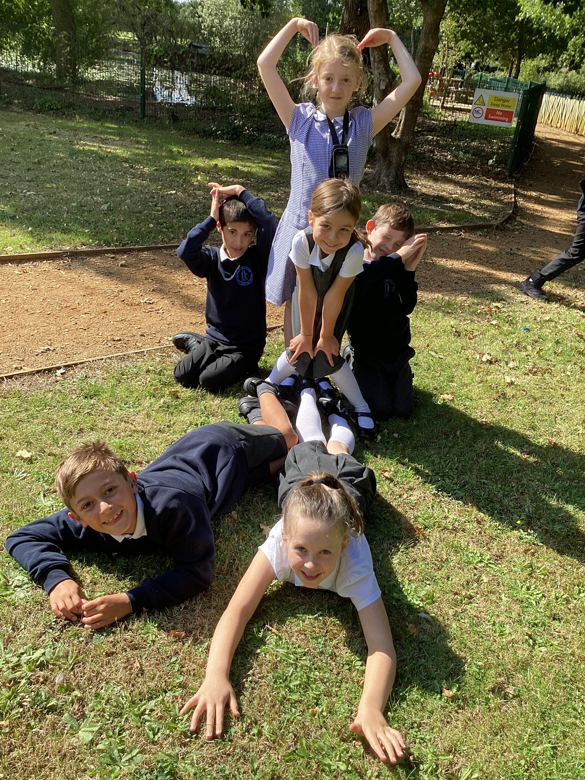
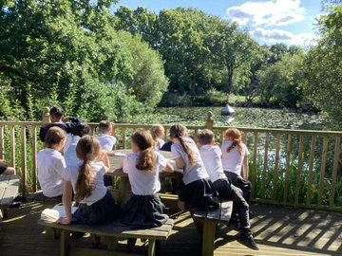
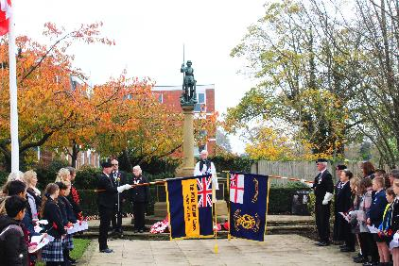
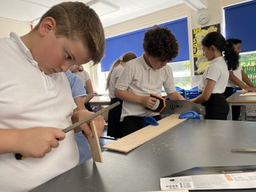
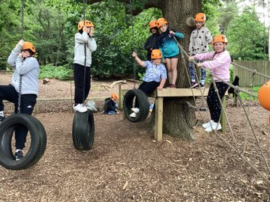
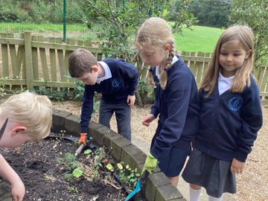
Respect

Slide 9
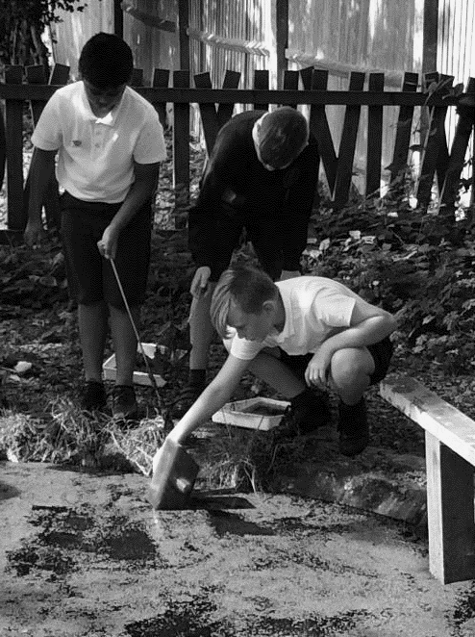
What is respect?
Respect is a positive way of treating or thinking of someone. It involves recognising their value and importance as a human being and treating them accordingly.
Being respectful of other people is an important value. Showing respect means demonstrating a concern for people you interact with and treating them as equals.
Why is respect important?
Receiving respect from others is important because it helps us to feel safe and to express ourselves.
Being respected by important people in our lives growing up teaches us how to be respectful toward others.
Respect means that you accept somebody for who they are, even when they’re different from you or you don’t agree with them.
Respect in your relationships builds feelings of trust, safety, and wellbeing.
Respect doesn’t have to come naturally – it is something you learn.
Respect is the glue that holds your relationships together. Learn ways to be respectful and know what to do when somebody isn’t respectful toward you.
The benefits of respect
Teaching respect will help ensure children do their best to address conflict in a productive way.
Teaching respect will allow children to communicate in a way that is effective and will encourage them to take responsibility for their own mistakes, and better tolerate the mistakes of others.
Showing children how to listen, not interrupt and take their turn helps them better engage conversationally with others. Listening to those around us is how we learn and grow.
Teaching children respect at an early age ensures they accept everyone for who they are.
Teaching children good manners stems from respect. Saying a simple “please” and “thank you” can go a long way and, with practice, these gestures can become natural behaviours. By practicing manners children learn that all relationships benefit from give and take.

Slide 10
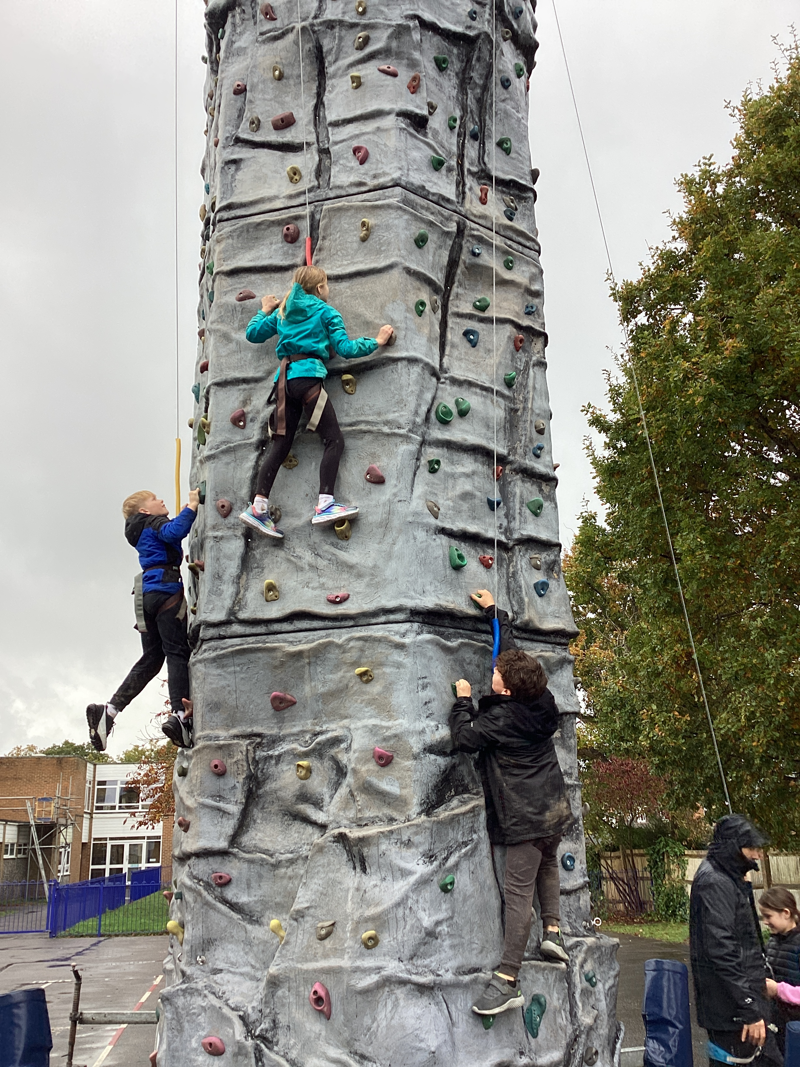
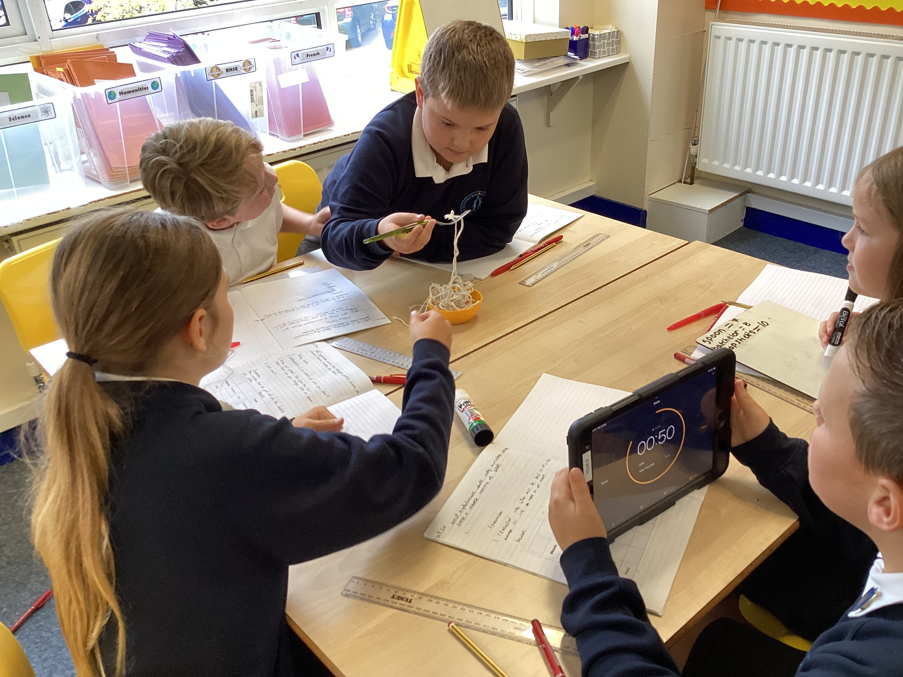
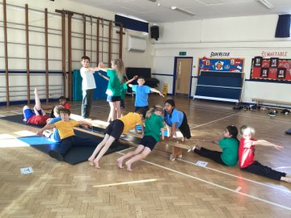
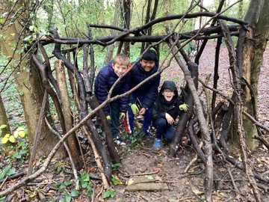
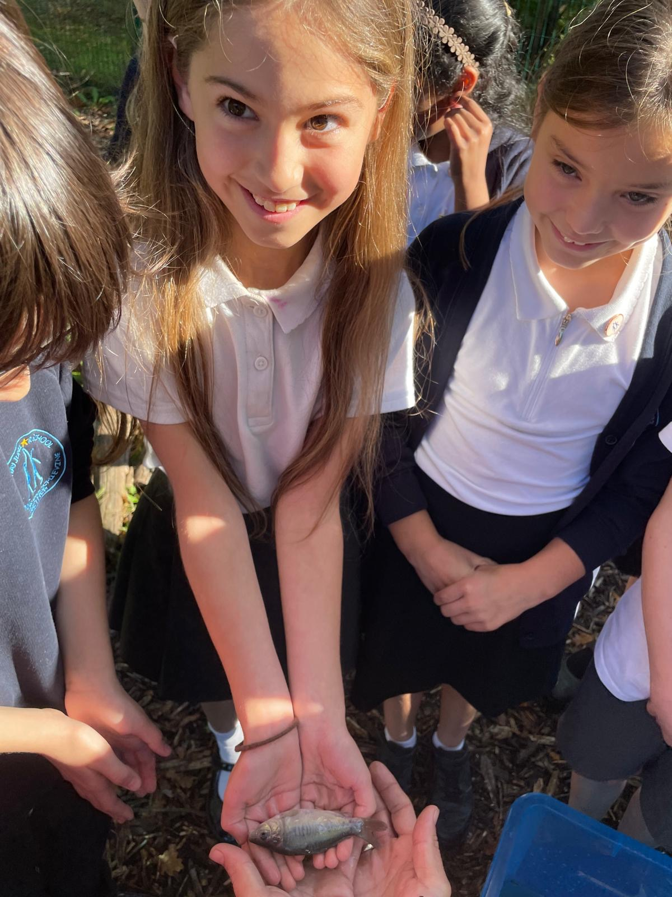
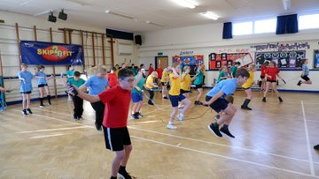
Resilience

Slide 11
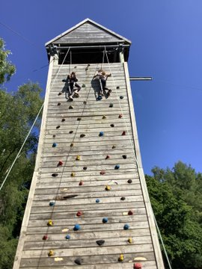
What is resilience?
Resilience is the ability to bounce back from a negative experience or difficult challenge. A rubber ball can be bounced and squeezed but still usually goes right back to the way it was – that’s “resilience”. Resilience allows you to face a problem or challenge, overcome it, and get back to life a little bit stronger and a little bit wiser. It’s coping with adversity in ways that boost your own well-being and protects you from getting overwhelmed.
Why is resilience important?
Children experience a tremendous amount of physical and mental growth on a daily basis. Between school, co-curricular activities, work and their social life, they face lots of new experiences and challenges. Being resilient gives them the ability to tackle these head-on, bounce back from any setbacks and have the best chance at succeeding. It allows them to learn and grow in all situations – two skills that are crucial to well-being and development. Resilience will also help children to approach new situations, people or experiences with confidence and a positive mindset, which will make them more likely to succeed.
The benefits of resilience
It provides opportunities to build positive relationships – between children and also between teachers and children.
It teaches emotional and social skills. These include social awareness, self-awareness, self-management, relationship skills and decision making.
It promote opportunities to feel connected to school. To feel valued, believed and that children can have a voice.
It provide opportunities for each child to be able to develop and be recognised for their own strengths. This contributes to the development of self-worth and confidence.
It provide a sense of meaning and purpose. This means helping children to connect to the local and global community and to find ways to contribute.

