Slide 1
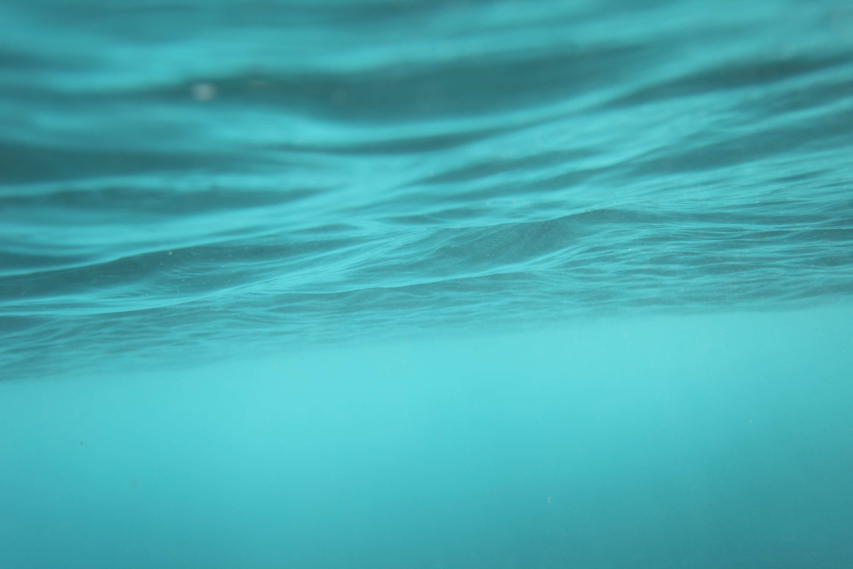
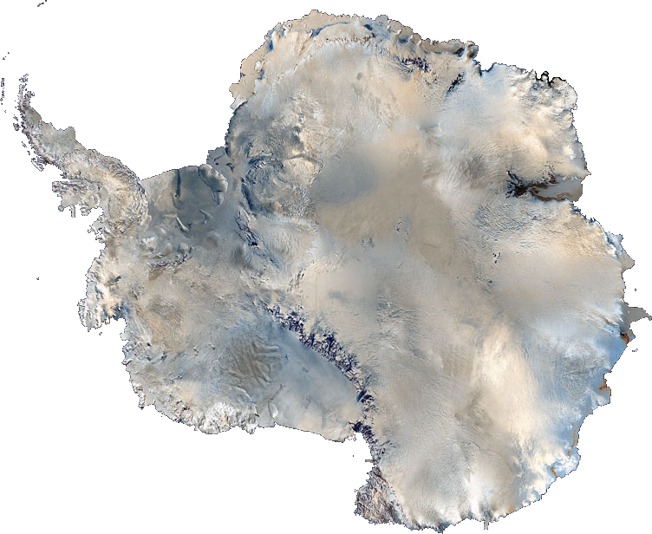
Frozen In Time
Year 6
Autumn Term

Slide 2
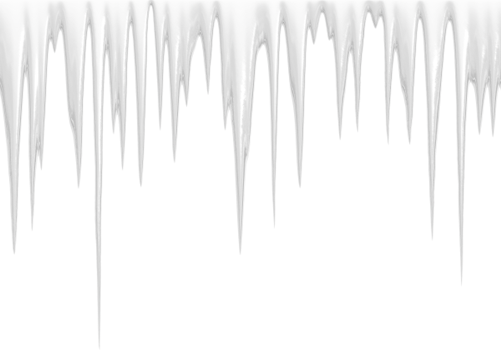
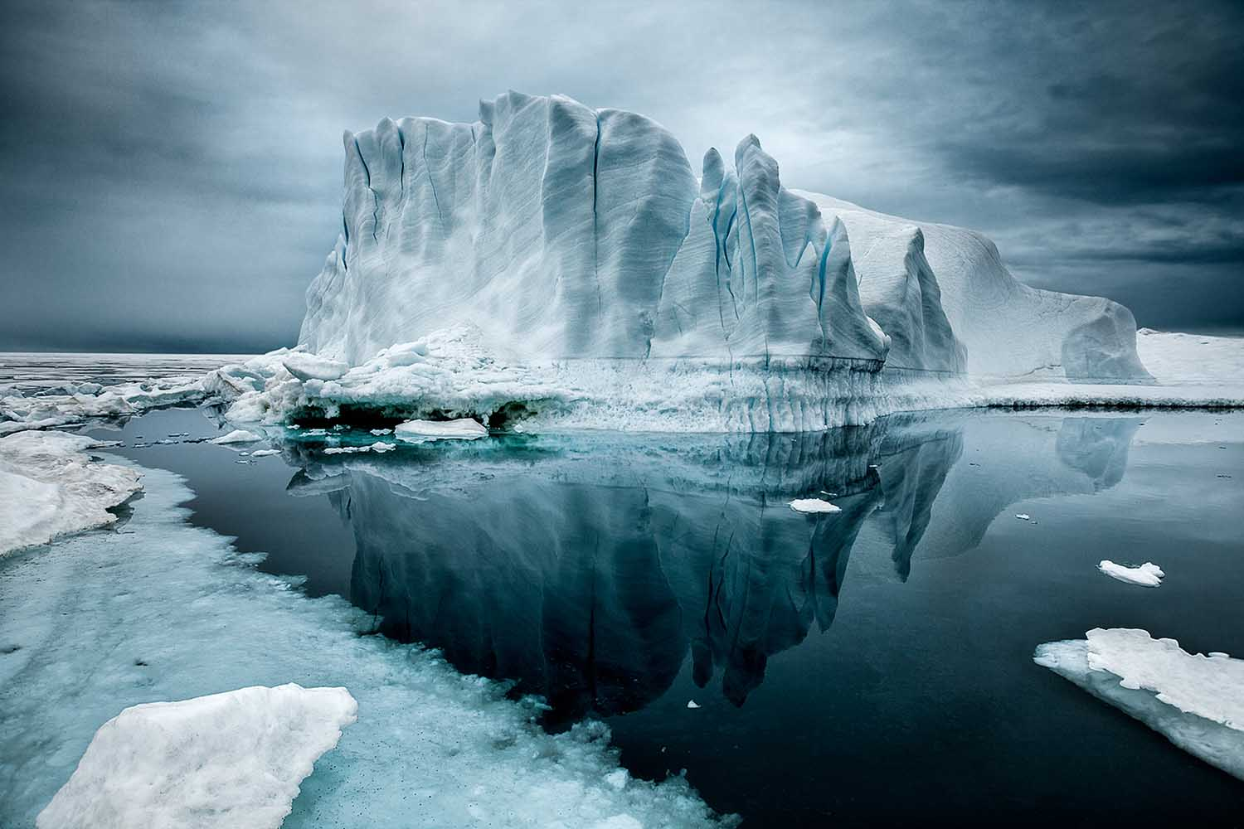
Antarctica is the highest, driest, coldest and windiest continent on Earth.
Antarctica covers 14.2 million km² (5.5 million square miles).
The Antarctic ice sheet is the largest ice store on earth.
Area: 5.4 million square mile (14 million kilometres)
Mass: 7.2 million cubic miles (30 million cubic metres)
Maximum depth: 15,669 feet (4776 metres)
Average depth: 7000 feet (2160 metres)
Covers roughly 98% of Antarctica
Contains 90% of the ice on earth
Contains 70% of the world’s freshwater

Slide 3
What will we be learning in each subject?
In English, we use our French trip and work on polar exploration as inspiration for a range of writing.
In science, we will be learning about evolution and inheritance as well as how living things adapt to their environment.
In Computing, we will be exploring creating websites and using microbits in programming.
In PE lessons we will be creating a dance routine, and developing our gymnastics skills. Games sessions will focus on invasion games.
In art, we will create 3D sculptures, inspired by the artist Lubania Himid. In DT, we will be building complex LEGO models, as well as making soup.
In geography, we will be investigating global biomes, global warming, climate change and studying mountains.
In RE, we will be learning about Christianity and different views on eternal life.
In French, we will be following the Kapow programme and learning about French sports and the Olympics.
In Music, we will be exploring soul and pop music, improving our singing, improvising and composing skills.

Slide 4
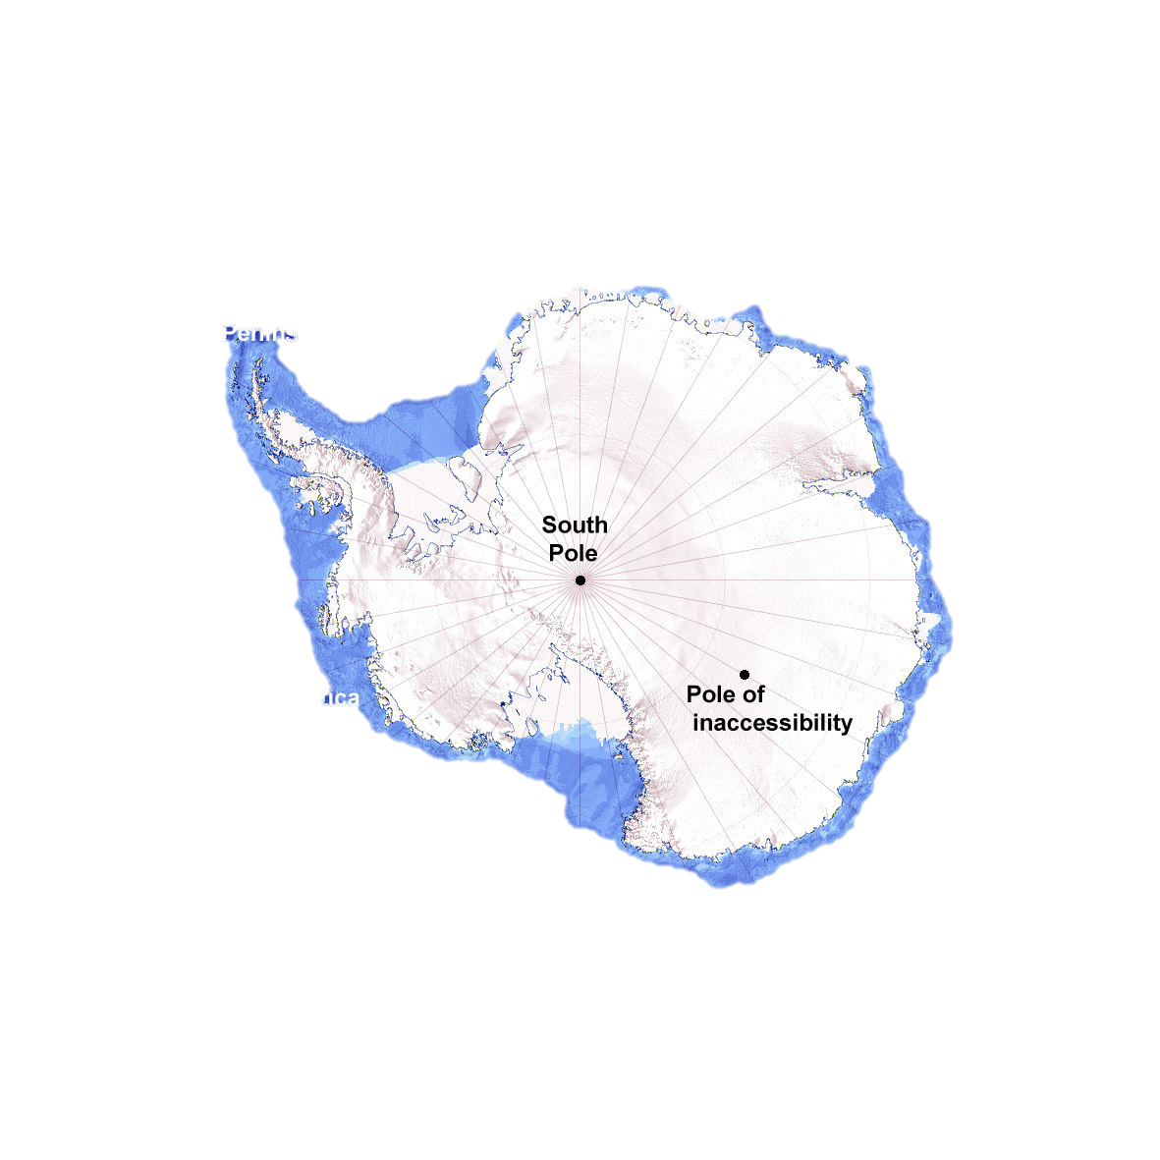
This term, we shall experience…
Soup making - Cooking £0.50
An Antarctic Survival Day (including climbing wall) £8.50 approximately
Key dates for your diaries...
France residential: 15th — 19th September
Bikeability: 8th — 26th September
Some of the questions we hope to answer this term are…
How is the climate in Alaska different/similar to the UK?
Where are the world’s highest mountains?
What were the achievements of famous polar explorers?
How do modern day mountaineers survive in hazardous conditions?
What is the impact of global warming on polar regions?

Slide 5
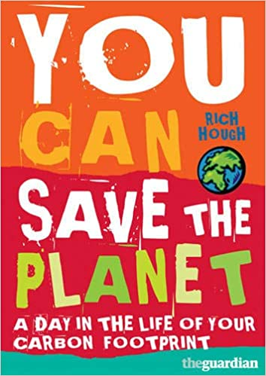
Join in with the learning at home...
Why don’t you watch…?
· Life in the Freezer
· Alaska: Earth’s Frozen Kingdom
· Planet Earth
Why don’t you look online at…?
· http://www.ecofriendlykids.co.uk/
· https://www.bbc.co.uk/teach/school-radio/articles/zr6992p
· http://www.kidsforsavingearth.org/
Why don’t you read…?
· ‘You can Save the Planet’ by Rich Hough
· ‘Why are the ice caps melting?: The Dangers of Global Warming’ by Anne F. Rockwell

Slide 6
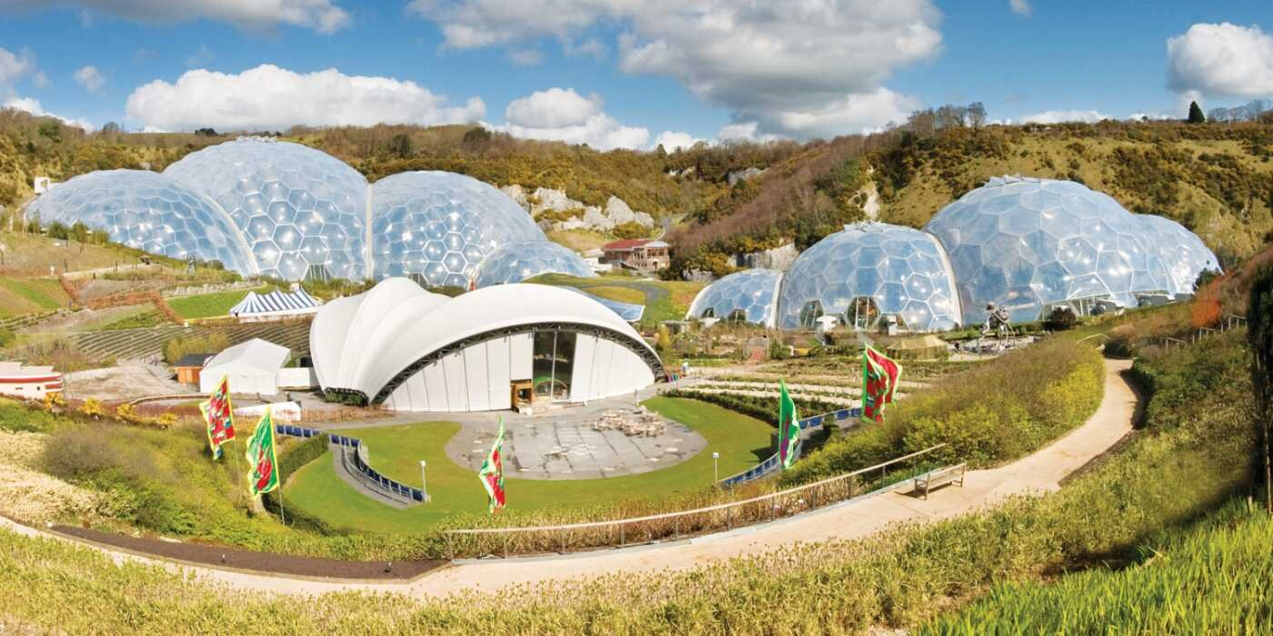
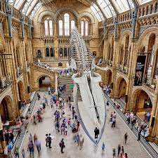
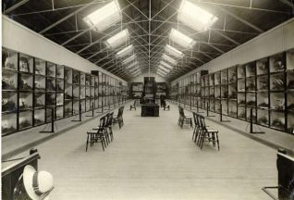
The Eden Project.
Why don’t you visit…?
· The Natural
History Museum,
London
The Booth Museum, Brighton

