Slide 1
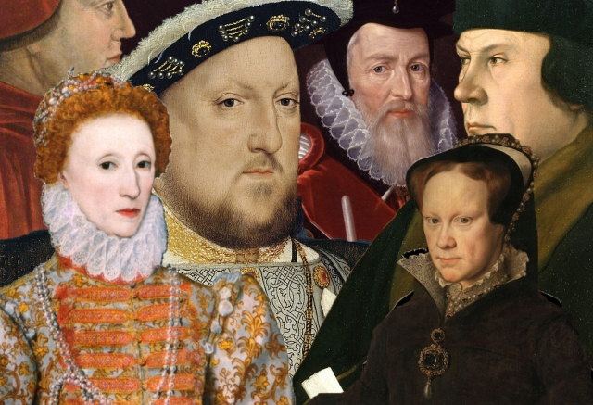
Power and Palaces
Year 5
Autumn Term

Slide 2
The Tudor period, from 1485 to 1603, was an important and fascinating era in British history . This was when the Tudors were the ruling family in England.
The first Tudor monarch was the legendary King Henry VII, who claimed the throne when his forces defeated Richard III at the Battle of Bosworth Field in 1485.
The Tudor rose was created when Henry VII brought an end to the Wars of the Roses (an ongoing battle between two royal groups – the House of Lancaster and the House of York). He joined the white rose of York with the red rose of Lancaster, creating the Union Rose (or Tudor Rose), which is still used as the floral emblem of England today!
Following his father’s death, Henry VIII became King of England in 1509 and ruled until his death in 1547. One of England’s most famous historical figures, Henry VIII is well known for his six marriages – and for having two of his wives beheaded!

Slide 3
A battle on a barren moor,
Three witches and a blood-soaked room.
A murdered king, a butchered friend,
A ghastly ghost and lots of gore.
Trees that walk, a fierce revenge,
A severed head...
This term at school we will enrich our learning journey with…
A visit to Hampton Court Palace
A trip to the local woods

Slide 4
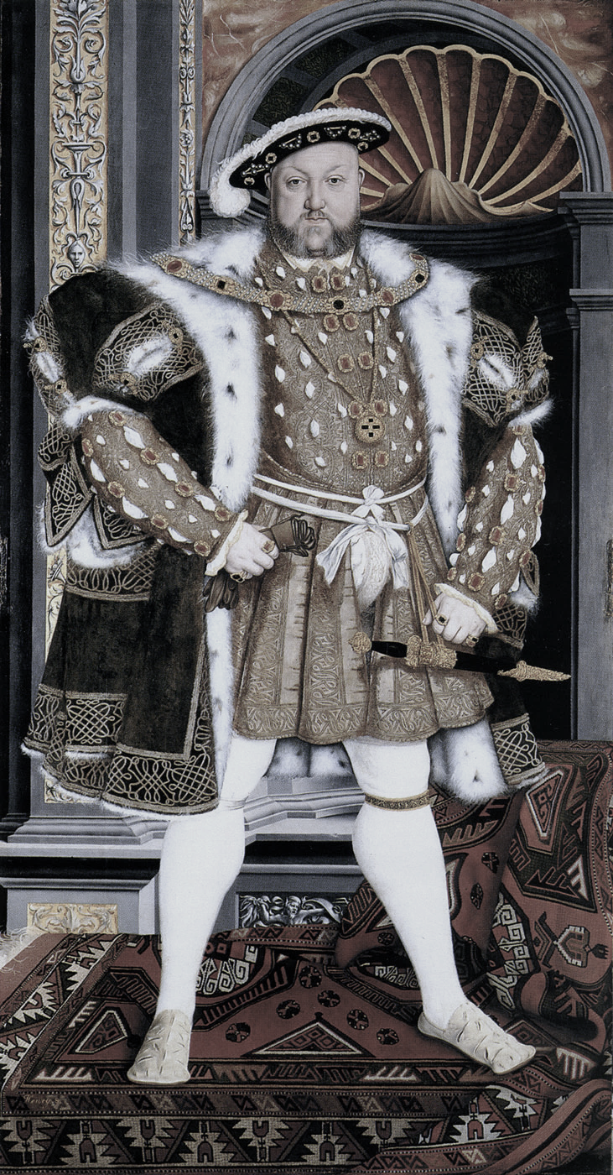
Some of the questions we hope to answer this term are…
Who were the Tudors?
What were the causes and consequences of the Battle of Bosworth?
What was life like in Tudor England?
Was Henry VIII a good King?
What did Tudors eat and why?
How were Tudors punished?
Who was Shakespeare and why is he considered to be so important?
Why was the Church of England created?
Could women perform in plays?
Where was the Globe theatre?

Slide 5
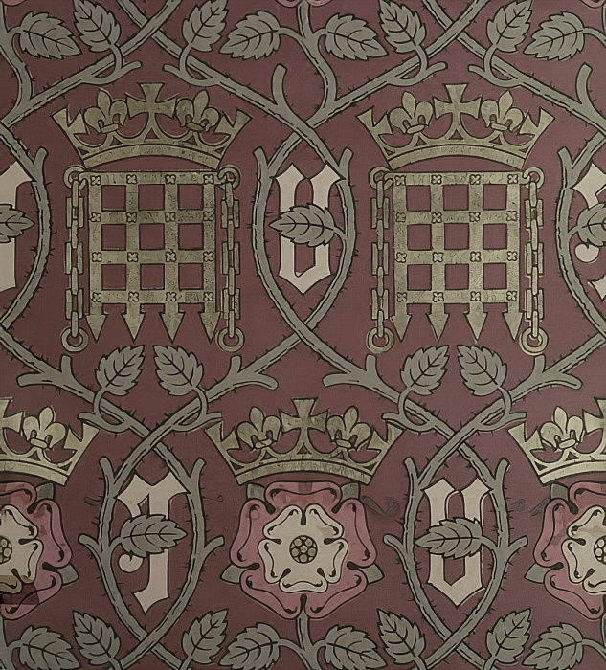
What will we be learning in each subject?
English: We will be writing persuasive leaflets inspired by our trip to Hampton Court and creative stories based on the book Bearkeeper. Later, we will develop speaking, listening and drama skill as we perform poetry and explore the work of Shakespeare, focusing particularly on Macbeth.
Maths: We will be mastering place value, the four operations and begin to master year 5 fraction concepts.
Science: We will be investigating the worlds of sound and forces.
Computing: We will be learning how to use systems and networks, creating media and learn about how to keep ourselves safe online.
Art and DT: We will be learning the skills of typography and the children will be producing their own designs on maps. In DT, we will also be harnessing our creativity to design and make Tudor food and create a Tudor money pouch.
History: We will discover what life was like in Tudor times and step back into the world of William Shakespeare, Henry VIII and his wives and children, On our historical learning journey, we will be using and evaluating a variety of historical sources , considering similarities and differences.
RE: We consider why people have to stand up for what they believe in and challenges faced.
Languages: We will be learning how adjectives must agree with the gender and number of the noun being described.
Music: We will learn about melody and harmony in music, as well as singing and playing in different styles.
PE : We will be developing our movement skills in gymnastics.
Games: We will be developing our skills in net/wall games, including tennis.
RSHE: We will be discussing how to look after our world, e-Safety, respect personal boundaries and be aware of hazards.

Slide 6
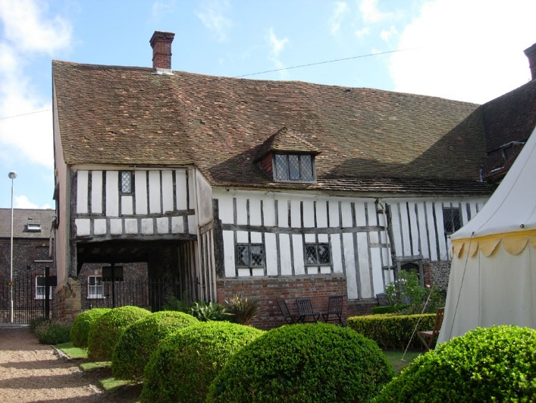
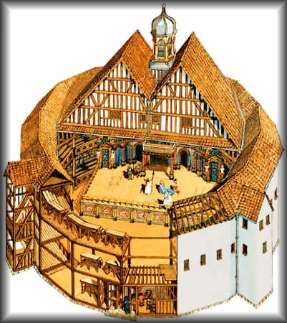
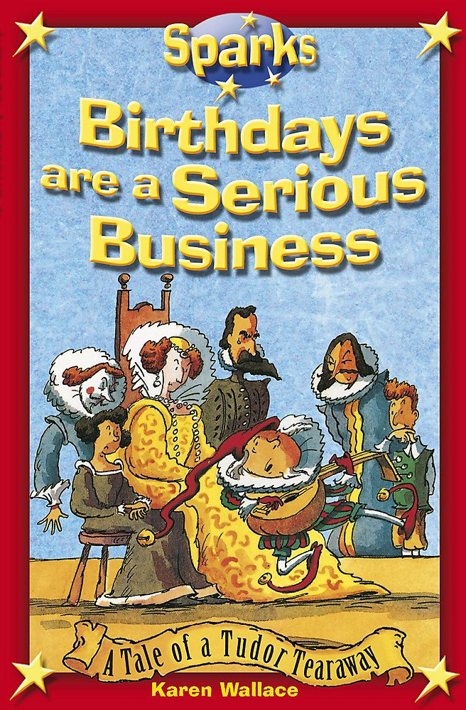
Join in with our learning at home by…
Visiting Anne of Cleves House – Lewes
Hever Castle
Weald and Downland Living Museum
Tower of London
Surfing
www.topmarks.co.uk/Interactive.aspx?cat=107
http://resources.woodlands-junior.kent.sch.uk/homework/Tudors.html
Reading Marcia Williams’ versions of Shakespeare.
Horrible Histories – The Terrible Tudors
Birthdays are a Serious Business (A tale of a Tudor tearaway) – Karen Wallace
The Prince, the Cook and the Cunning King – Terry Deary

