Slide 1
WHO’S BEHIND THE BOOK?

Slide 2
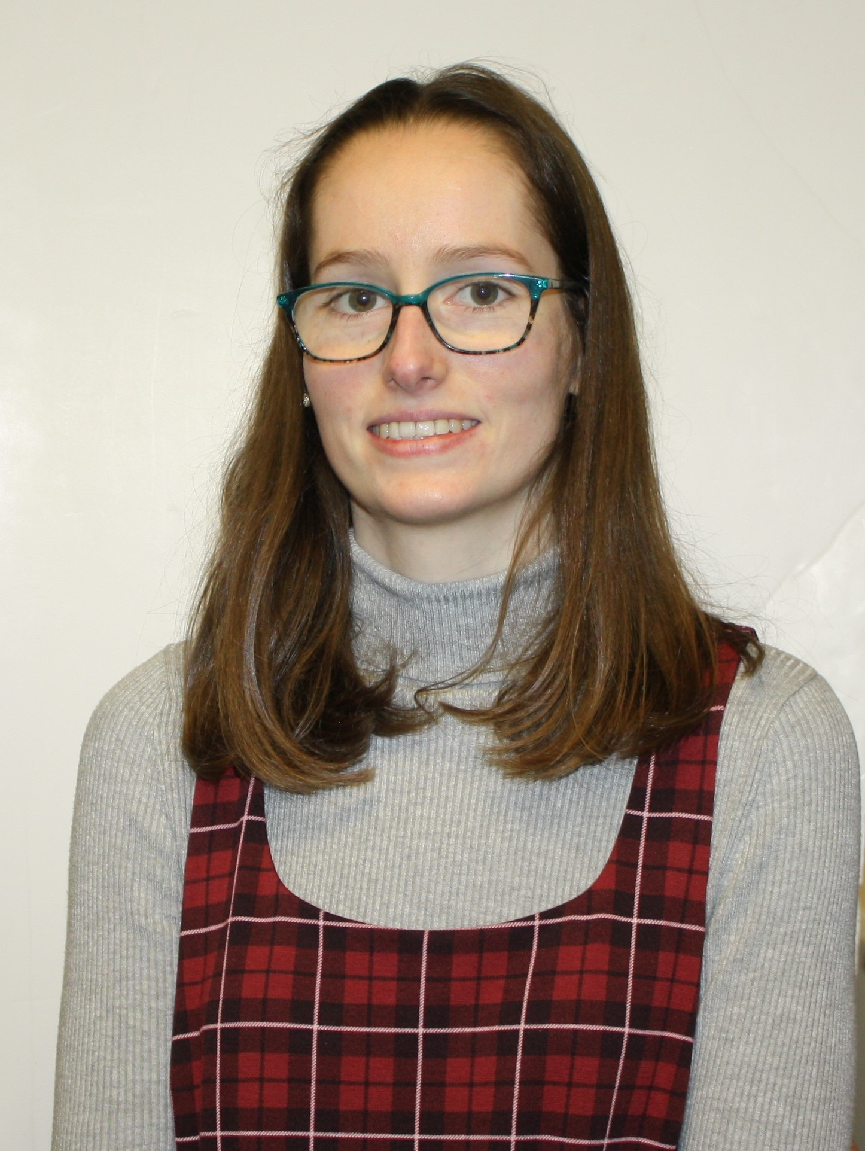
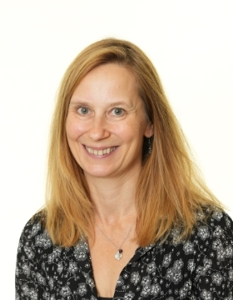
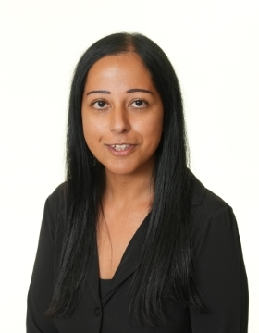
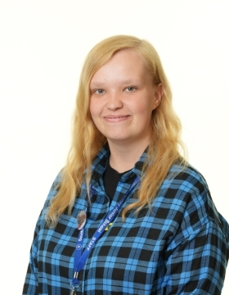
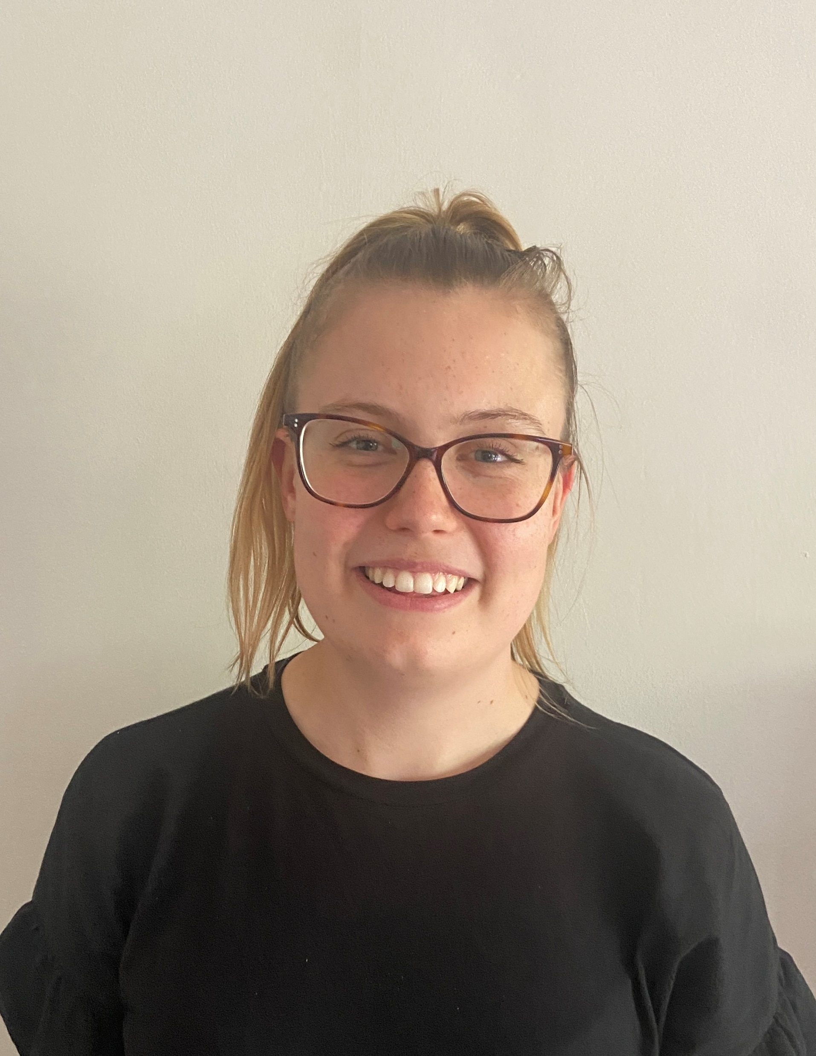
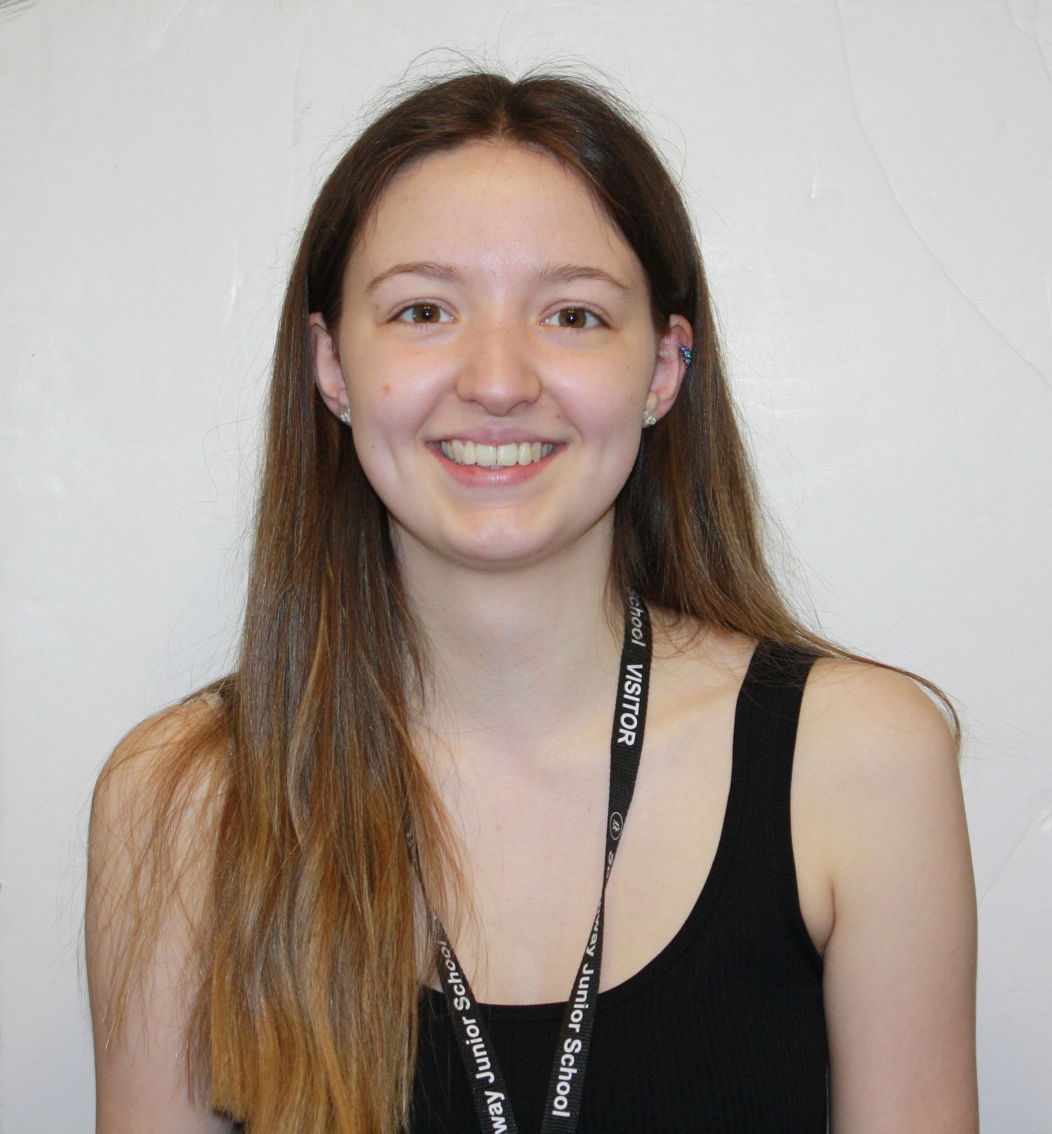
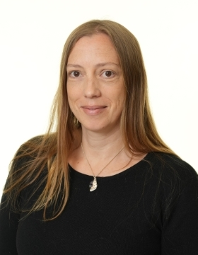
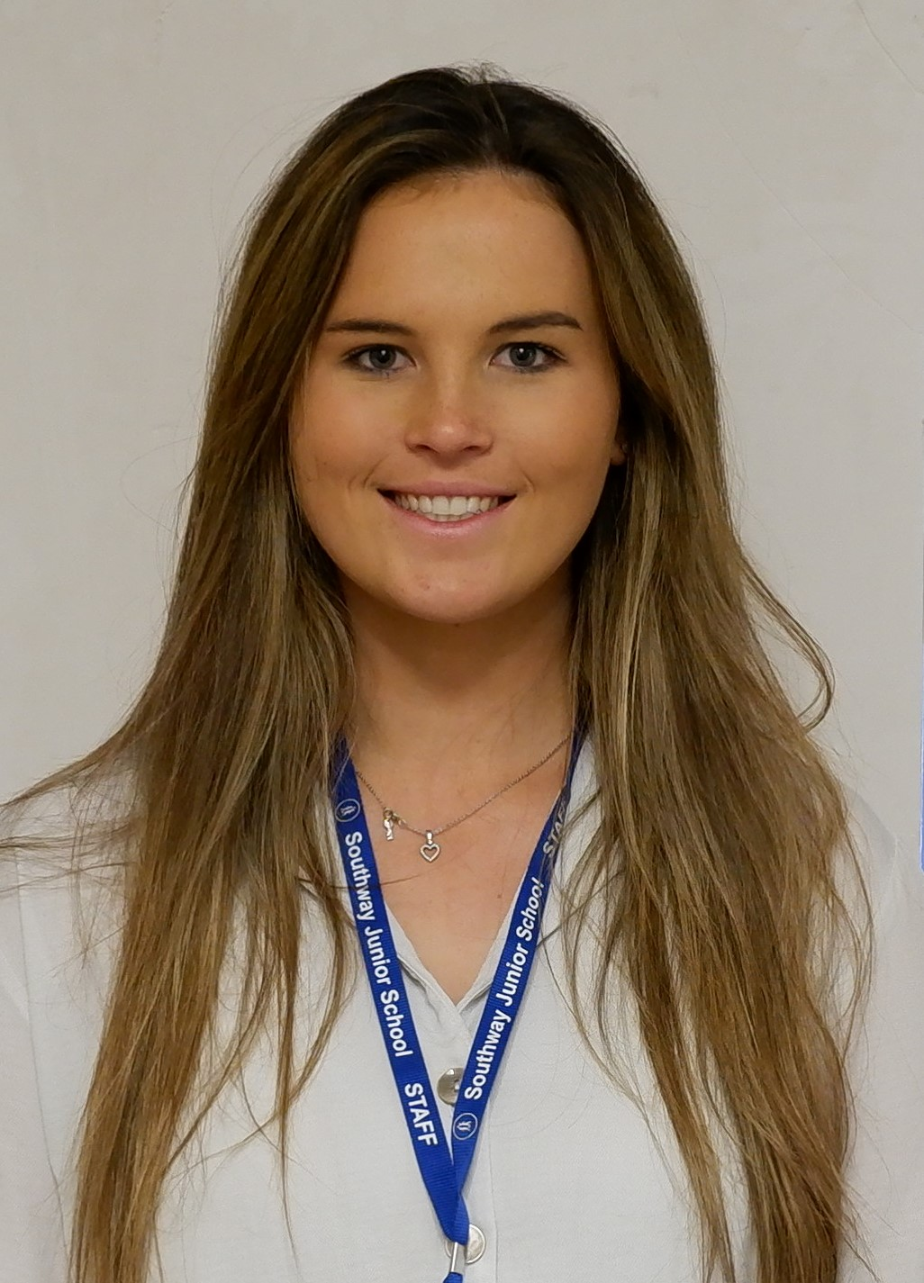
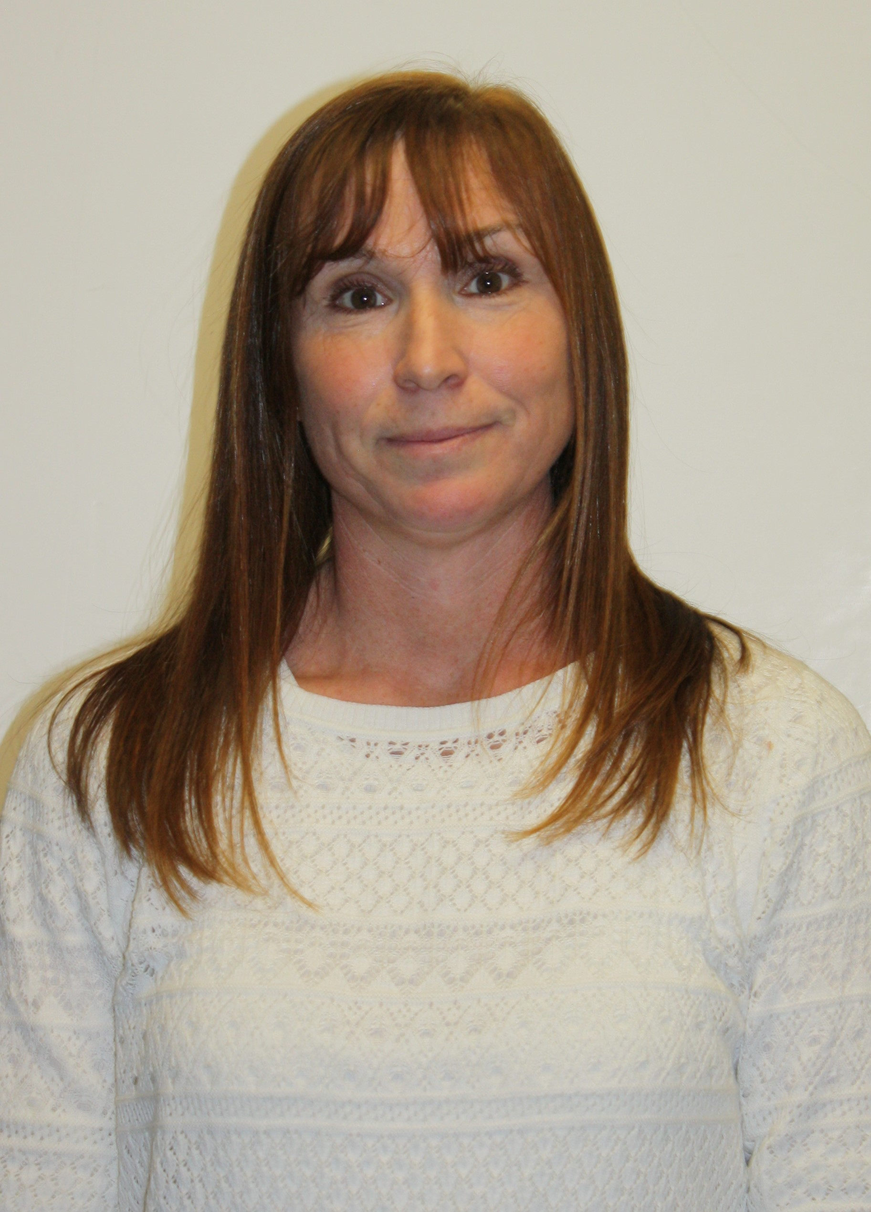
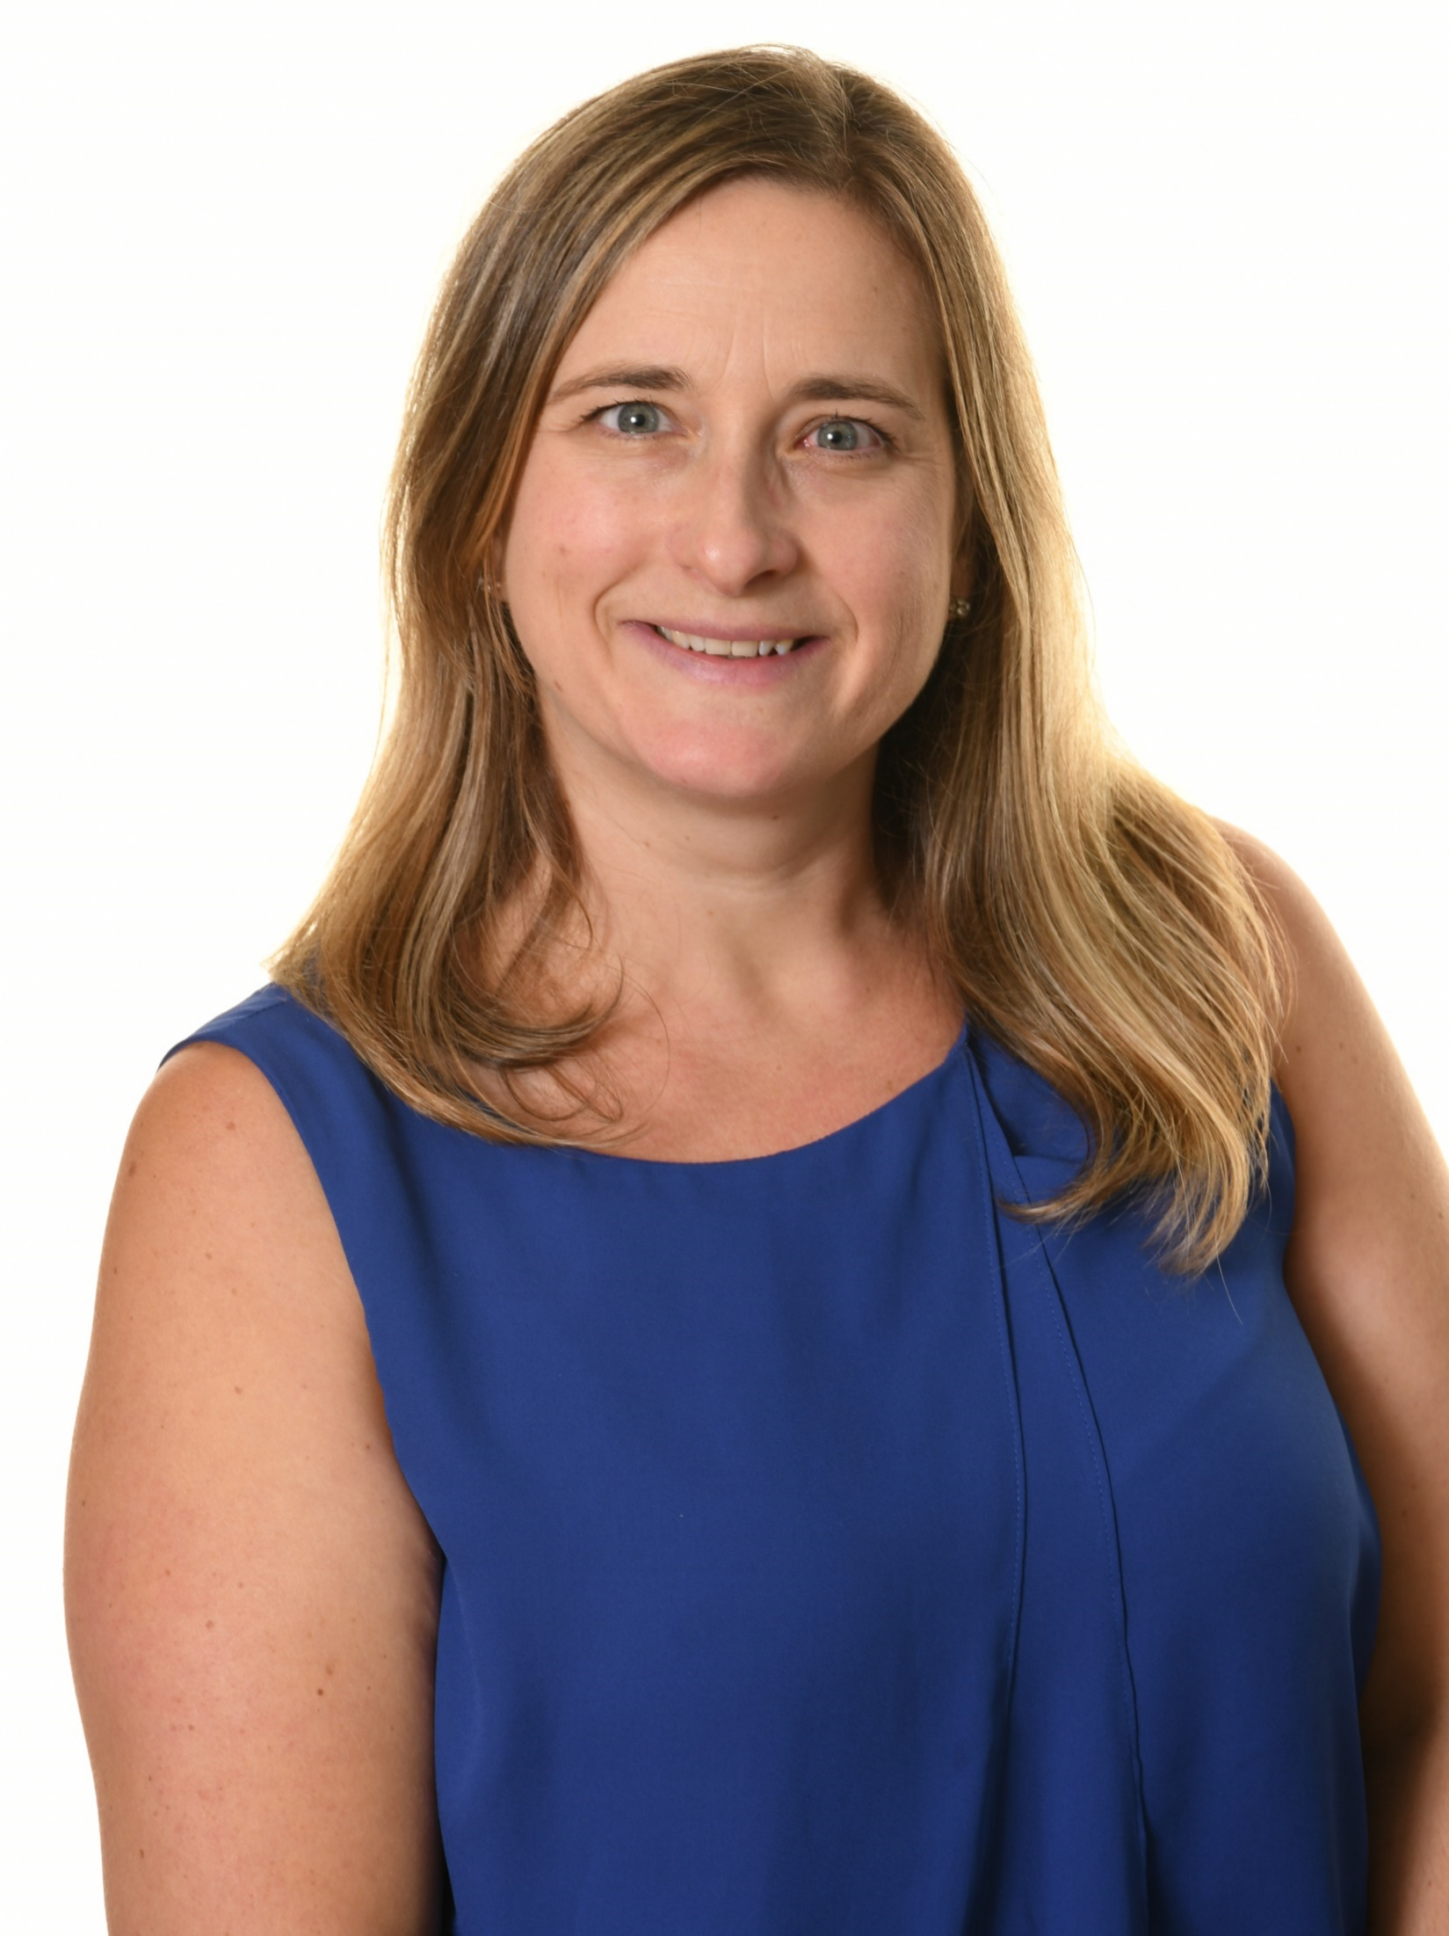
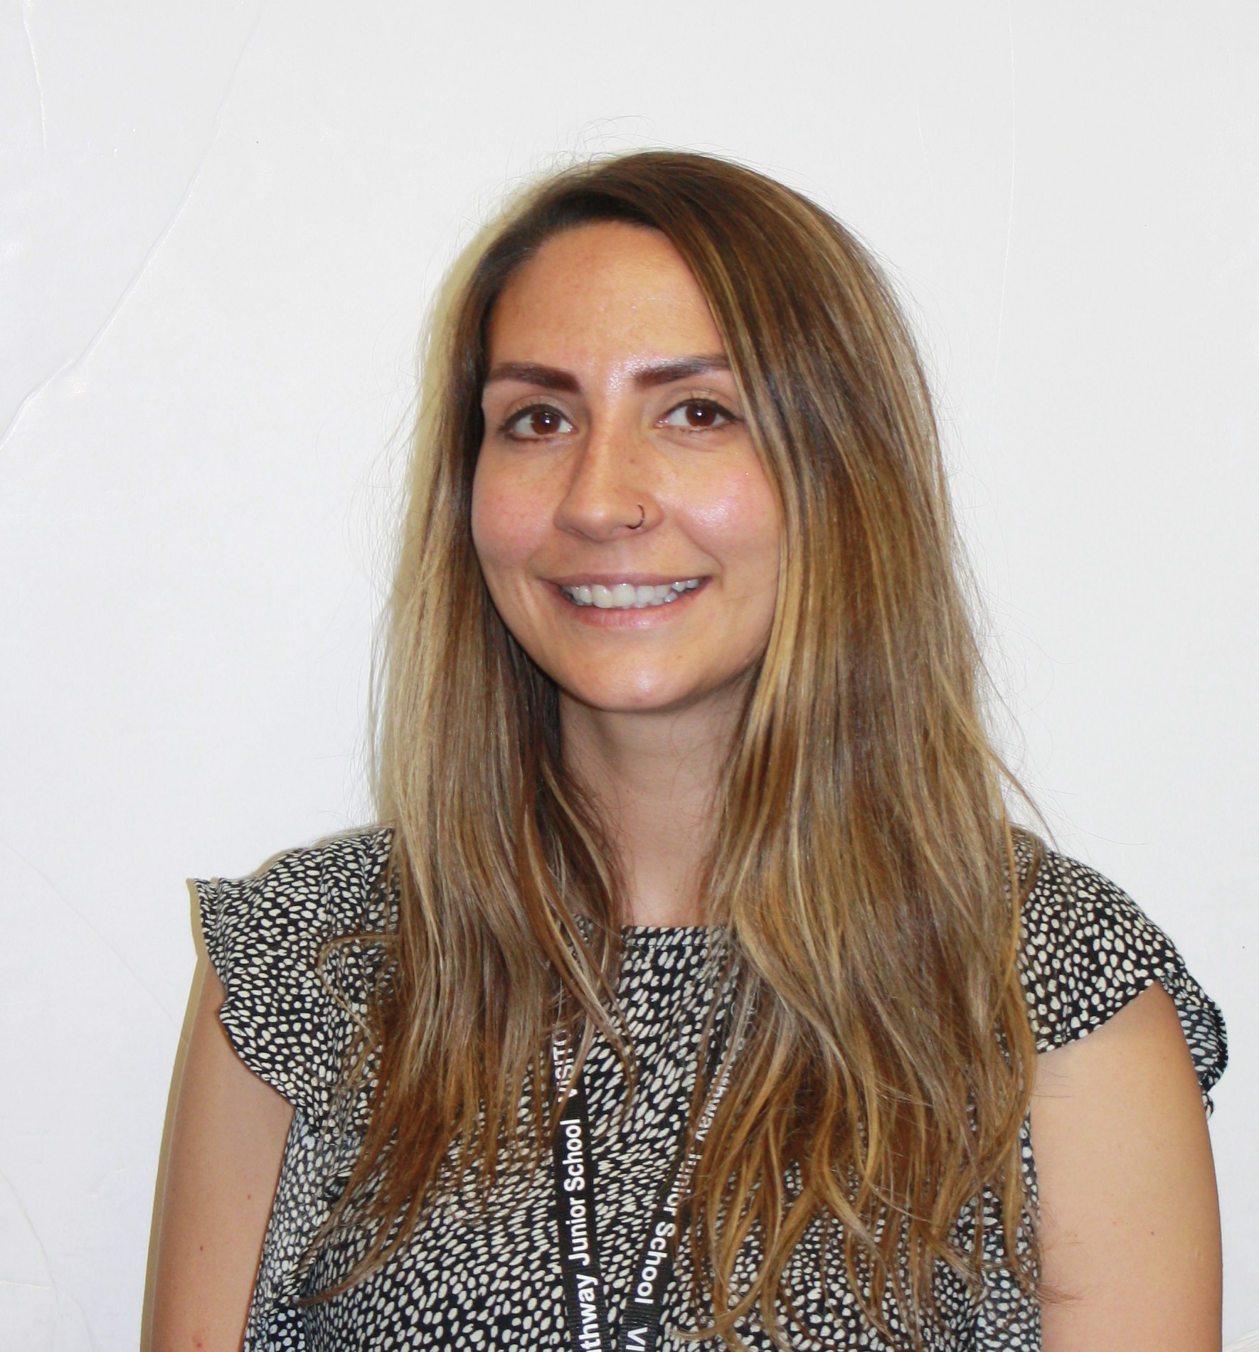
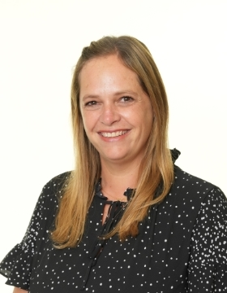
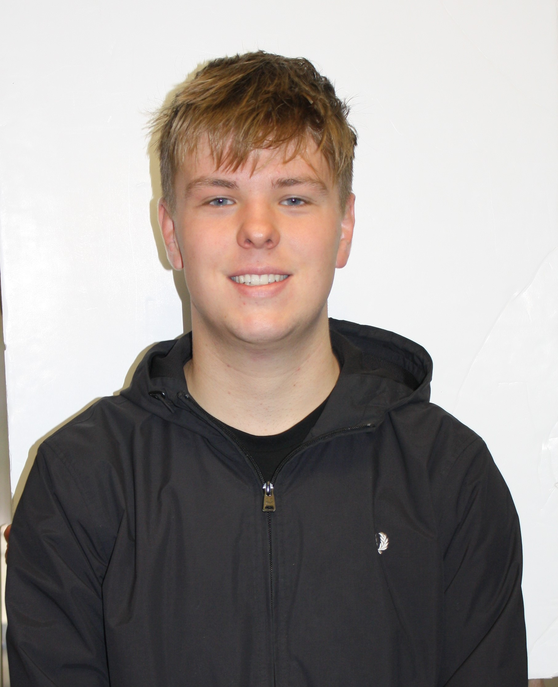
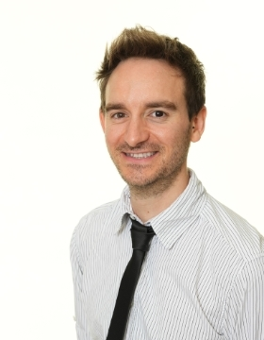
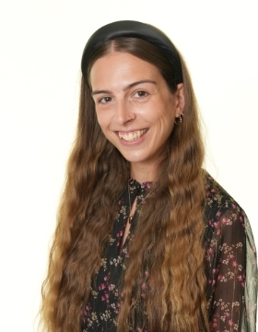
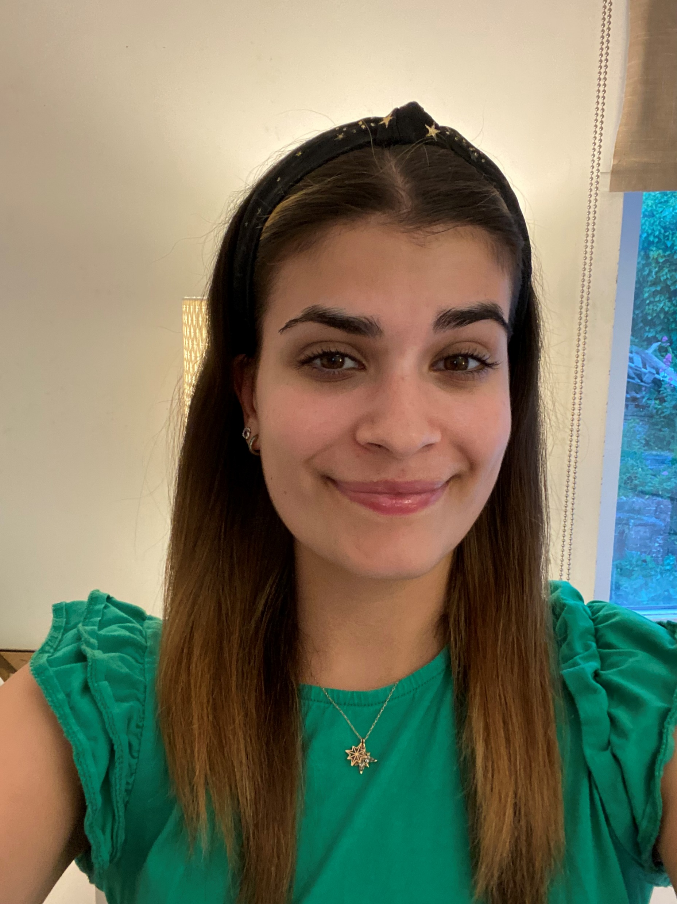
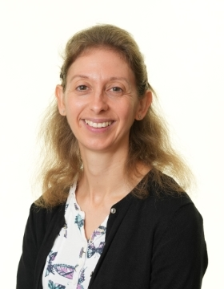
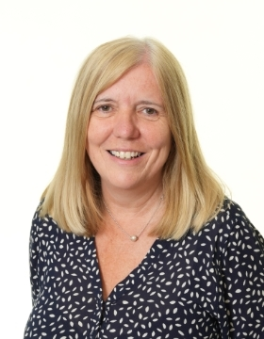
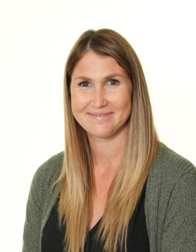
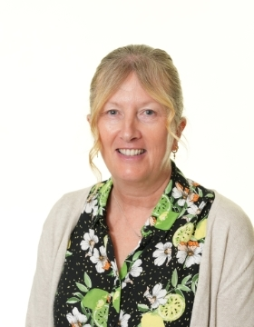
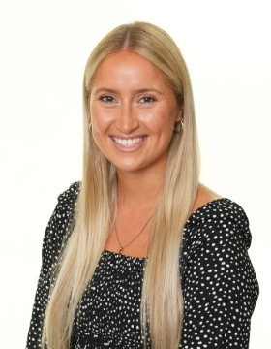
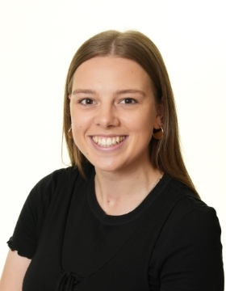
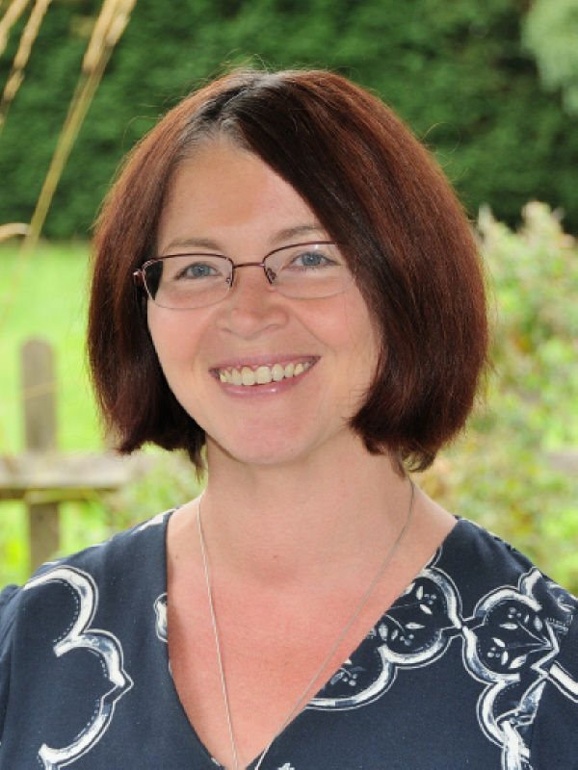
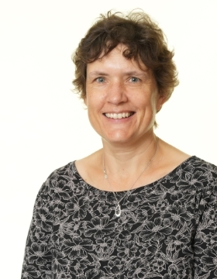
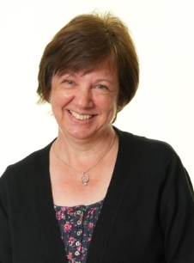
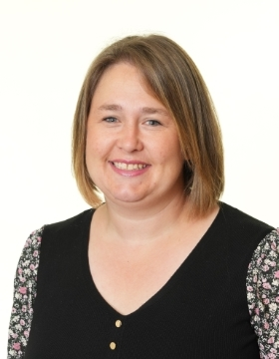

Slide 3
MR POWELL MISS HAIGH MRS ALBERY MRS TUBB MISS PIERCE MISS AYRES MISS TYRRELL

Slide 4
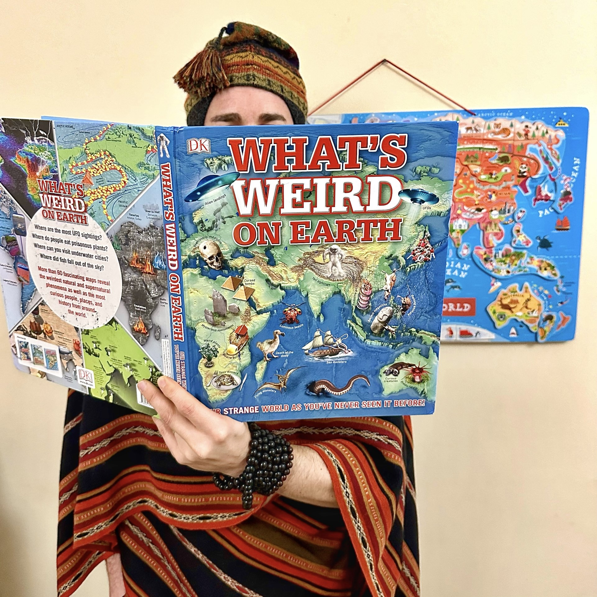
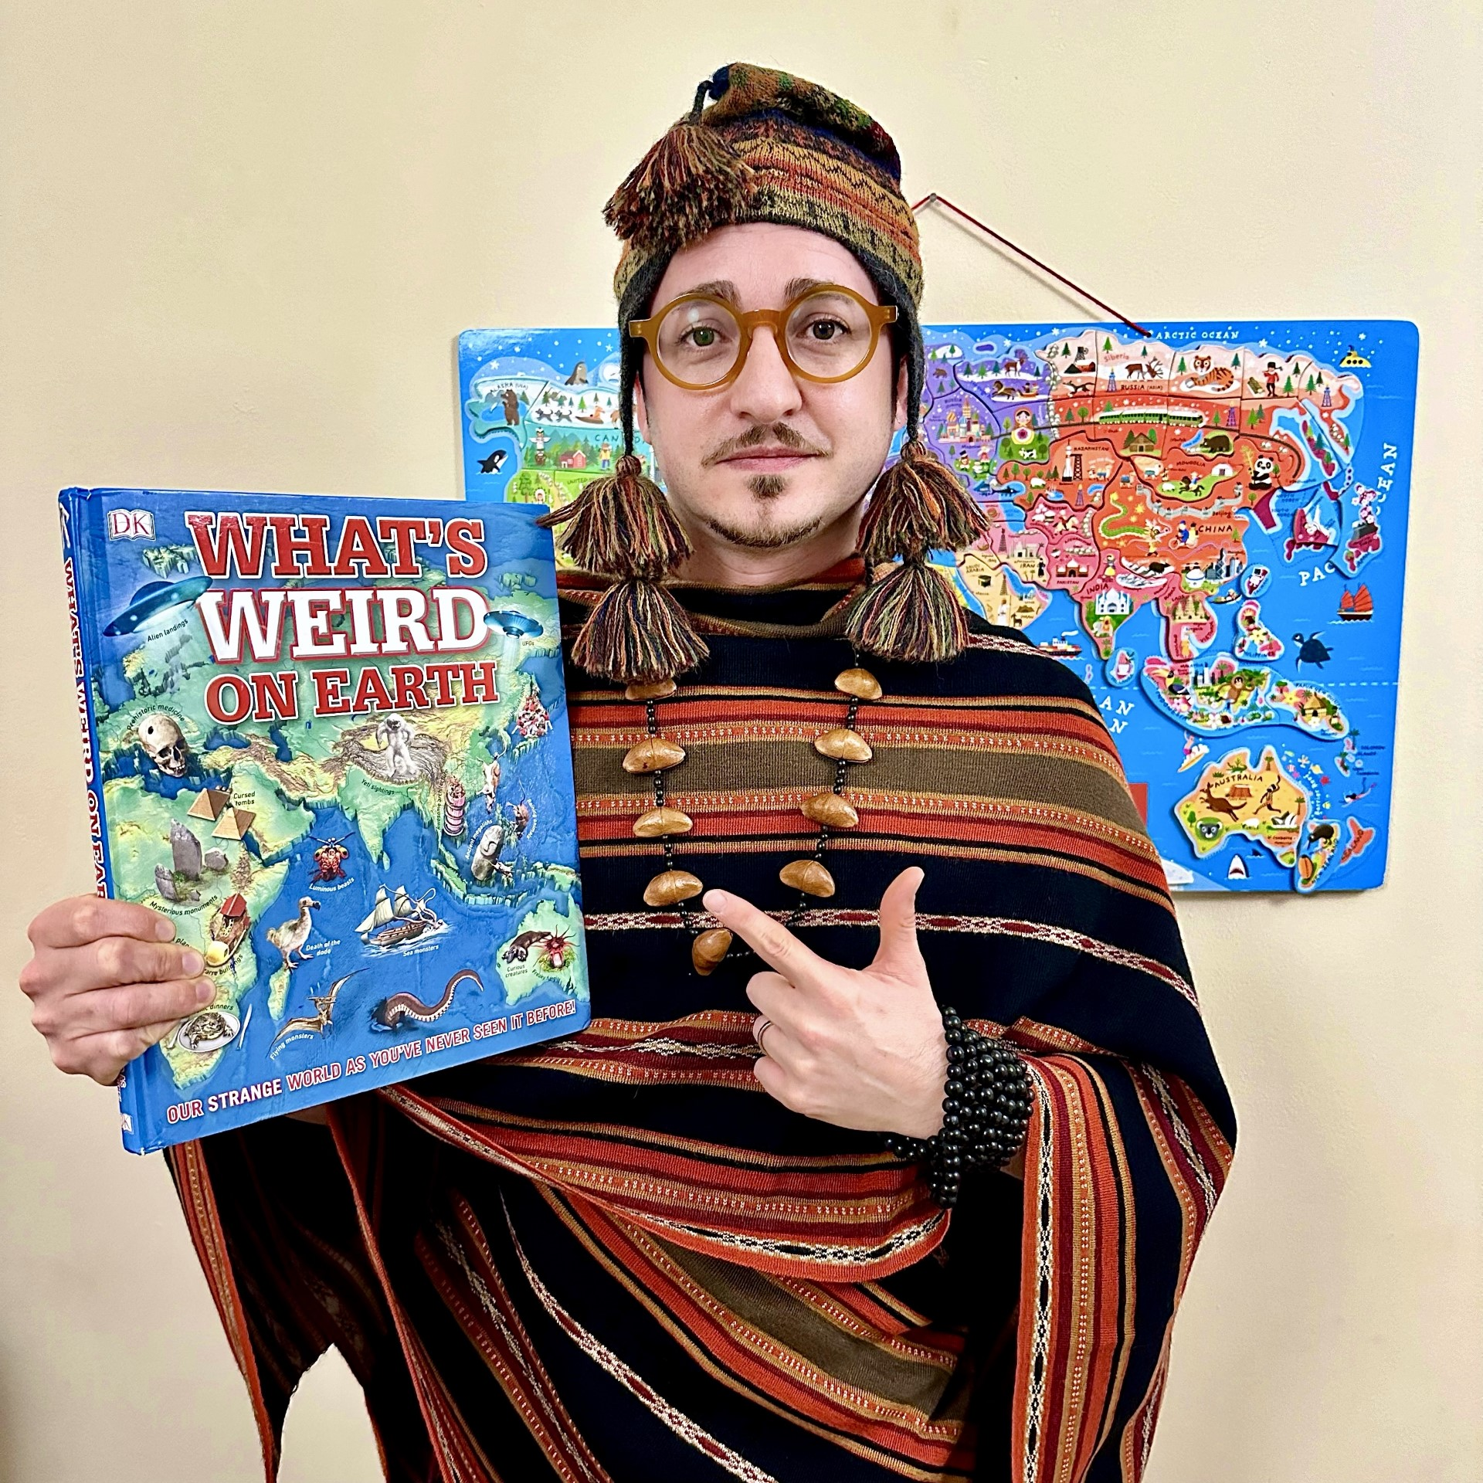
WHO’S THIS…?

Slide 5
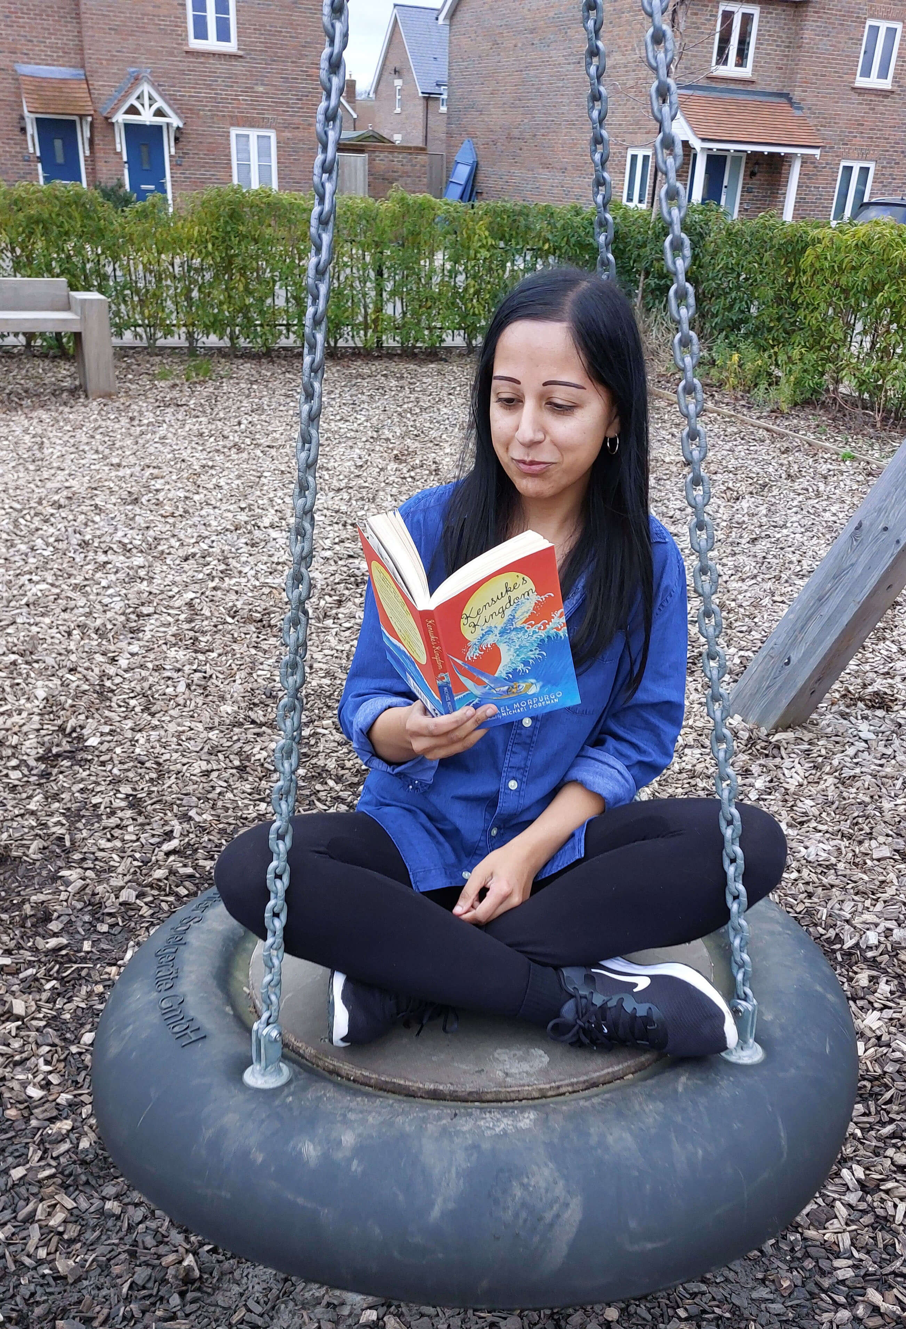
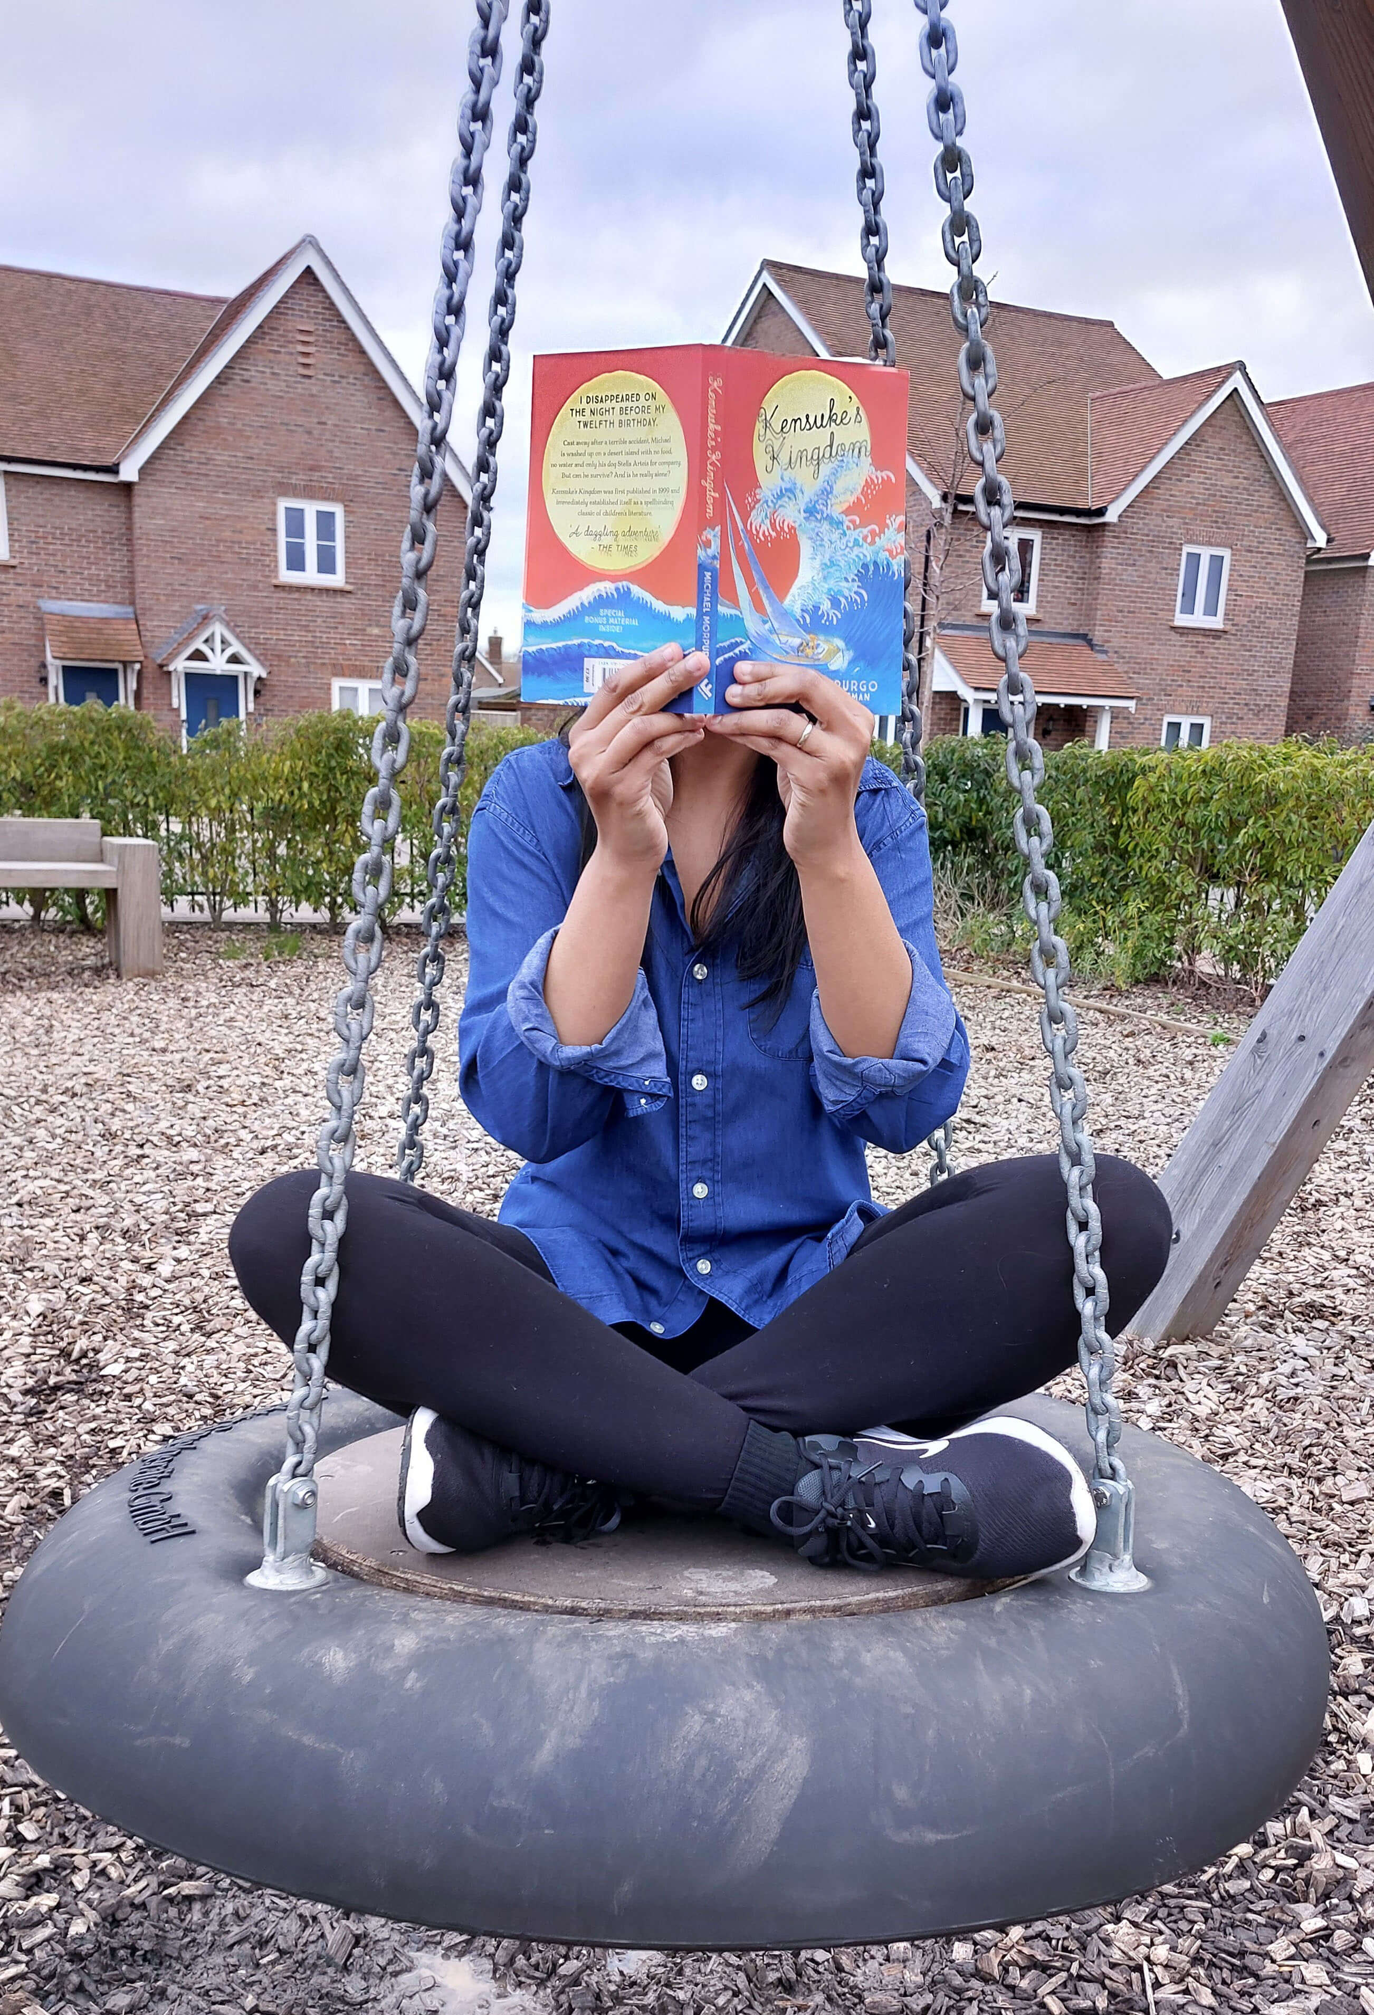
WHO’S THIS…?

Slide 6
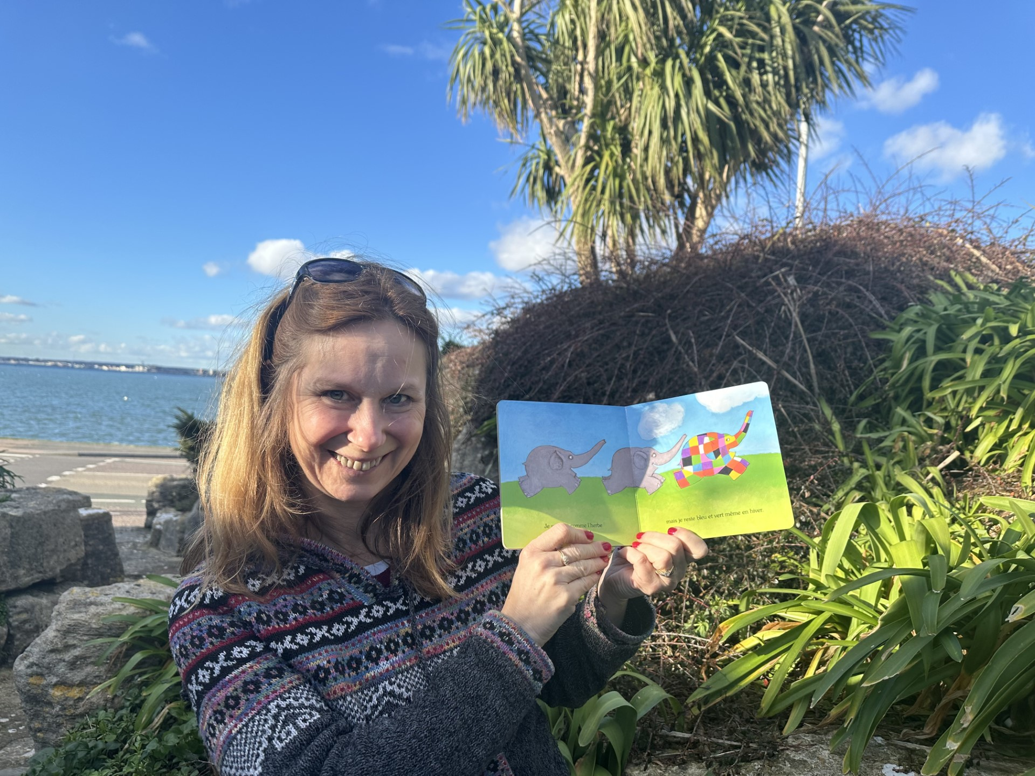
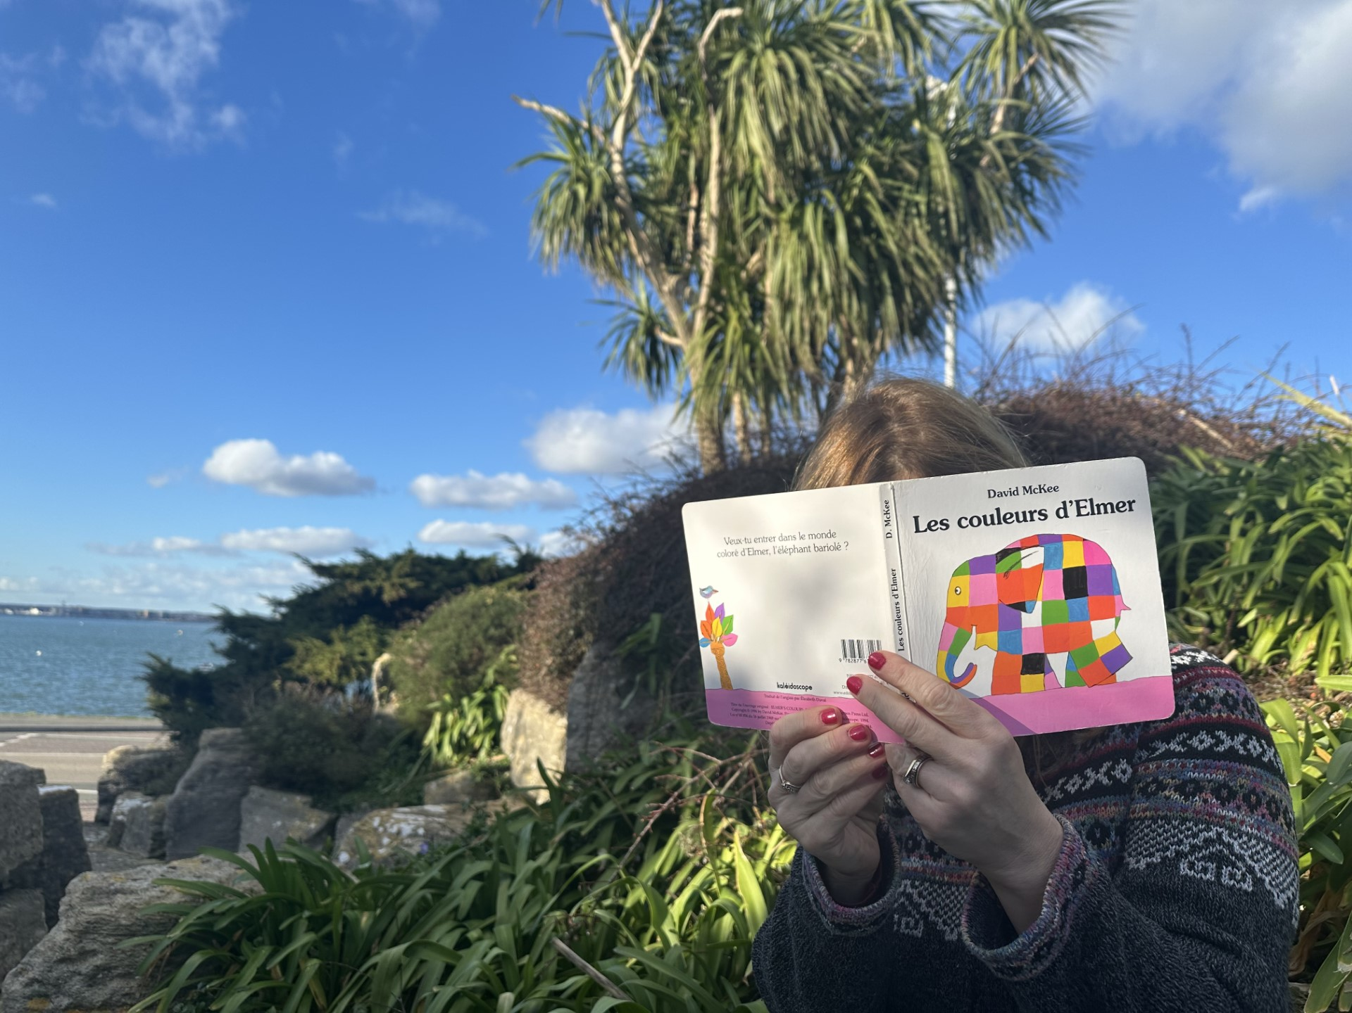
WHO’S THIS…?

Slide 7
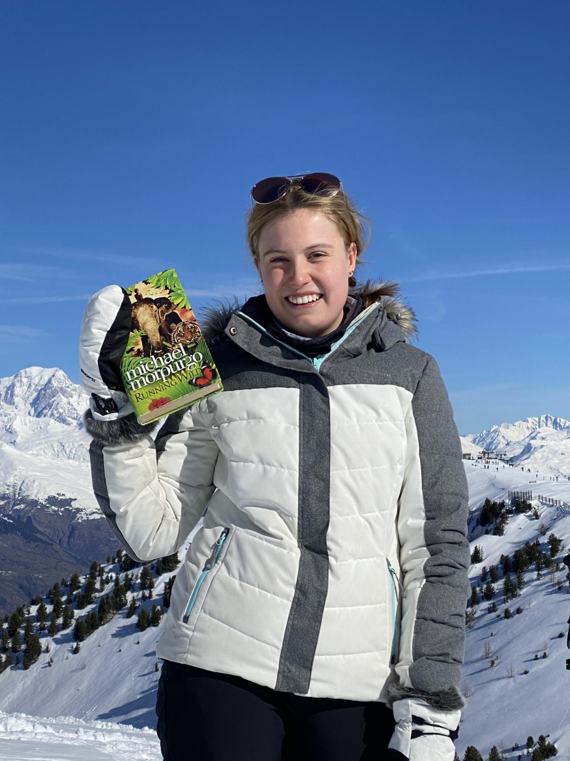
WHO’S THIS…?

Slide 8
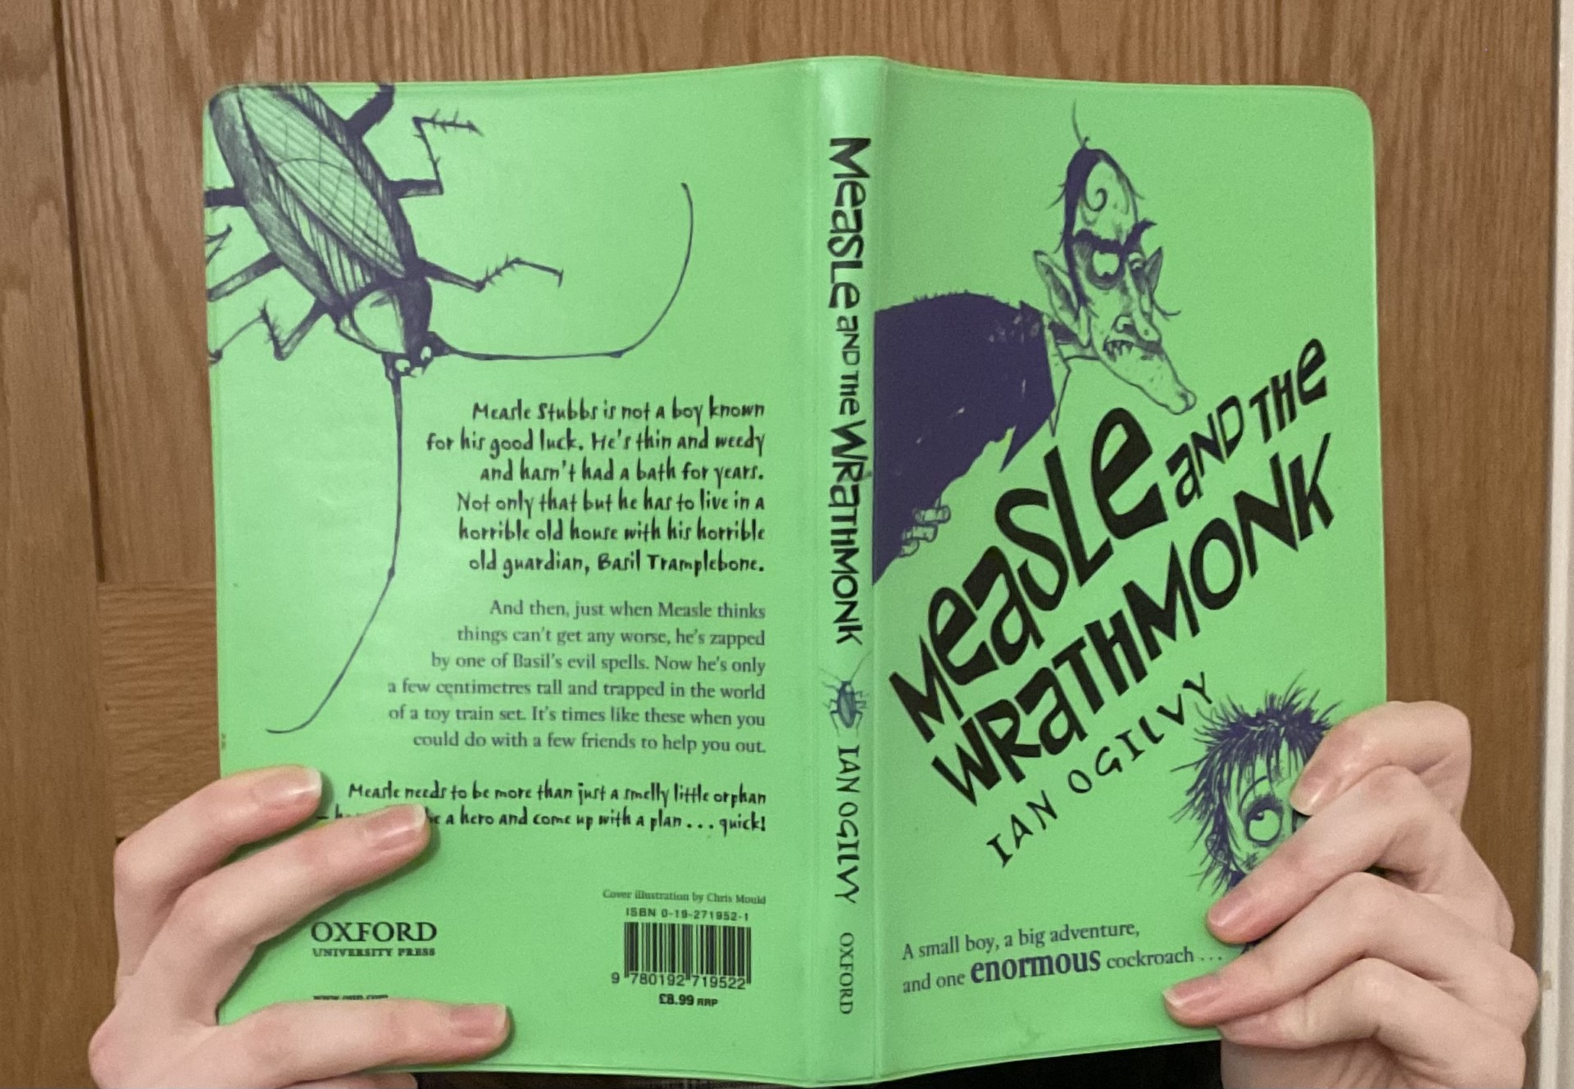
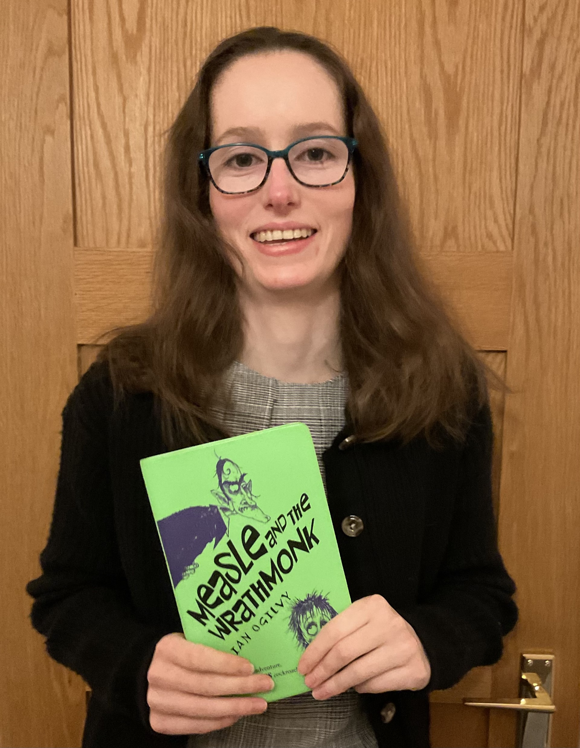
WHO’S THIS…?

Slide 9
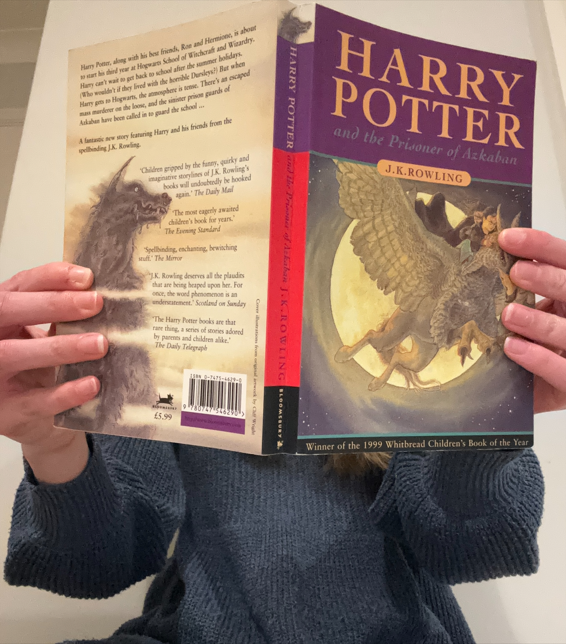
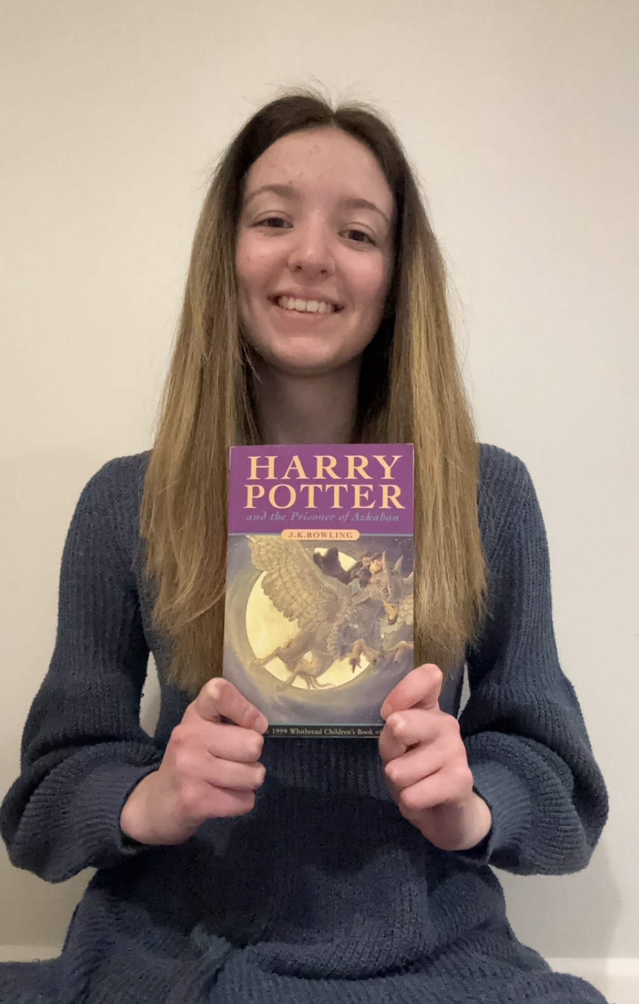
WHO’S THIS…?

Slide 10
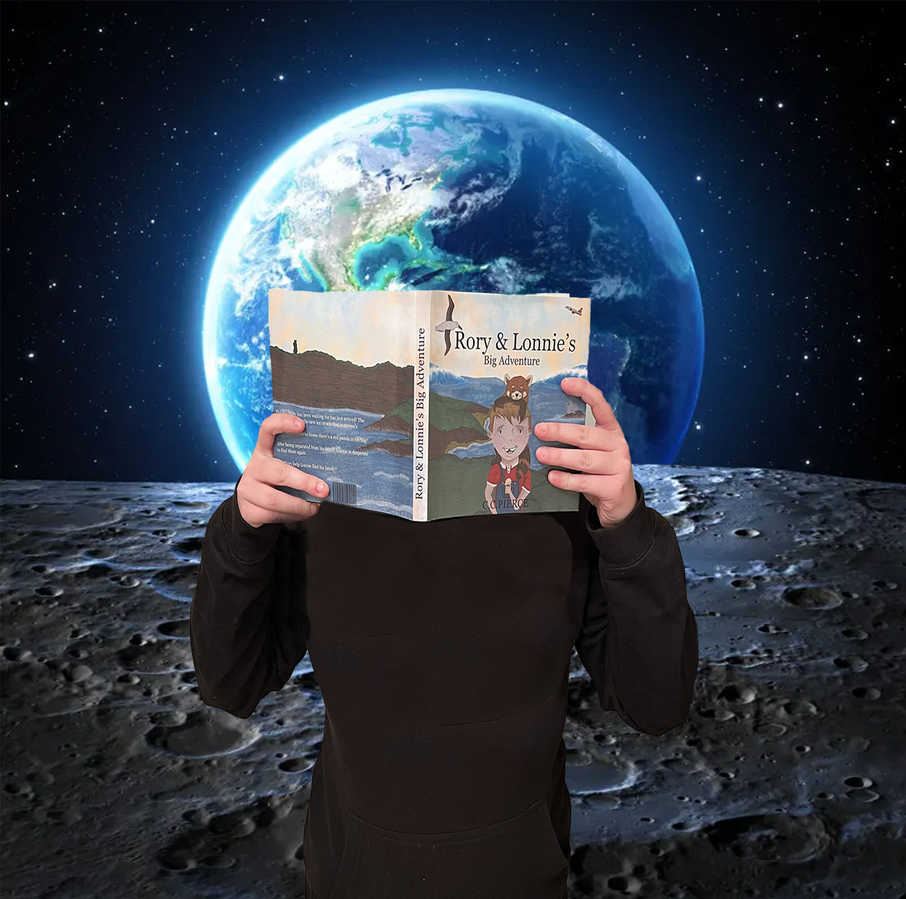
WHO’S THIS…?

Slide 11
MS MURTHEN MRS MOTTRAM MISS HALL MRS CRANFIELD

Slide 12
WHO’S THIS…?

Slide 13
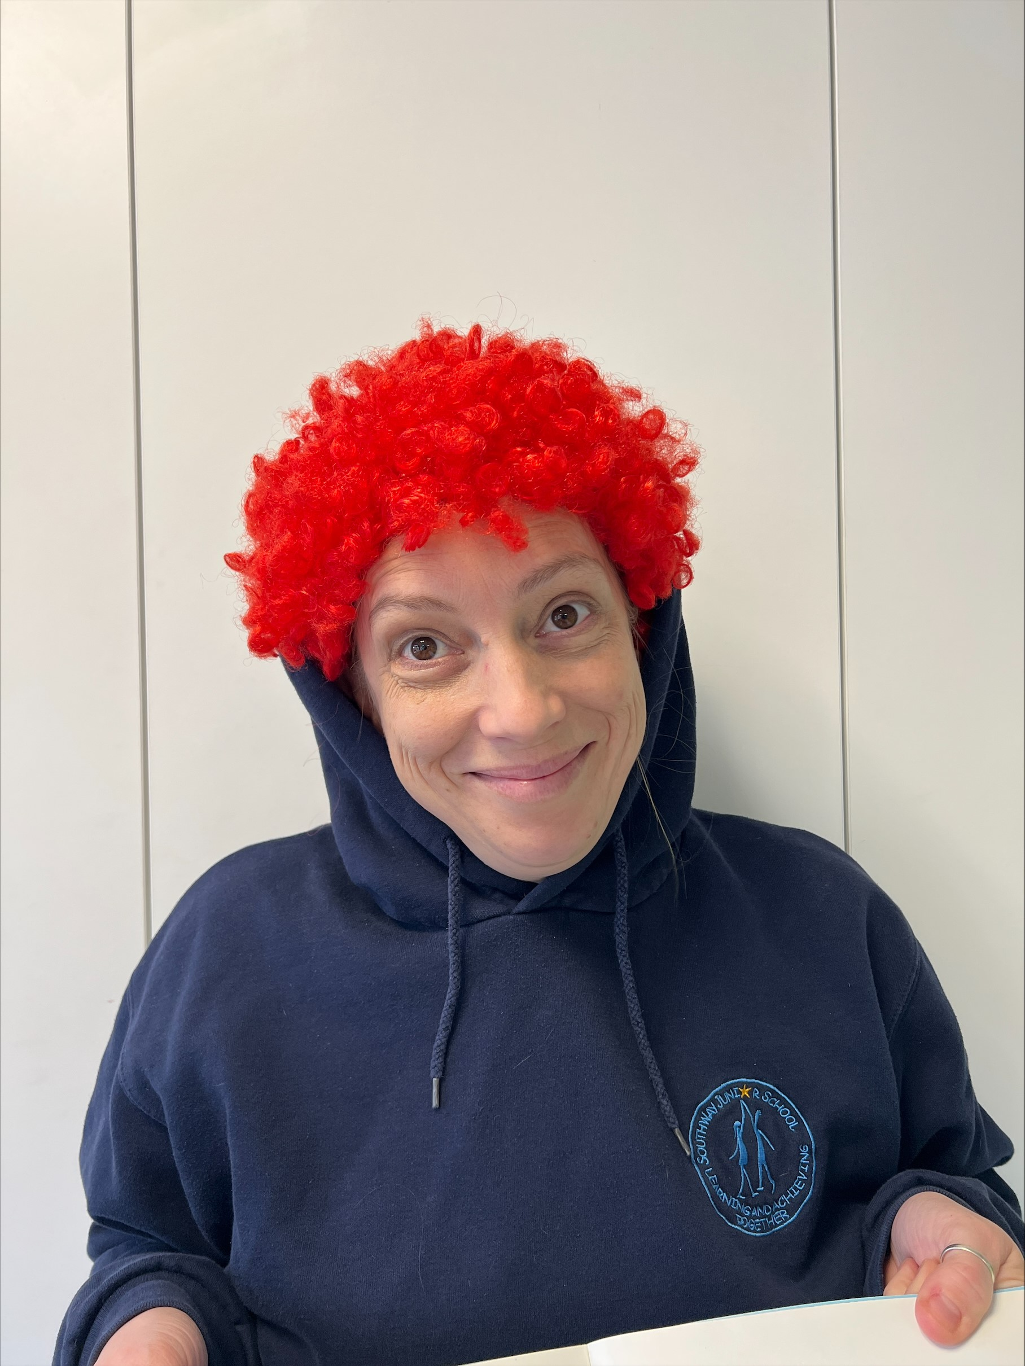
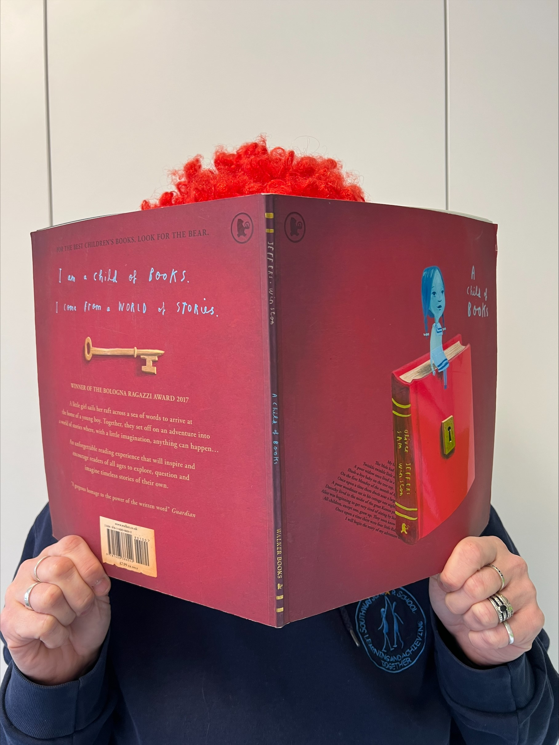
WHO’S THIS…?

Slide 14
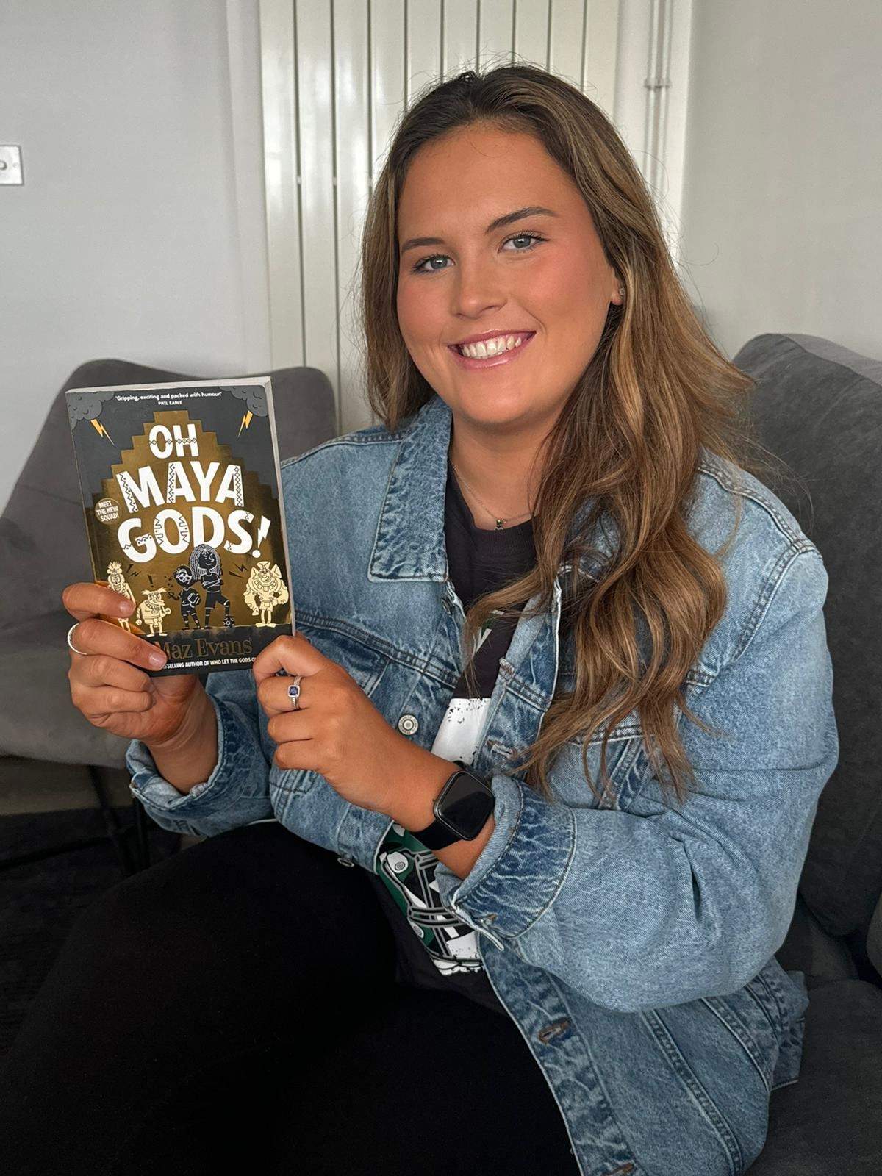
WHO’S THIS…?

Slide 15
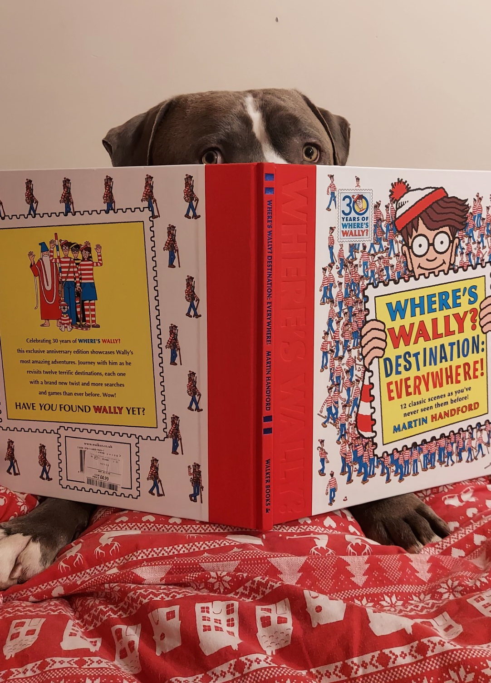
WHO’S THIS…?

Slide 16
MRS PIERIS MISS WARBURTON MISS MORRIS MR PHILLIPS MR BLANCHARD MRS LAMBERT MISS CHERRIMAN MISS IMRAY

Slide 17
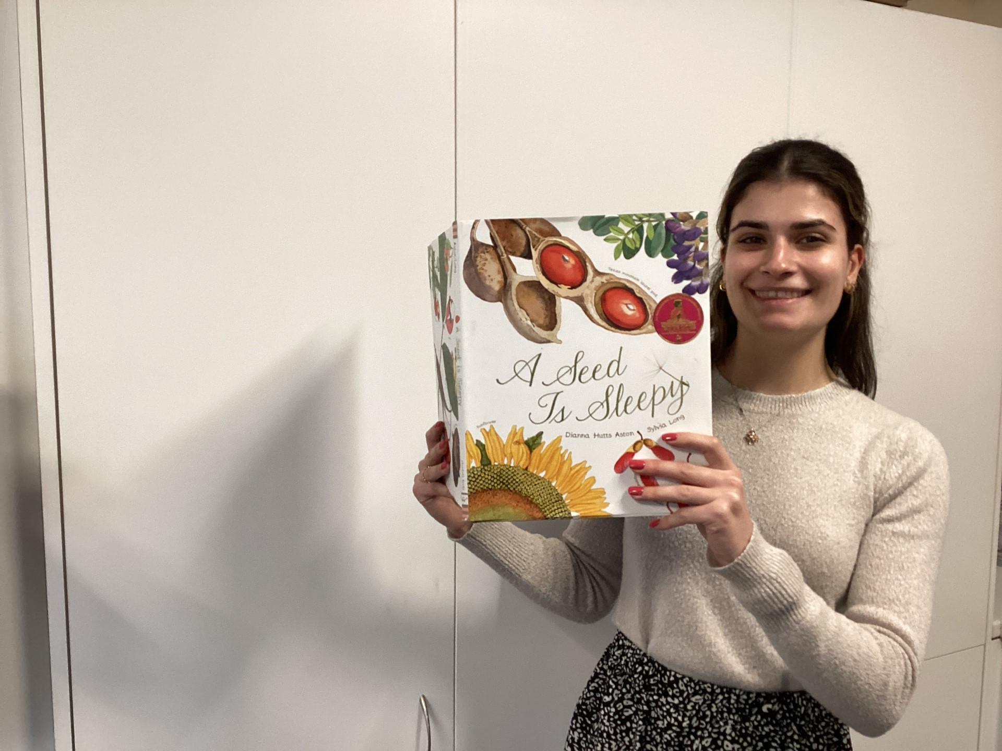
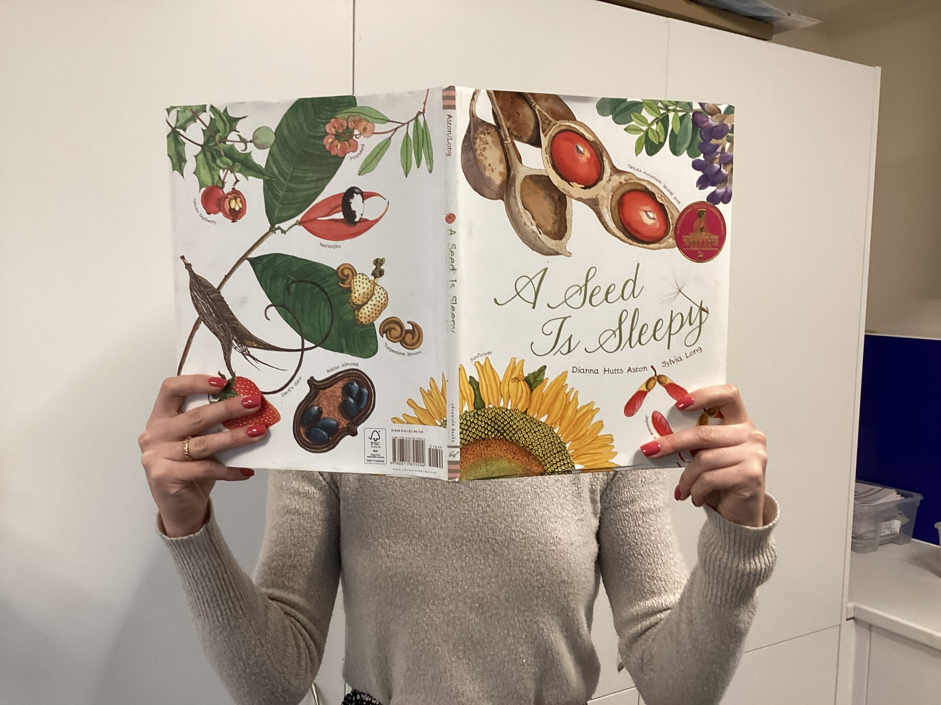
WHO’S THIS…?

Slide 18
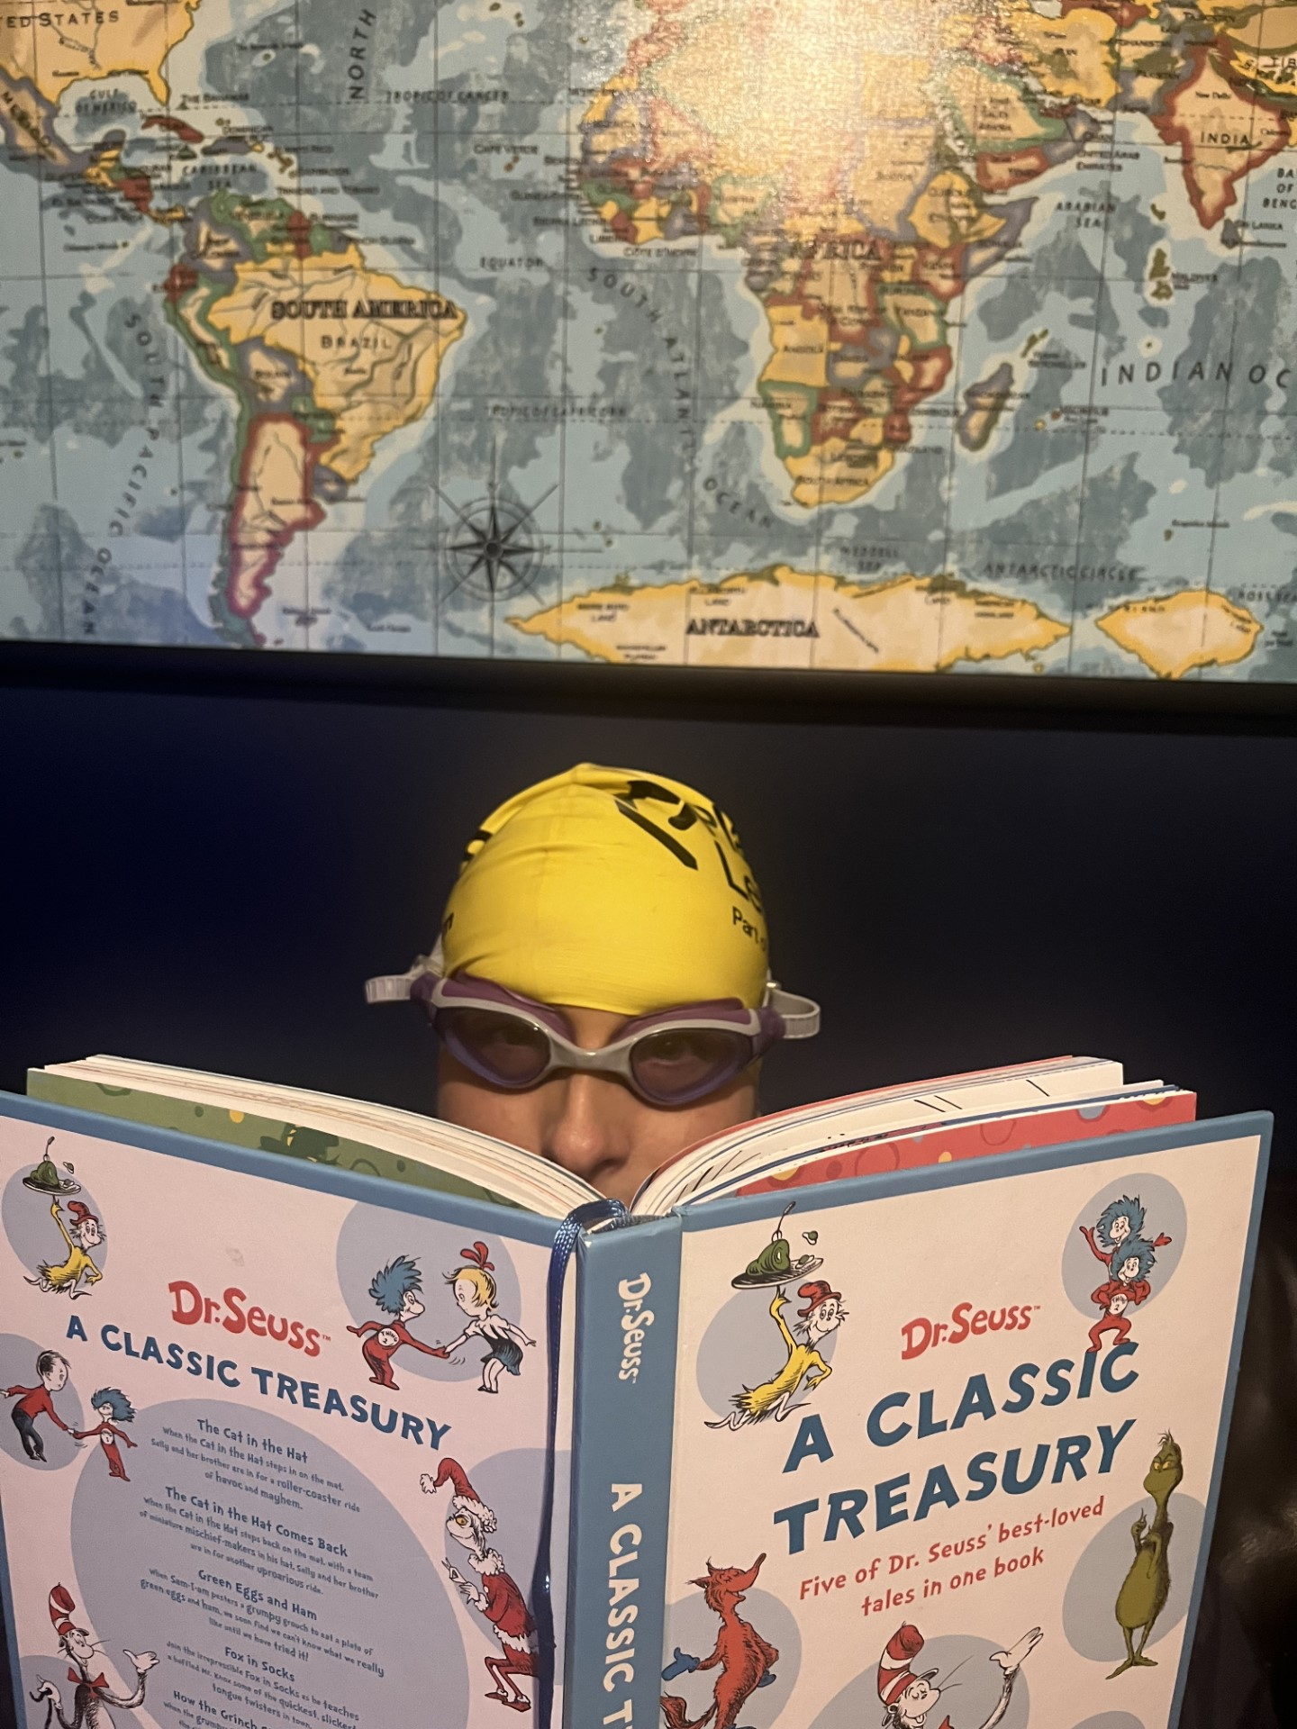
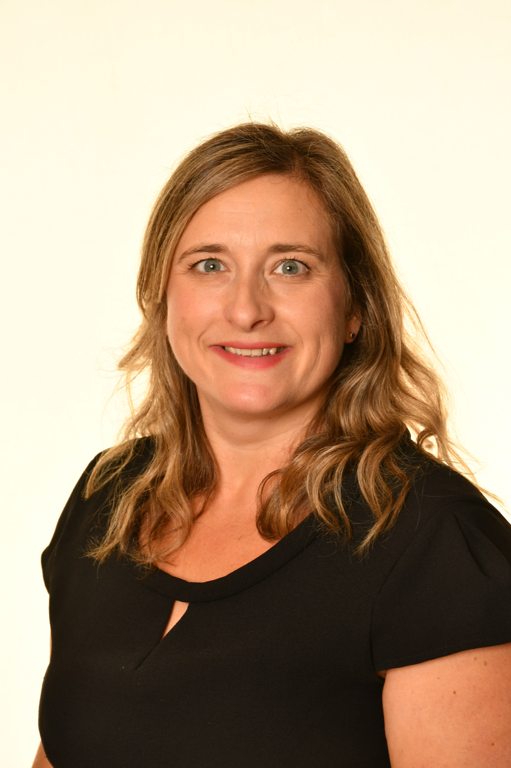
WHO’S THIS…?

Slide 19
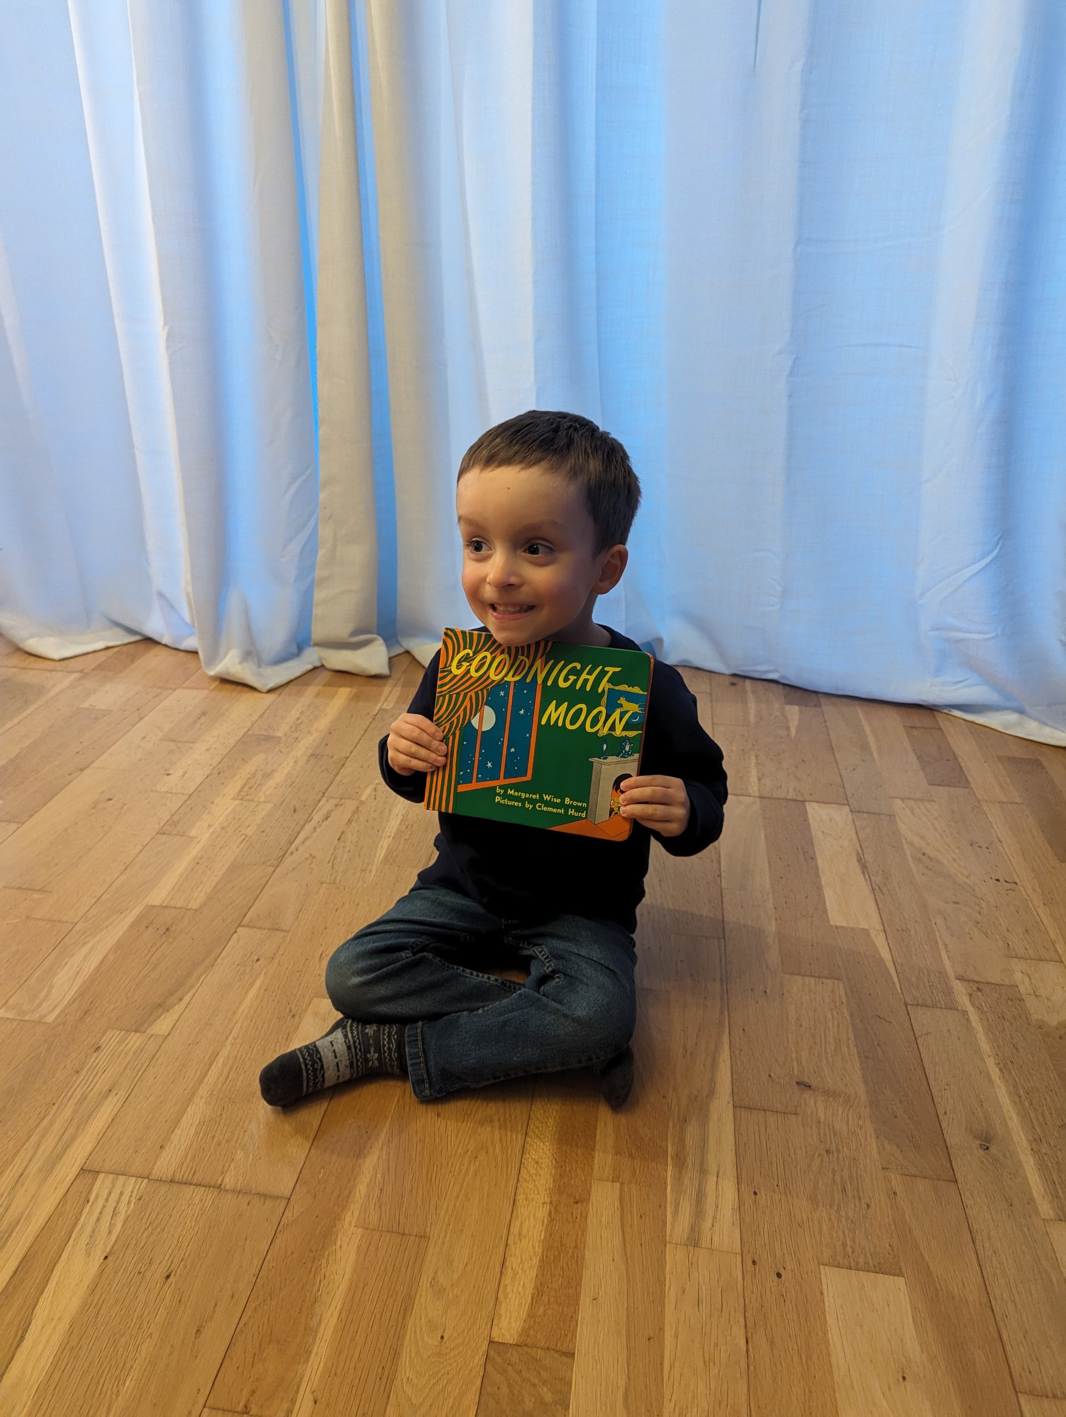
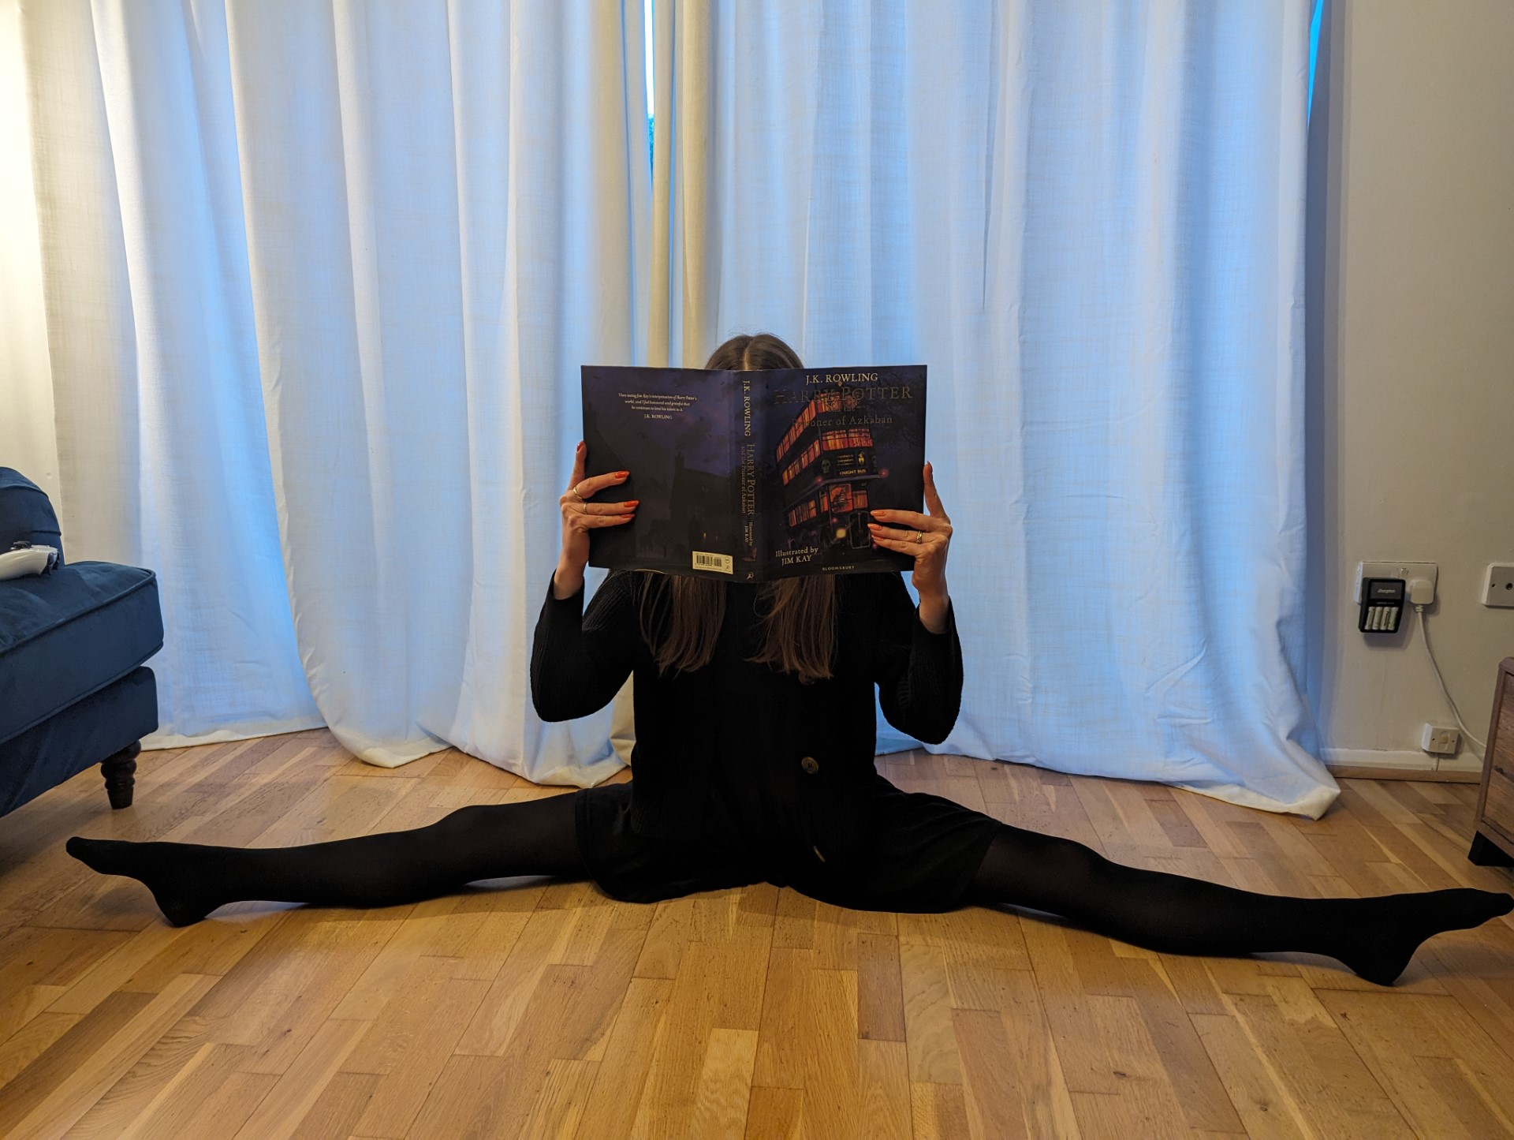
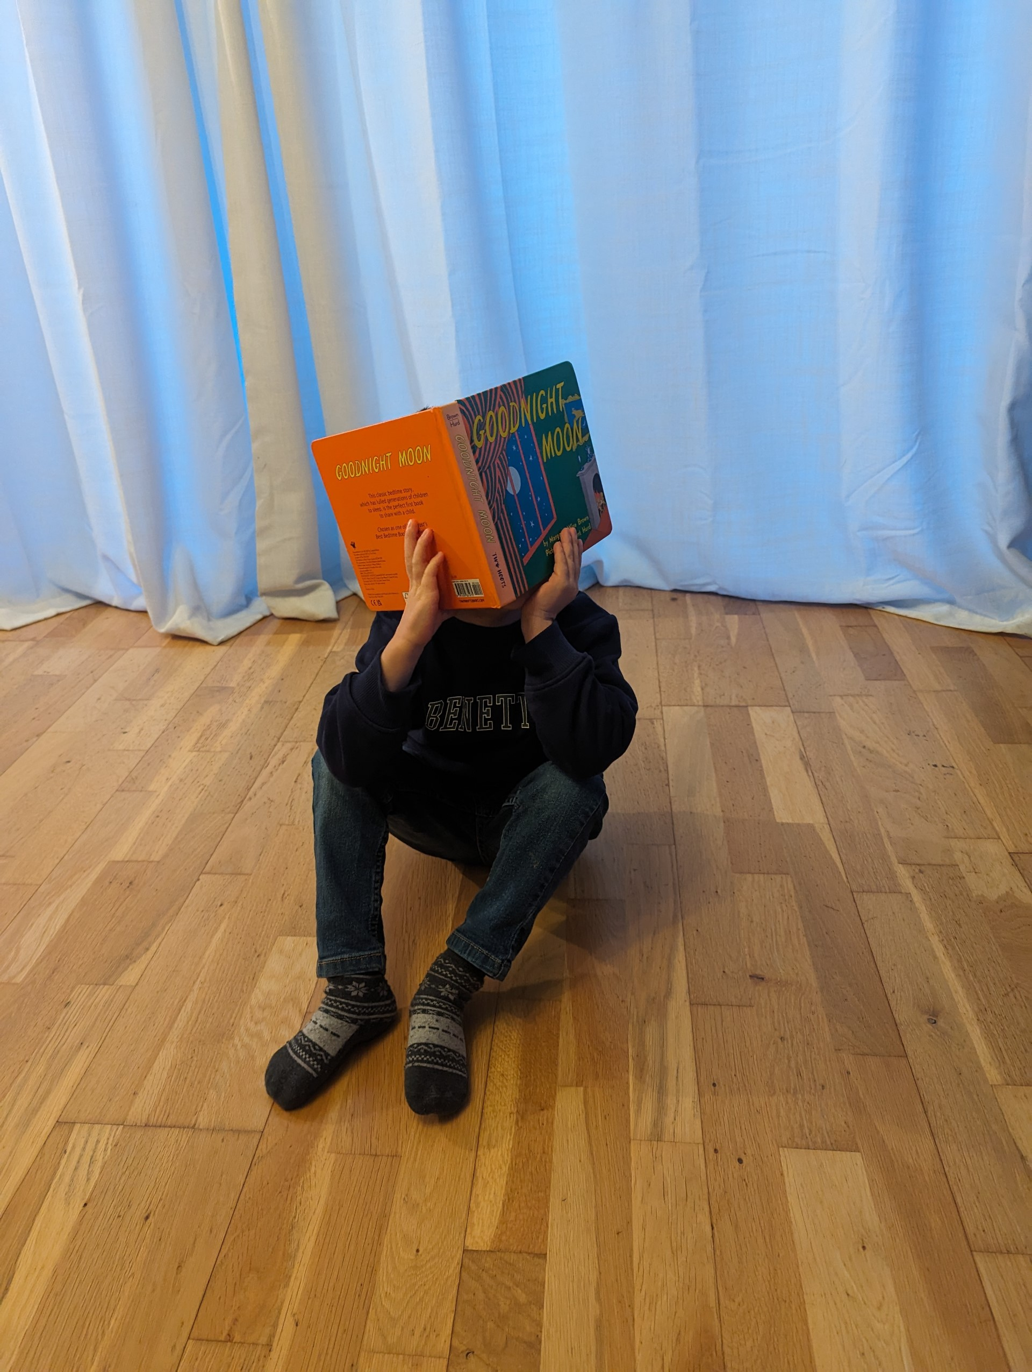
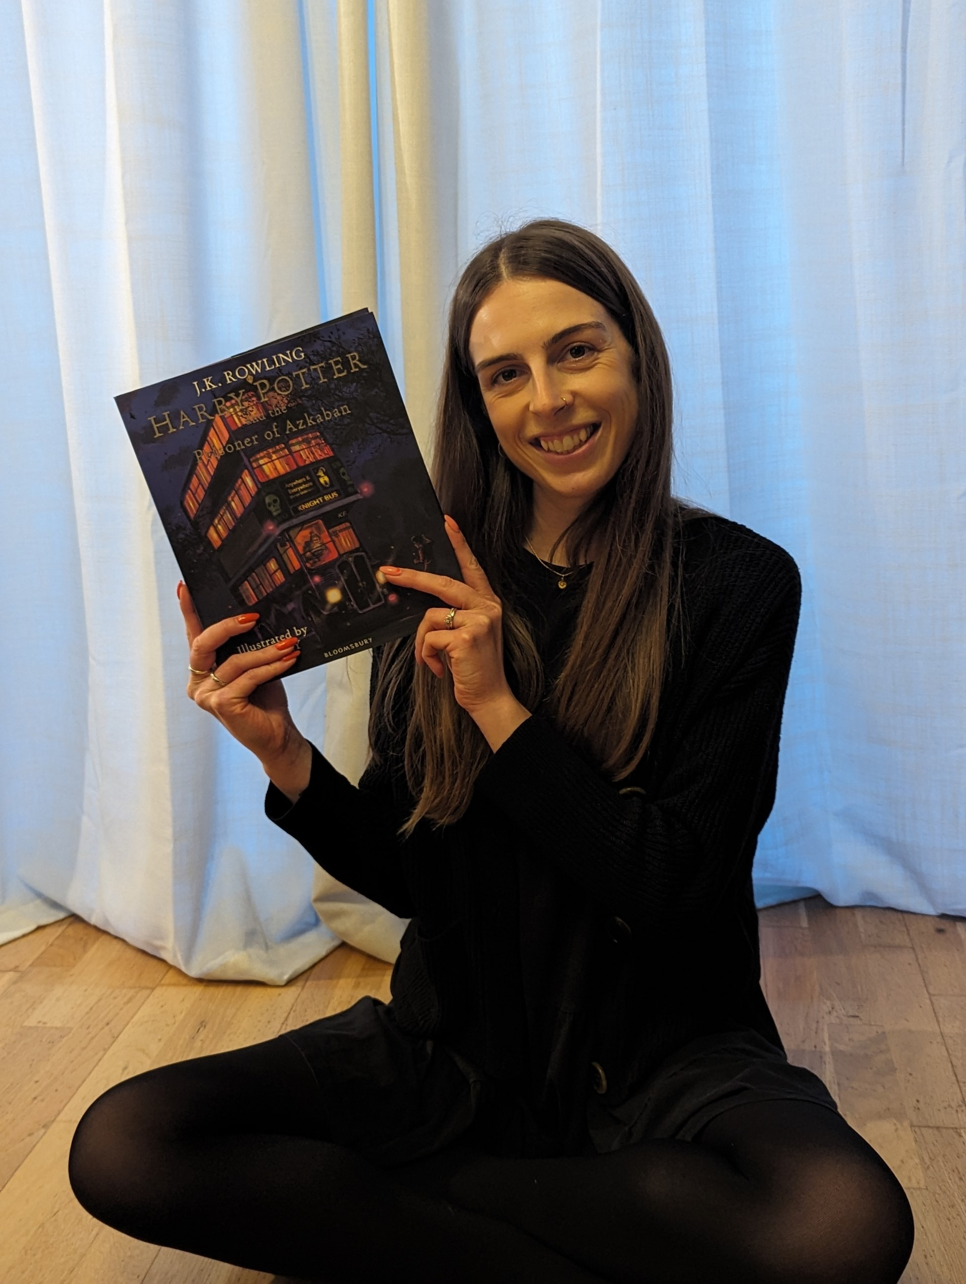
WHO’S THIS…?

Slide 20
WHO’S THIS…?

Slide 21
WHO’S THIS…?

Slide 22
WHO’S THIS…?

Slide 23
WHO’S THIS…?

Slide 24
WHO’S THIS…?

Slide 25
MISS BAILEY MISS WHITMAN MRS SMITH MISS RISBY MISS HARMAN MR RIDGEWELL

Slide 26
WHO’S THIS…?

Slide 27
WHO’S THIS…?

Slide 28
WHO’S THIS…?

Slide 29
WHO’S THIS…?

Slide 30
WHO’S THIS…?

Slide 31
WHO’S THIS…?

Slide 32
MRS BONDONNO MRS McCONNELL MRS FROST MRS JENKINS MRS WORTH MRS MORLEY

Slide 33
WHO’S THIS…?

Slide 34
WHO’S THIS…?

Slide 35
WHO’S THIS…?

Slide 36
WHO’S THIS…?

Slide 37
WHO’S THIS…?

Slide 38
WHO’S THIS…?

