Slide 1
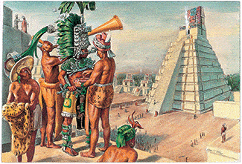
Mysterious Maya
Year 4
Spring Term

Slide 2
Did you know?
The Spanish word Conquistador means 'he who conquers'.
Children’s heads were often bound between two planks of wood. This was in order to change the shape of their heads! A sloping forehead (and large nose) were thought to be attractive to the Maya.
The Maya believed that being cross-eyed was very attractive. They even trained their children to become cross-eyed by tying a bead between their eyes, to encourage them to look inwards.
The Maya believed that the earth was flat and square. They thought it was held up on the back of a huge turtle-like creature.

Slide 3
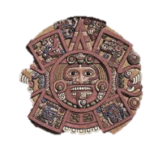
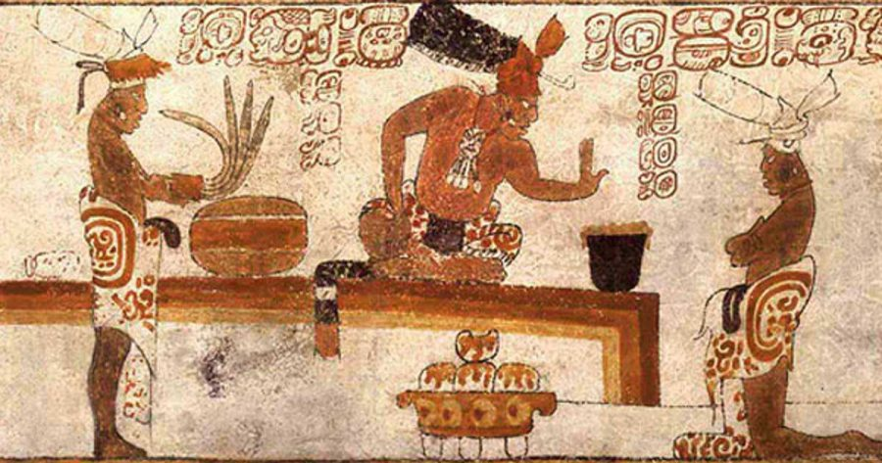
Some of the questions we hope to answer during
this term are...
What is an ancient civilisation?
Who were the ancient Maya?
Where did the ancient Maya people live?
What is the Maya calendar?
What did the ancient Maya believe?
Why was chocolate important to the ancient Maya?
What did ancient Maya writing look like?
What happened to the ancient Maya?
Which animals were important for the ancient Maya?
This term we will enrich the learning with…
◊ Chocolate tasting: 50p donation
◊ Maya Feast: £1 donation
◊ Maya Workshop : £8.50
◊ Creating Tie-dye shirts

Slide 4
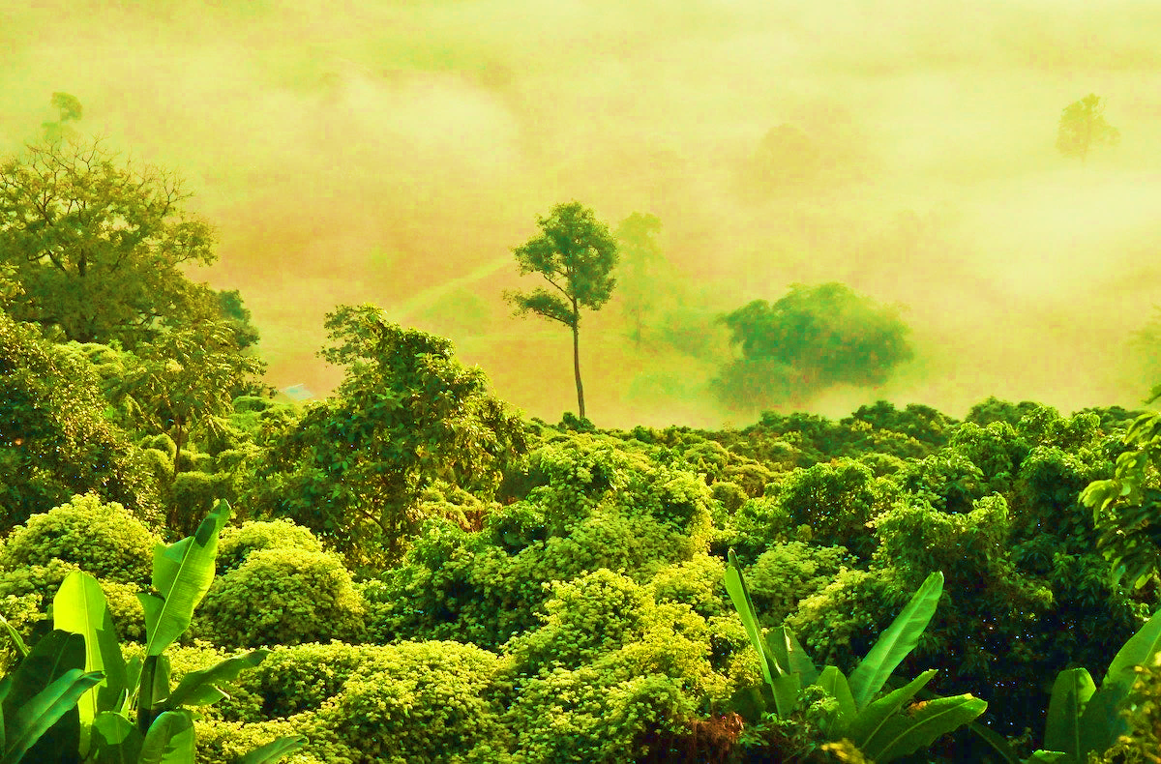
What will we be doing in each subject?
In English, we will create a non-fiction page on Maya Ancient Civilisation. This term we will enrich our writing by reading many different myths, tales and stories from the Maya culture.
In maths, we will continue making cross-curricular links through geometry and statistics, alongside discrete teaching of fractions, decimals, negative numbers and multiplying and dividing.
During Science lessons, we will investigate light, how we see and shadows. In design technology, we will design and make our own tie-dye t-shirts and experiment with food that the Maya used to eat!
During computing, we will be using coding-based programming tools to create interactive stories, games and animations, in addition to learning about internet safety.
In art, we will explore Maya culture through painting and collage, and explore using pastels.
In PE, we will develop our dance skills incorporating the theme of carnival animals whilst also building on our gymnastic knowledge. During games, we will play tag rugby and hockey.
Finally, in History and Geography, we will be learning about the ancient civilization of Maya and exploring North and South America.

Slide 5
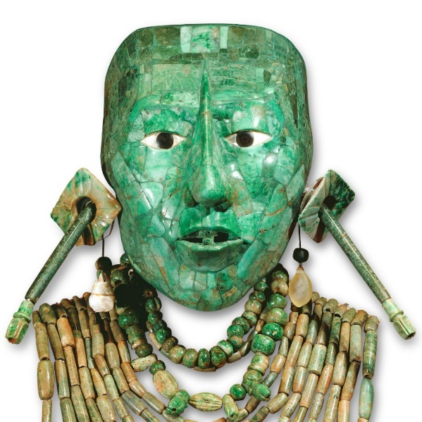
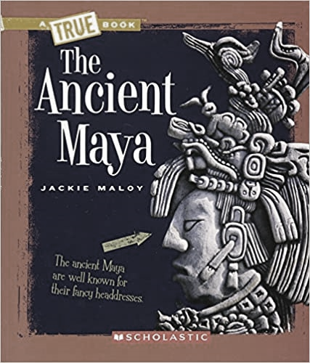
You might like to join in with our learning at home by...
Reading:
The Chocolate Tree (A Maya Folktale)
The Hero Twins (A Maya Myth)
The Ancient Maya (True Books: Ancient Civilizations). By Jackie Maloy.
Websites:
https://www.bbc.co.uk/bitesize/topics/zq6svcw
http://www.history.com/topics/maya
http://mayas.mrdonn.org/

