Slide 1
Victorian Towns and Twisted Tales
Year 4
Autumn Term

Slide 2
The Victorians were the people who lived during the reign of Queen Victoria, from the 20 June 1837 until the date of her death on the 22 January 1901. It was an era of exciting discoveries, inventions and exploration following the Industrial Revolution.
During the Victorian era, Britain expanded its territory throughout the world and became the largest, richest and most powerful empire in world history. A quarter of the world’s population lived in the empire and Queen Victoria was even Empress of India! New inventions, such as the telephone, motorcar, typewriter, bicycle and moving film totally changed the way that people lived, worked and travelled.
In 1856, an engineer named Henry Bessemer invented a new method for turning iron into steel making it possible to build ships, bridges and other structures on a scale like never before! Expansion of the railways meant that people could travel faster and further than ever before. Before trains, the fastest mode of transport was horses.
The boom in industry saw lots of people moving to cities to find work. For the first time in world history, more people lived in cities than in the countryside, making city centres very cramped!

Slide 3
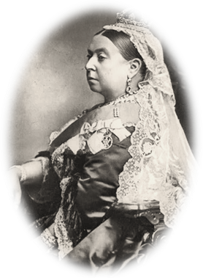
Our learning this term
In English, we will become news reporters, investigating the criminal activities of a den of pickpockets from Dickens’ Victorian England. We will also be developing our story writing skills by writing alternate endings to a novel. In preparation for our Preston Manor visit, we will write letters of application for a job as a domestic servant in a Victorian household.
In Science, we will focus on electricity, conduction and insulation, as well as exploring the topic of magnetism, where we will put our knowledge into practice and create a magnetic Victorian toy. In DT, we will be using our knowledge of magnets to create William Morris inspired Victorian games.
During computing lessons, we will be using different methods to publish our work. In our Art lessons we will be learning how to tell stories through our sketching. This will include looking at sequencing images to share and tell stories.
In PSHE, we will learn about new beginnings and continuing our understanding of online safety.
During RE lessons we will be exploring whether all religions are equal. Our history and geography lessons will focus on what life and our local area was like in Victorian times, with a focus on inventions and how Brighton has developed. PE will include dance, invasion games, and gymnastics.
To enhance our learning journey and bring it to life we will have a Victorian school day and invite children to dress up in appropriate costume.

Slide 4
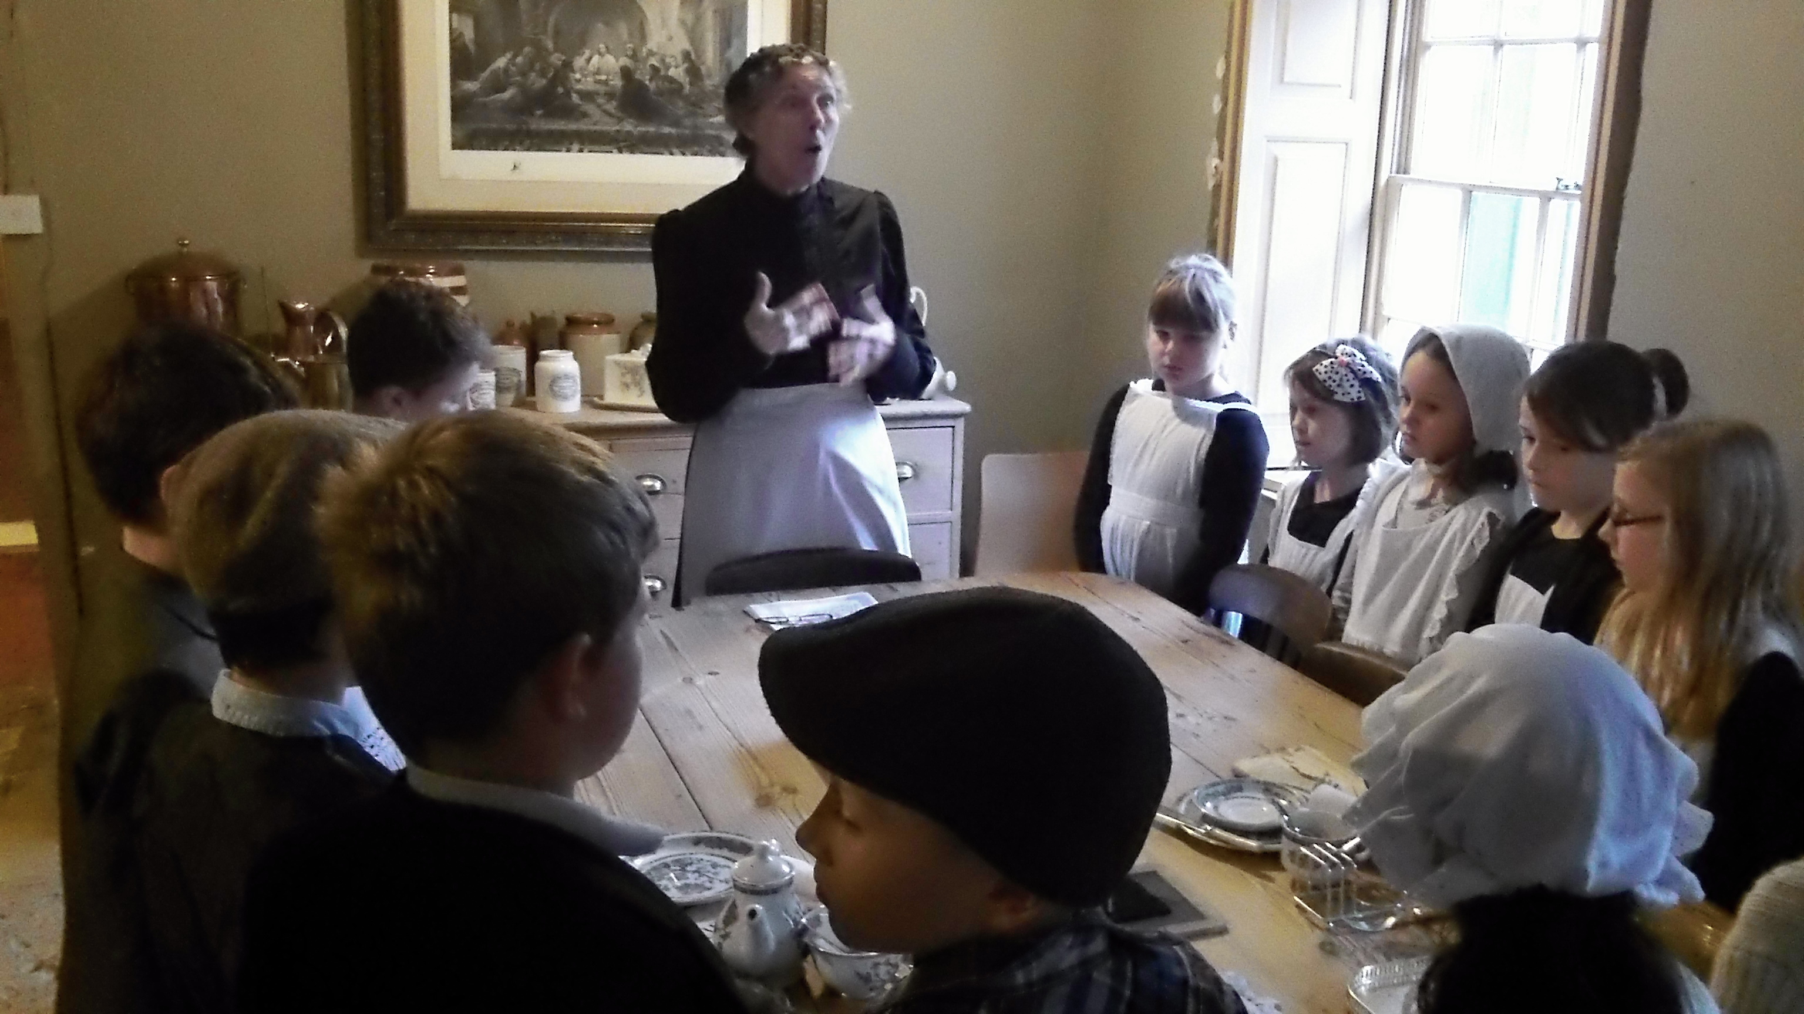
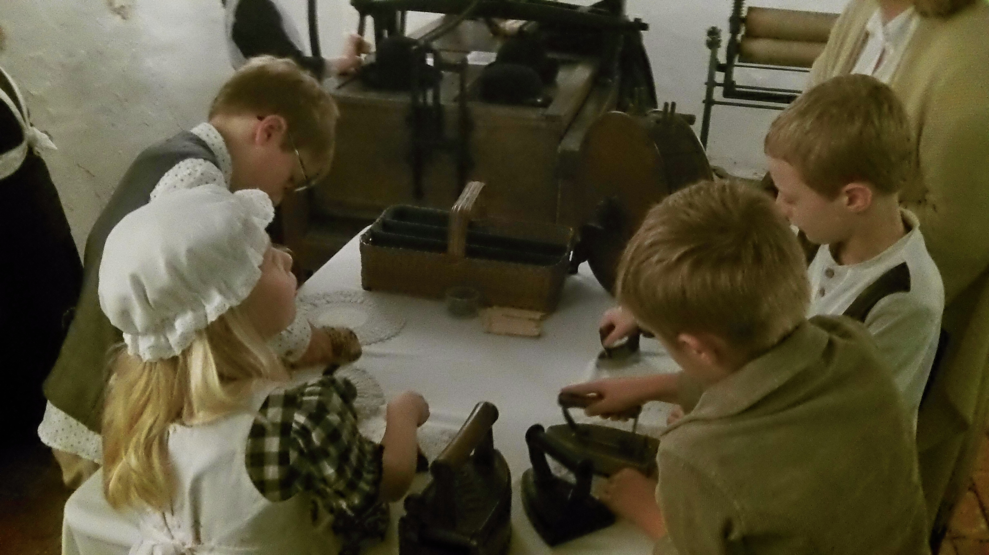
Some of the questions we are hoping to answer this term are...
Who were the Victorians?
What was invented in Victorian times?
How did life differ for the rich and poor?
What was it like to be a child in Victorian times?
What were Victorian schools like?
What did Brighton look like in Victorian times?

Slide 5
This term we are hoping to enrich the learning with these fantastic opportunities, including:…
A visit to Preston Manor (cost TBC)
A Victorian School Day (no cost)
A Victorian town trail around Brighton with a trip on the Volk’s railway (cost TBC)

Slide 6
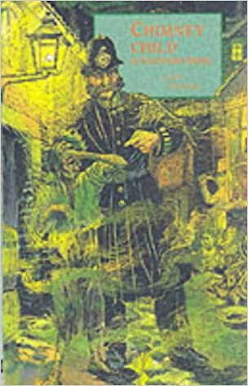
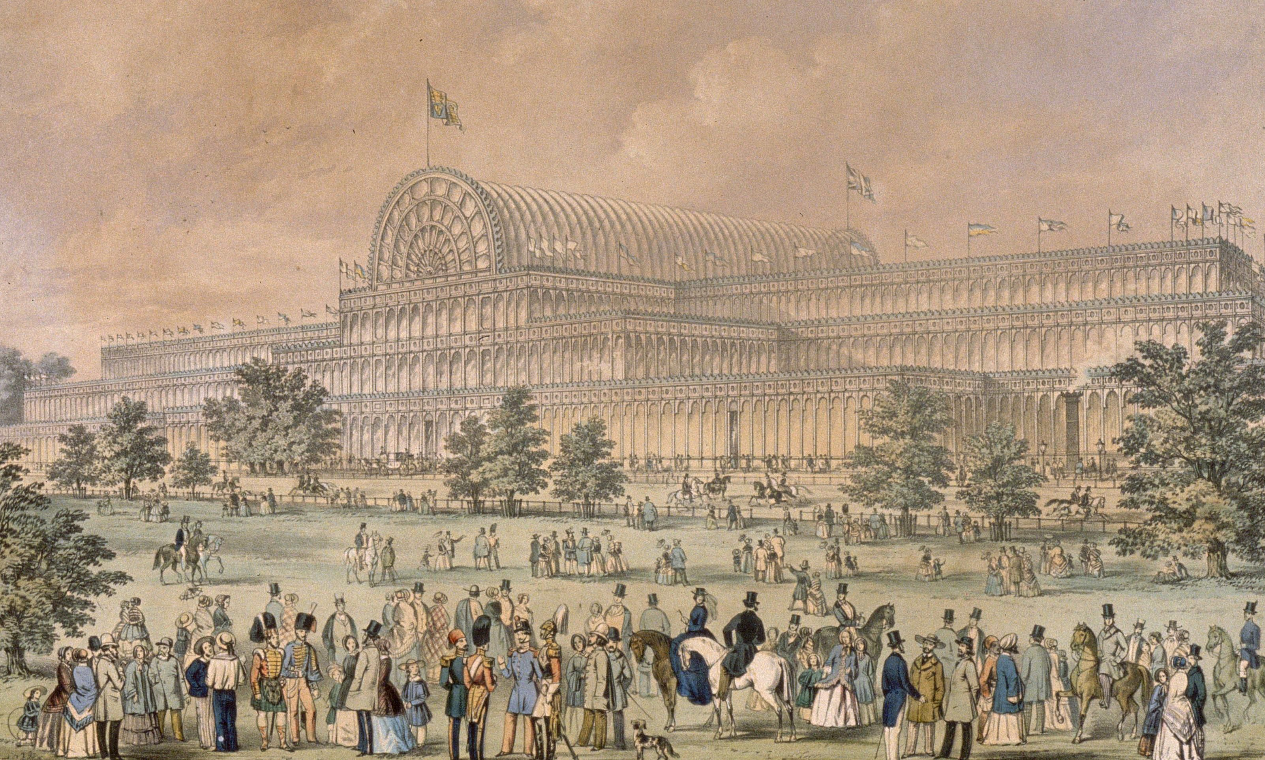
Things to do: Research what life was like in Victorian England. Collect pictures of Victorian toys; you could even try making one! Reading: The Vile Victorians (Horrible Histories) Terry Deary’s Victorian Tales Chimney Child by Laurie Sheehan Websites: http://www.bbc.co.uk/schools/primaryhistory/victorian_britain/ http://www.nzsc.co.uk/pleasuregardens http://www.channel4.com/learning/microsites/Q/qca/victorians/
Visiting:
Victorian and Albert Museum in London.
Charles Dickens Museum in London.
Brighton Pier (built during Victorian times)

