Slide 1
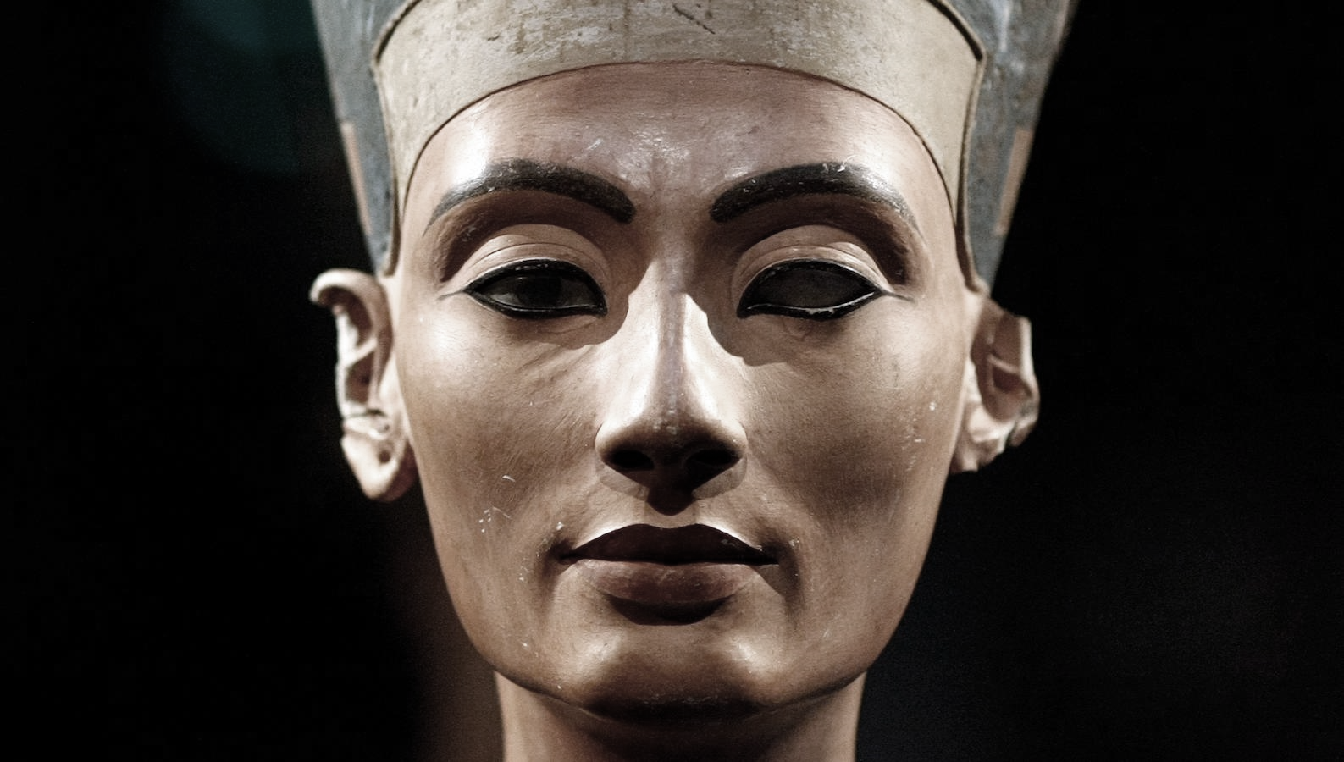
Walk Like an Egyptian
Year 6
Spring Term

Slide 2
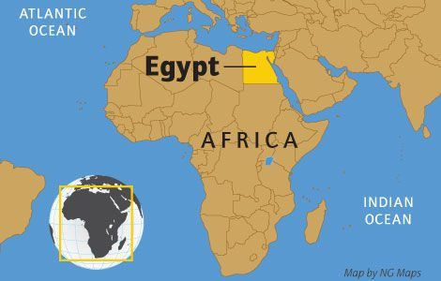
The Pyramid of Khufu at Giza is the largest Egyptian pyramid. This incredible structure weighs as much as 16 Empire State buildings!
Both Egyptian men and women wore make-up. The eye paint was usually green (made from copper) or black (made from lead). As well as offering protection from the sun, the Egyptians believed make-up had magical healing powers, too!
Unwrapped, the bandages of an Ancient Egyptian mummy could stretch for 1.6km. Yikes!
The Egyptian alphabet contained more than 700 hieroglyphs! Uncover the meaning behind these ancient symbols by checking out our awesome hieroglyphics feature.
Ancient Egyptians believed in more than 2,000 deities! They had gods for everything, from dangers to chores! Each had different responsibilities and needed to be worshipped so that life could be kept in balance.
Cats were considered sacred animals by the Ancient Egyptians. It’s thought that most families kept a cat as a pet, which they believed would bring the household good luck!
Love playing board games with your pals? Well, gang, so did the Ancient Egyptians! One popular game was Senet, which was played for over 2,000 years! The game involved throwing sticks (in the same way we throw dice) to see how many squares to move your piece forward on the board.
The Ancient Egyptians invented lots of things we still use today, such as paper, pens, locks and keys and – believe it or not – toothpaste!

Slide 3
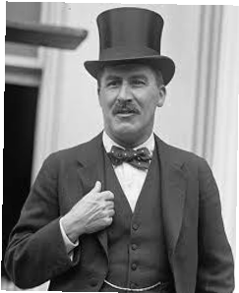
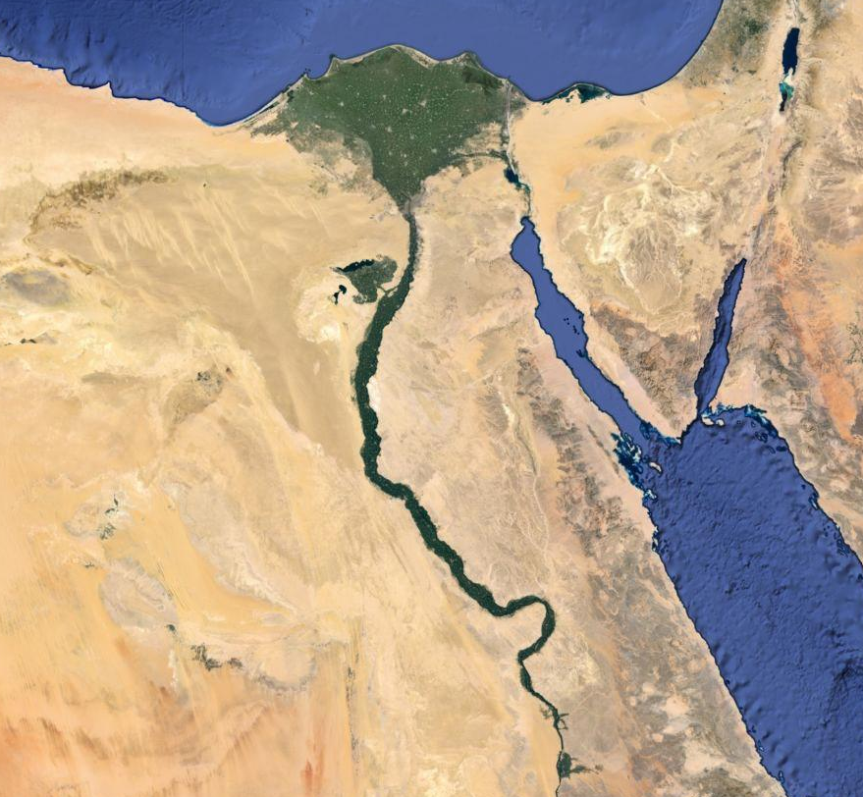
This term, we shall experience…
• A trip to the British
Museum, to see the amazing
Egyptian artefacts
• DT- creating a healthy salad.
(approximate cost: £1.50)
Some of the questions we hope to answer this term are…
Who was Howard Carter?
Where in the world is Egypt?
Why was the River Nile so important?
How did Egyptians communicate?
Was the Egyptian social system fair?
Who were the Egyptian gods?
How and why did the Egyptians make pyramids?
What is mummification and why did they do it?

Slide 4
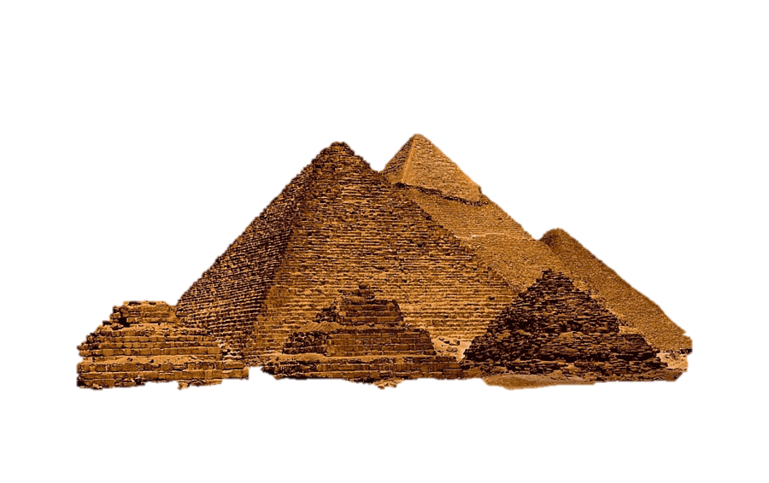
What will we be doing in each subject?
In English we will be writing short stories, mummification instructions and creating non-fiction pages.
In Science we will be learning about light and electricity; making a variety of circuits.
In Computing, we will be exploring programs involving scratch and Excel to collect and display data.
PE lessons will cover dance and gymnastics, as well as invasion games including tag rugby and hockey.
Art and DT lessons will focus on exploring identify through the use of mixed media self-portraits as well as healthy salad making.
In Humanities, we will be identifying artefacts, considering what it takes to be an archaeologist, and how we have found out about the past.
In French, we will be learning about verbs.
In Music, we are focusing on creative composition using both singing and instruments to explore our learning.
In RE lessons, we will study why different religions are different across the world and special places.

Slide 5
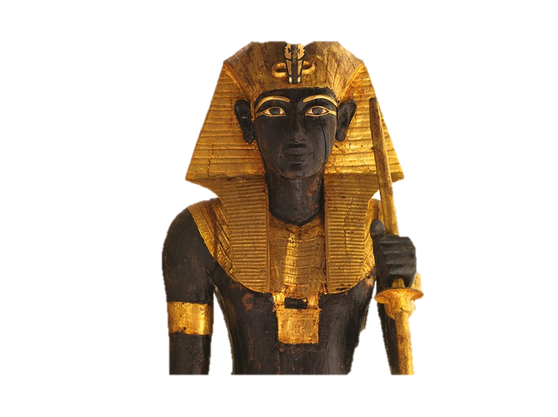

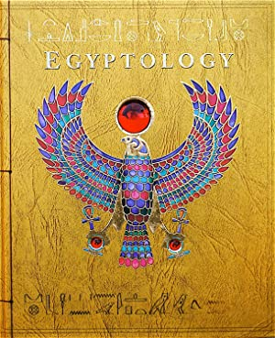
Join in with the learning at home...
Why don’t you watch…?
• The Prince of Egypt
• Documentaries about Howard Carter and Tutankhamen
Why don’t you look online at…?
www.guardians.net/egypt/kids/index.htm
www.teachingandlearningresources.co.uk/funhistory.shtml
www.britishmuseum.org
Why don’t you visit…?
Brighton Museum—Ancient Egypt Galleries
Why don’t you read…?
‘Egyptology: Search for the Tomb of Osiris’, by Emily Sands
‘Wonders of Egypt: A Course in Egyptology’, by David Steer
‘Egypt (Time Travelers Field Notes’, by Gordon Volk

