Slide 1

We’ll Meet
Again
Year 5
Spring Term

Slide 2
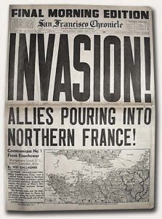
This term we will be learning all about World War II. The children will be immersed in many hands-on experiences, taking them back to life during the war.
English: We will be reading World War 2 novels and writing non-fiction, poetry and fiction for a range of audiences and purposes.
Art and D.T.: In art, we will be learning about architecture and creating our own buildings based on the principles learnt. In D.T. we will be cooking with rationed supplies and experiencing what people ate in war time Britain.
Humanities: In history, we will be finding out why Britain went to war and which countries
were involved, exploring the impact of war on children’s lives and
celebrating VE day.
In Geography, we
will investigate European countries and
capital cities and comparing regions.

Slide 3

What will we be learning in each subject?
Maths: We will continue to cover the Y5 maths curriculum, including multiplication, division, fractions, area, perimeter and statistics.
Science: In
science we will
learn about the
properties of
materials.
ICT: We will be
Learning to create
Media using Google
Drawings and
investigate
Databases.
RE: We will be learning about Judaism.
MFL: We will be looking at verbs in French.
PE and Games: We will be developing skills in gymnastics, orienteering and netball, and learning to dance the Charleston.
RSHE: We will discuss inclusion, acceptance, peer pressure and Internet Safety.

Slide 4
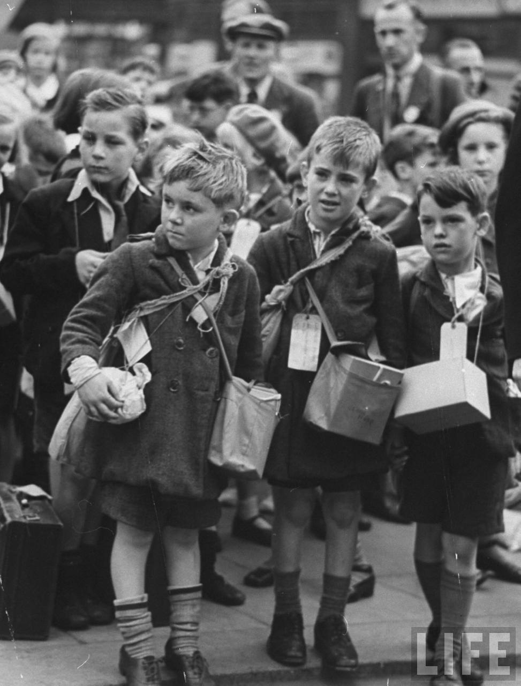
This term at school we are going to enrich the learning with…
A trip to Newhaven Fort
£TBC
An Evacuation experience
£0.00
Cooking a VE day feast/Bubble and squeak £1.50

Slide 5
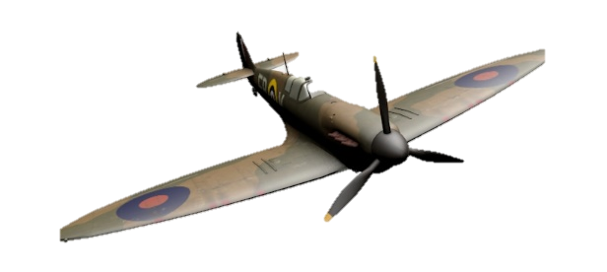

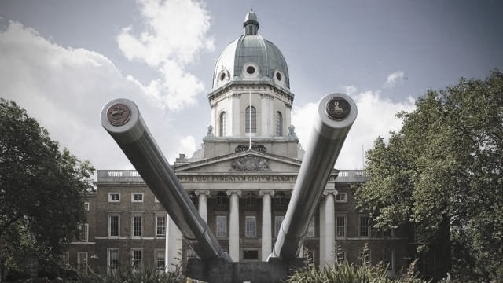
What can you do at home?
Read…
Anne Frank’s Diary
When Hitler Stole Pink Rabbit — J. Kerr
Carrie’s War — Nina Baldwin
Woeful Second World War — T. Deary
Friend or Foe — M. Morpurgo
Visit…
Imperial War Museum — Duxford or London
Churchill’s War Museum
HMS Belfast
Portsmouth
Dockyard

