Slide 1

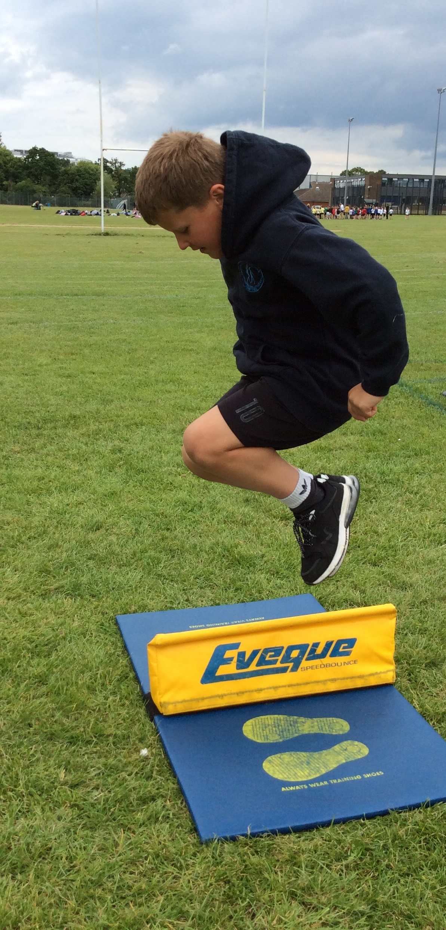
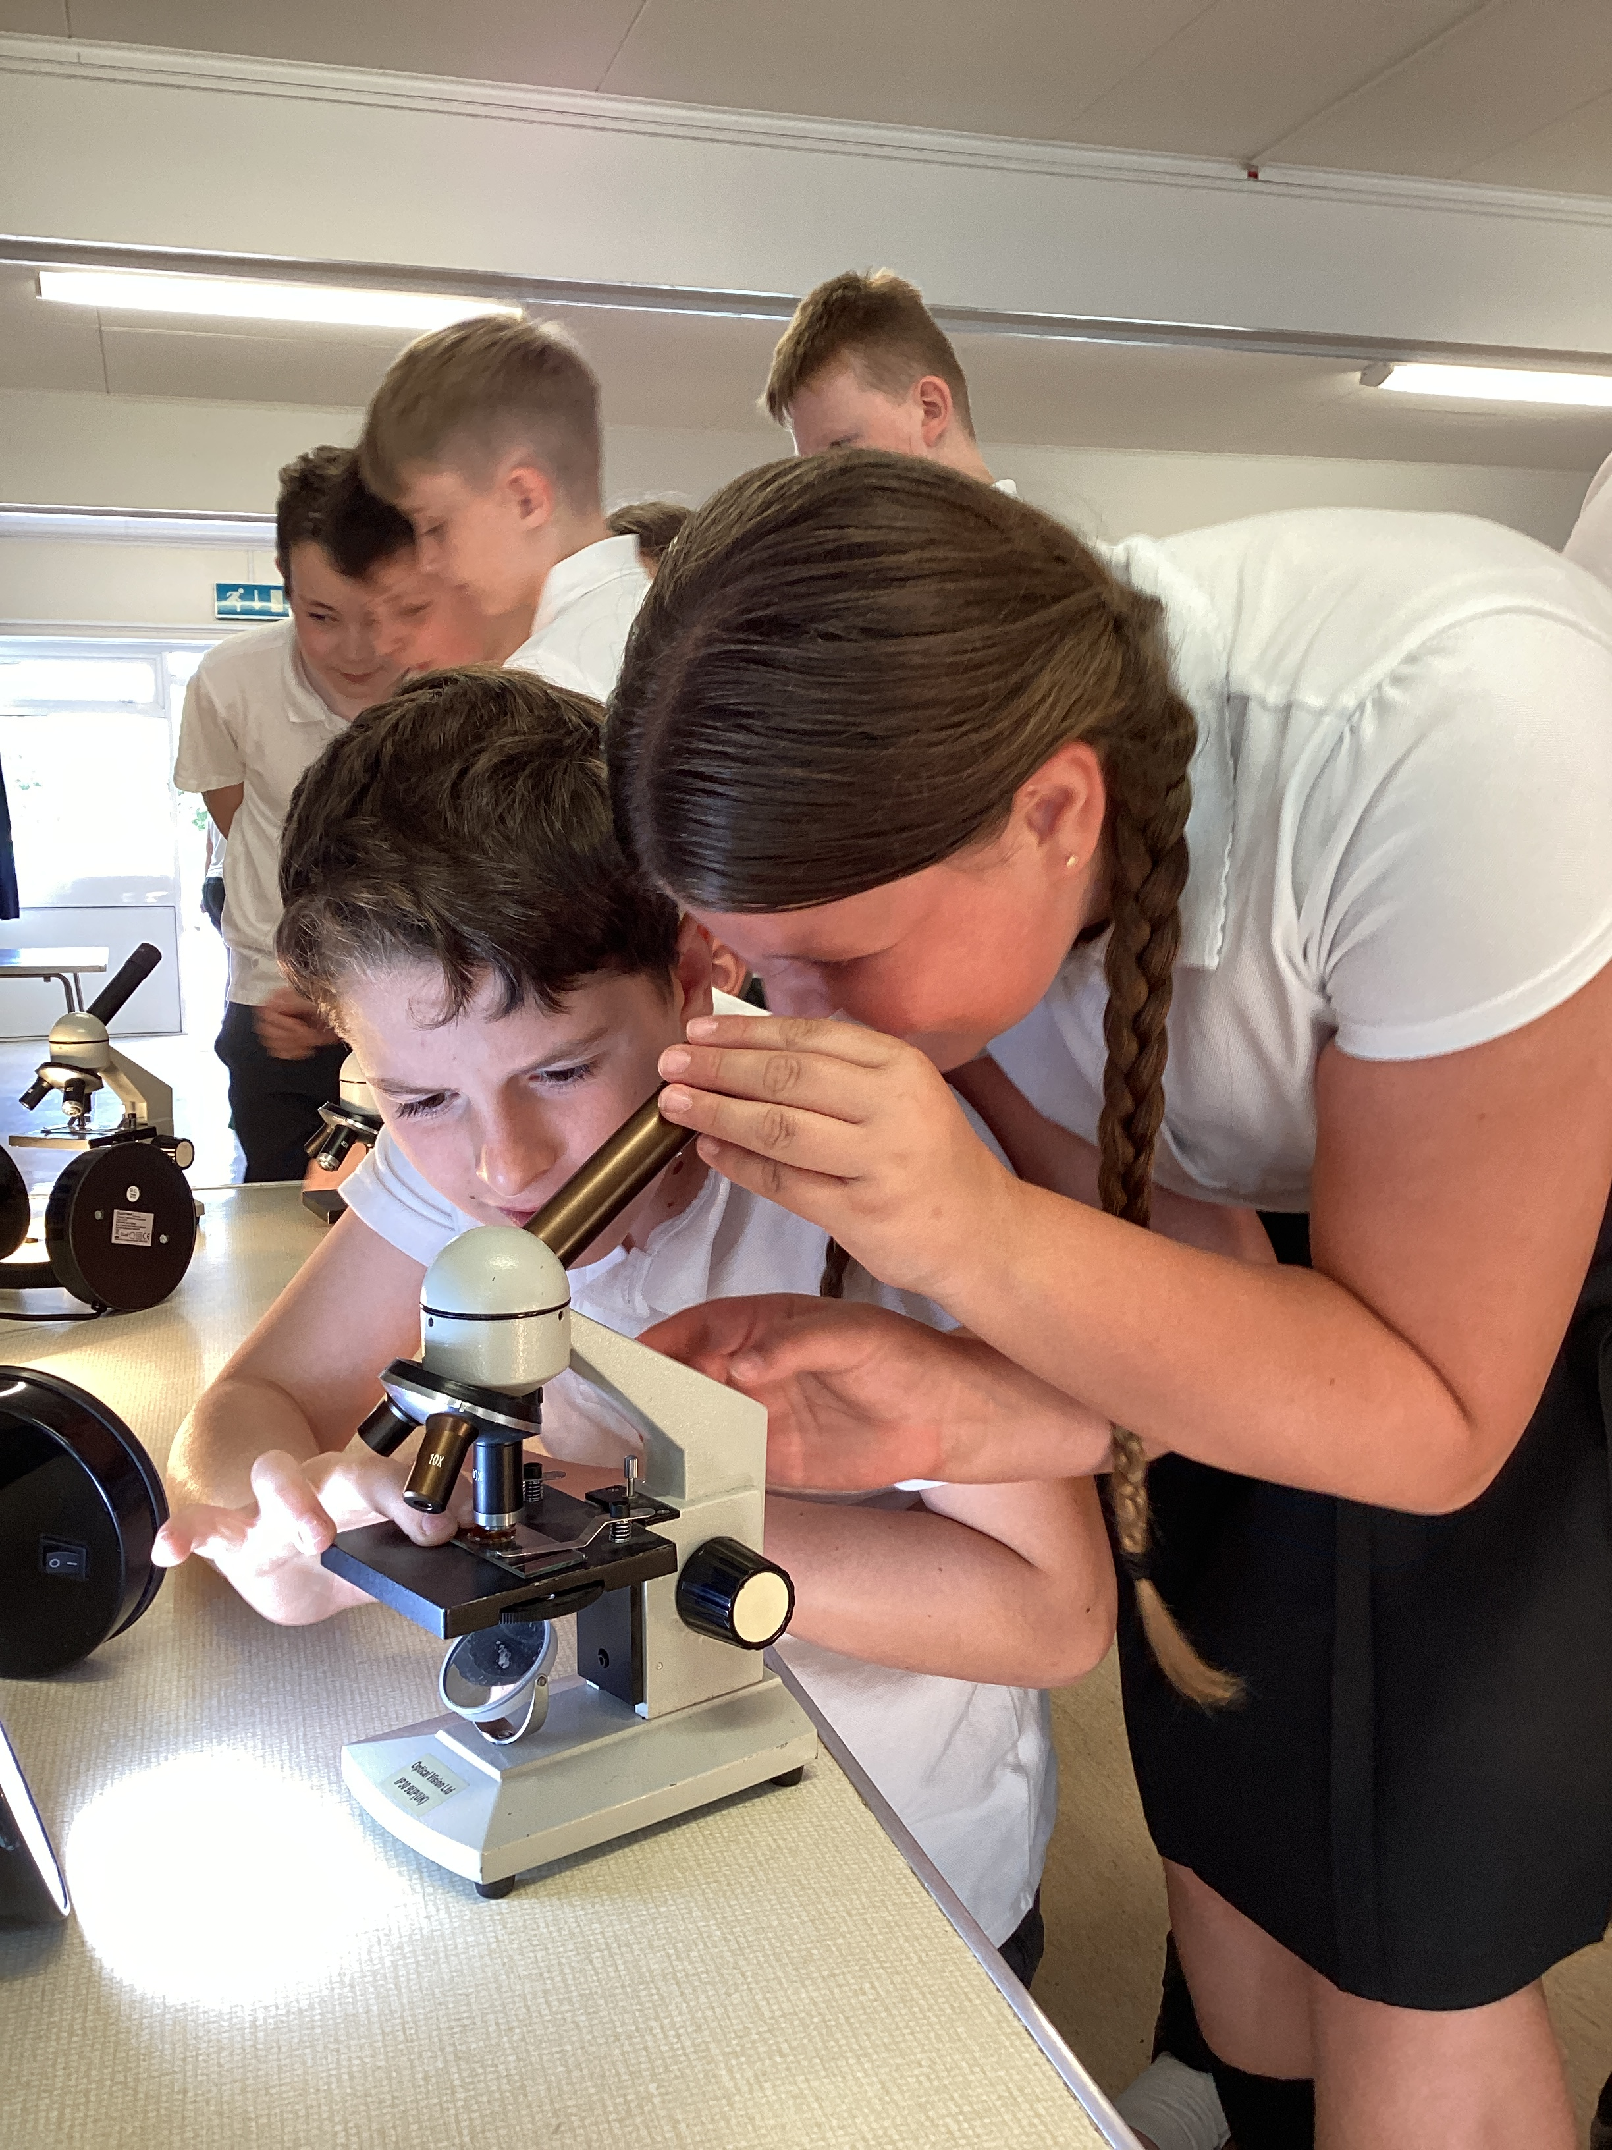
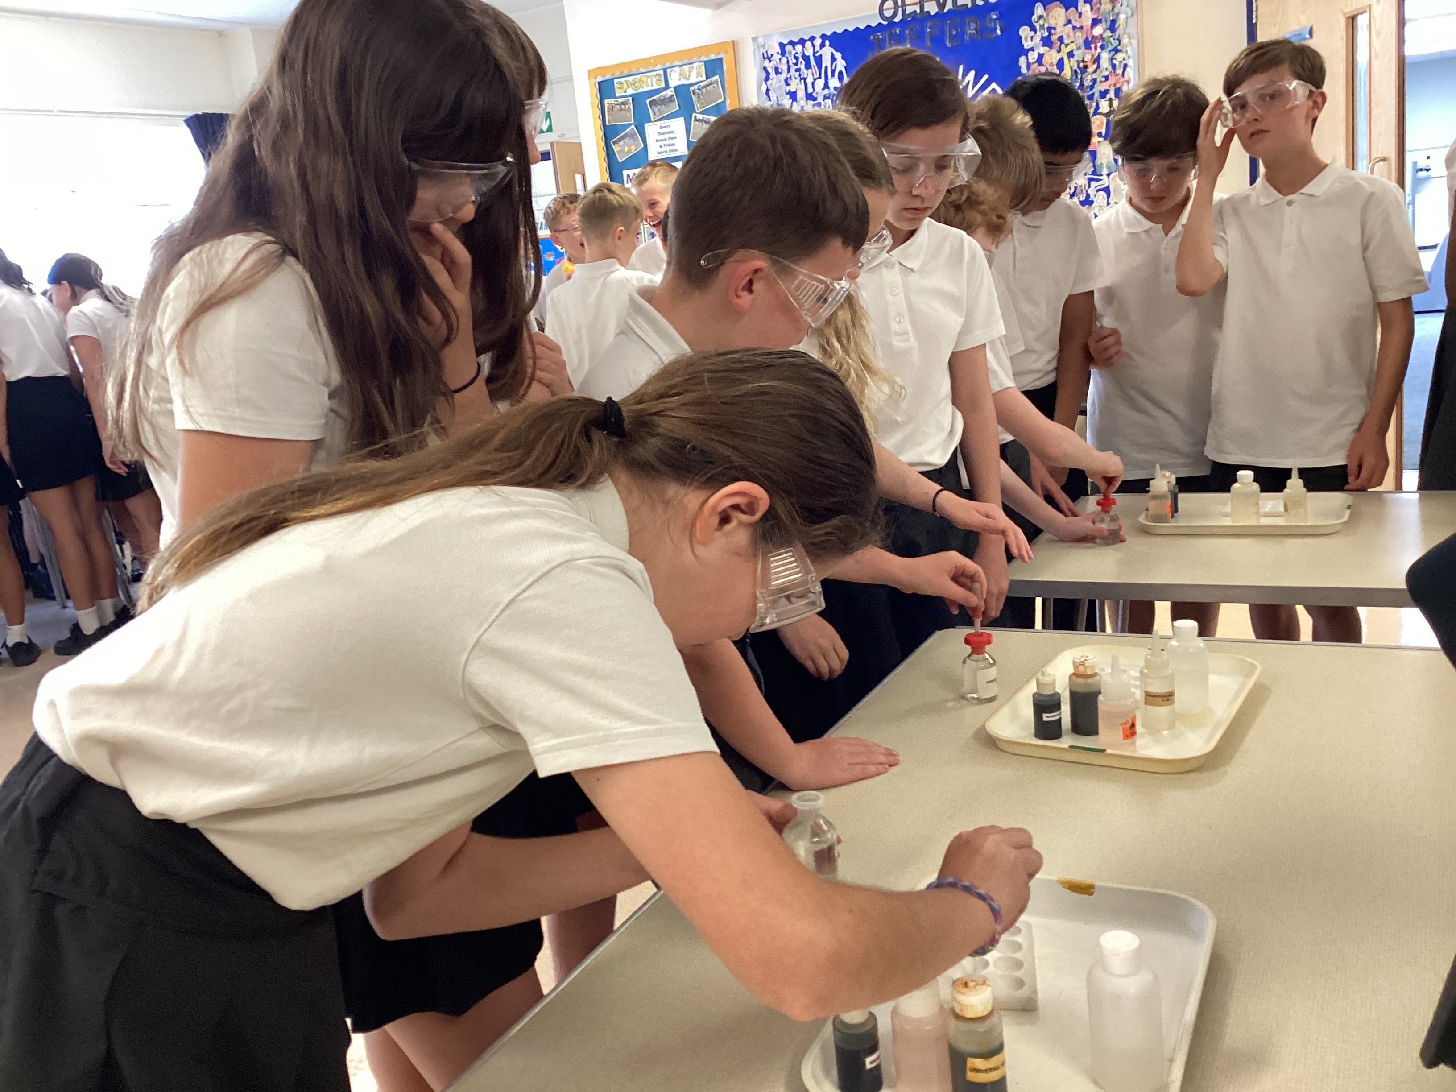







Southway Junior School
June 2024
Newsletter
Learning and Achieving Together
Dear Families,
Last week, a very exciting and immersive Science Week took place at Southway based on the concept of ‘time’. Children were tasked with thinking scientifically to make a paper aeroplane fly for the longest time whilst also completing science quizzes throughout the week. Year 3 were able to crack the code following some STEM based clues and also enjoyed a visit from Leap Environmental all about volcanoes. We also welcomed some Year 10 students and teachers from The Burgess Hill Academy to showcase some interactive Biology, Chemistry and Physics experiments, which all our children thoroughly enjoyed joining in with! Finally, a selected number of Year 5s headed to The Burgess Hill Academy to complete a ‘Rock to Metal Magic’ Science Immersion afternoon, which was thoroughly enjoyed by all. Thank you to Miss. Ayres for coordinating this fantastic week.
We have also been celebrating reading in assemblies and our Year 4 children have been completing their times tables assessments after a fun filled residential to Lodge Hill! Mrs Smith
House Points
Last Tuesday, Year 5 enjoyed a fun-filled day out at the Seven Sisters Country Park. The children explored the features of the river (which they had previously learnt in Geography), sketched the meandering Cuckmere river, explored the rate at which the river flowed and learnt about coastal features. The somewhat unpredictable weather, even played ball on the day. Fun was had by all!
Hill 2894
Dyke 2594
Beacon 2576
Cliff 2431
Attendance
Whole school attendance 95.6%
(3rd June – 14th June)
Highest class attendance is:
Picasso (98.25%)
Tel: 01444 233824
www.southwayjunior.co.uk
parentline@southwayjunior.co.uk
Southway Junior School

Slide 2
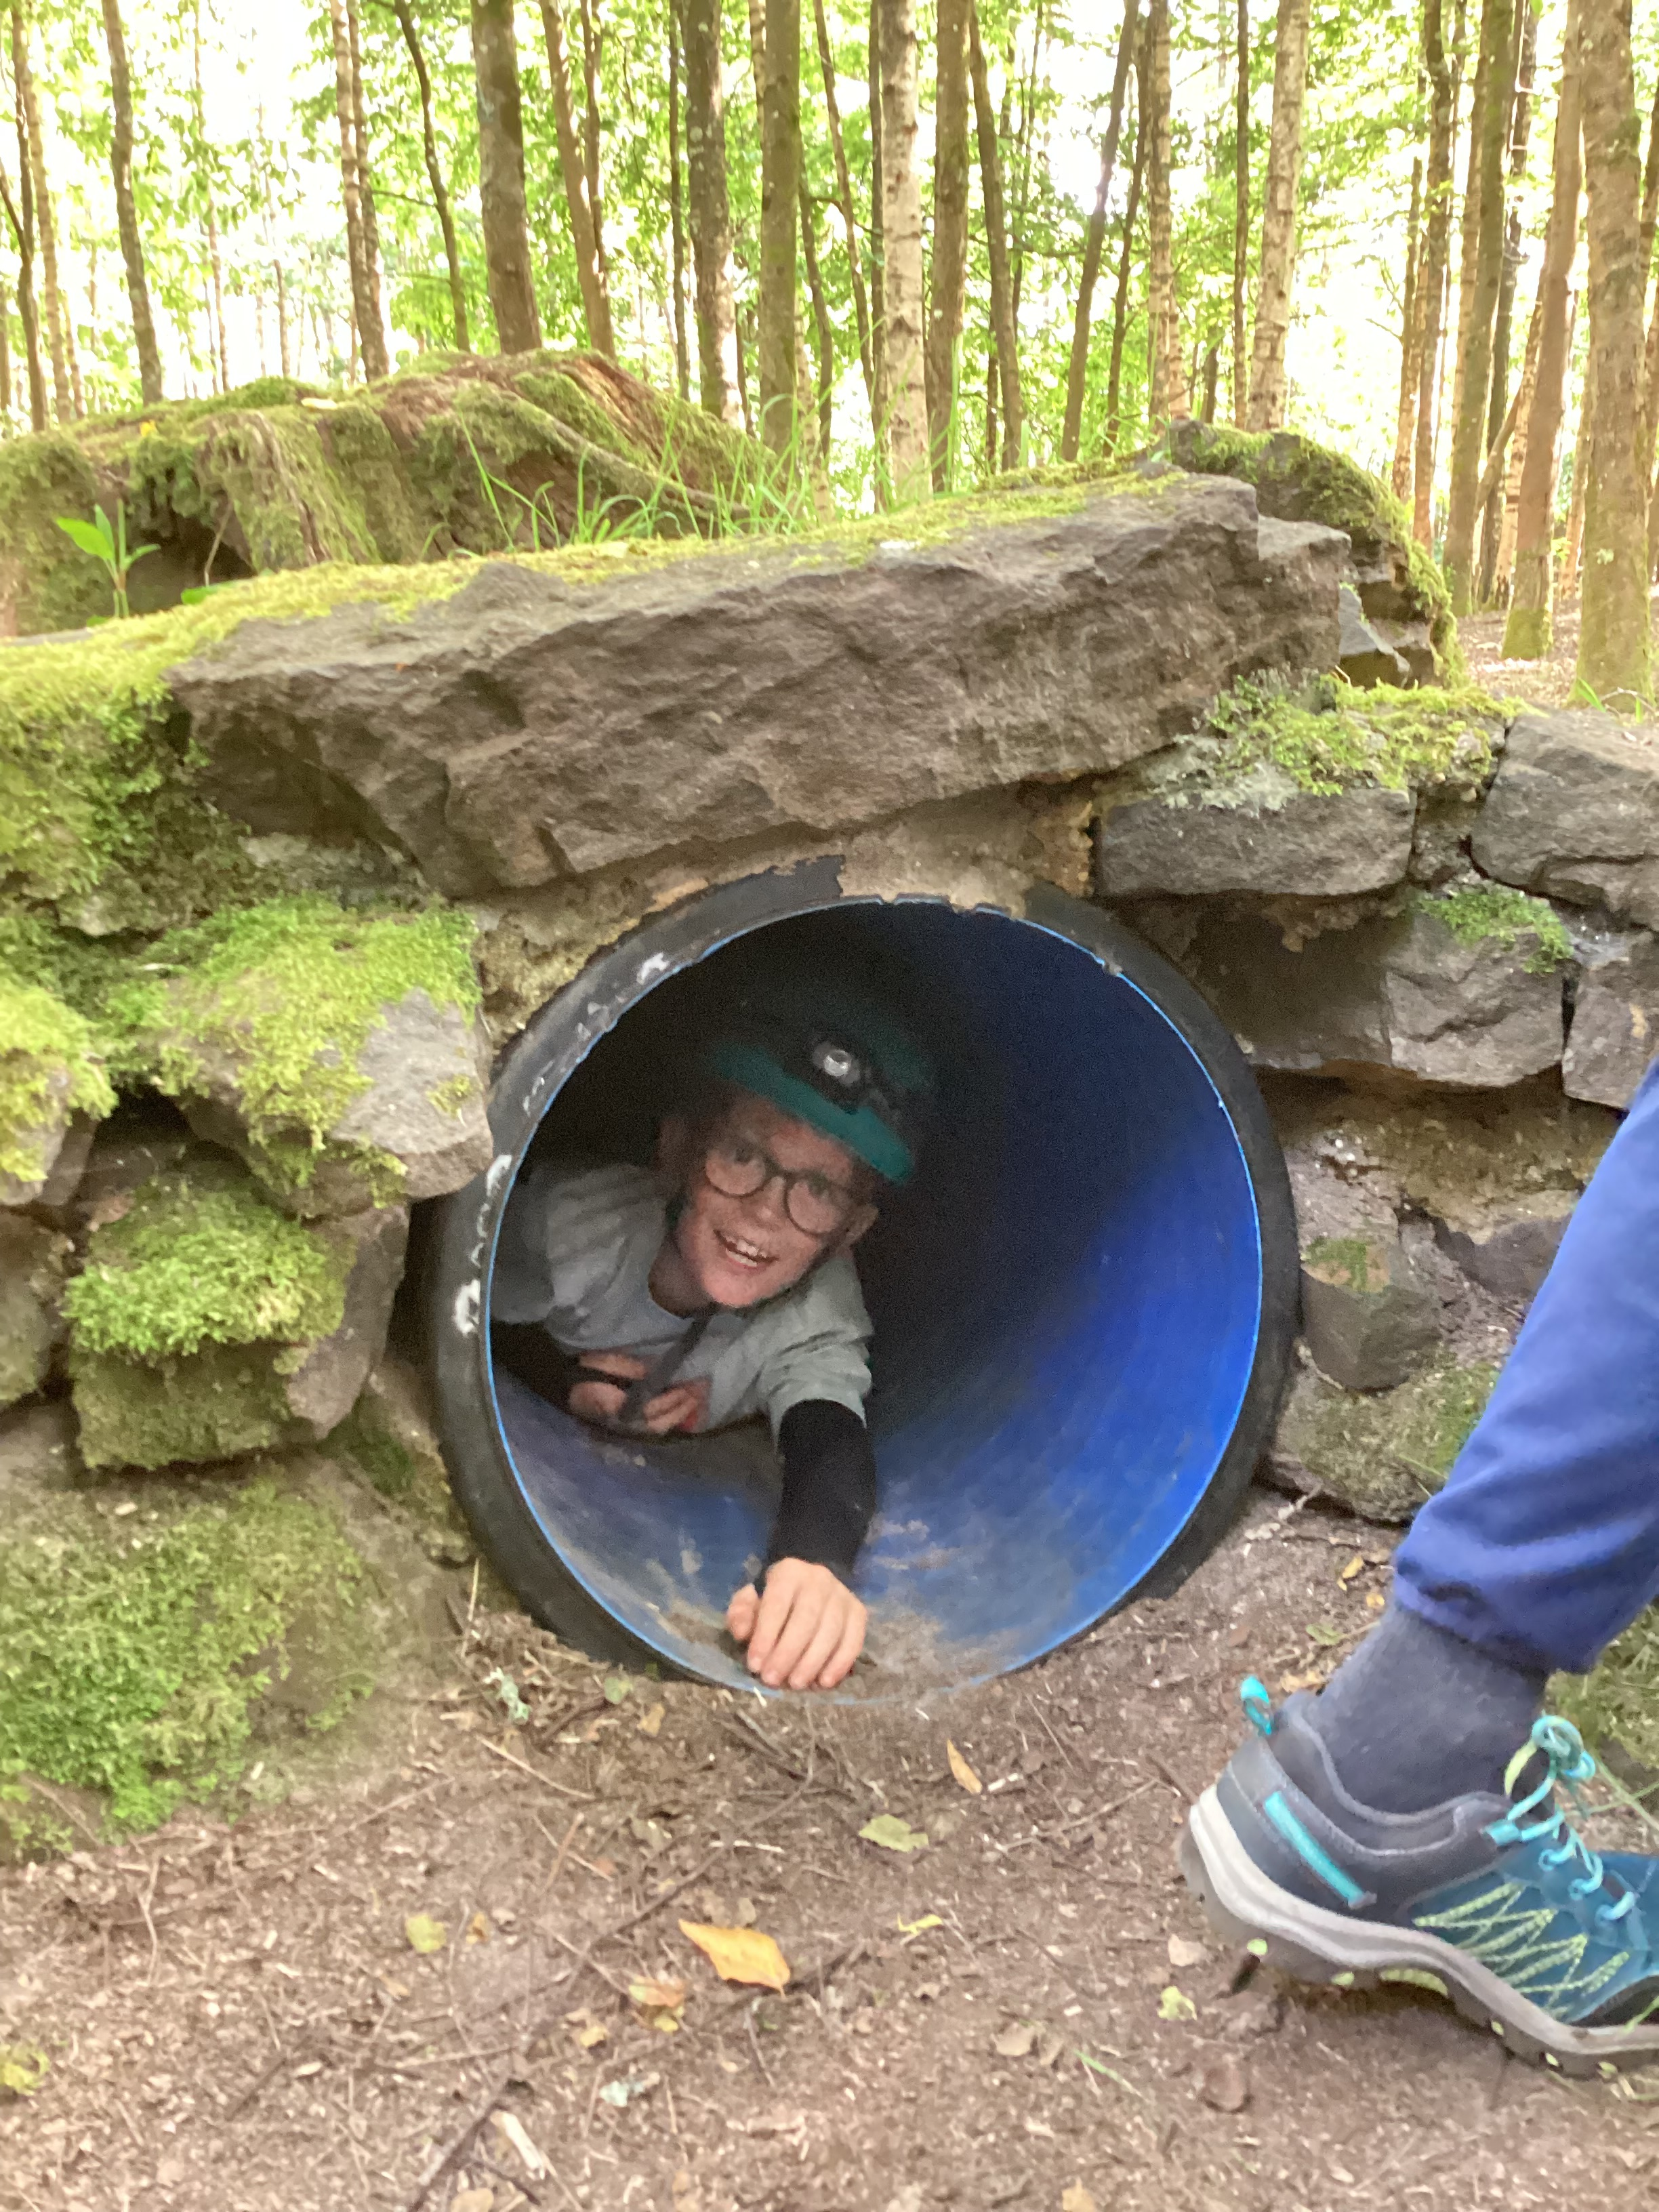
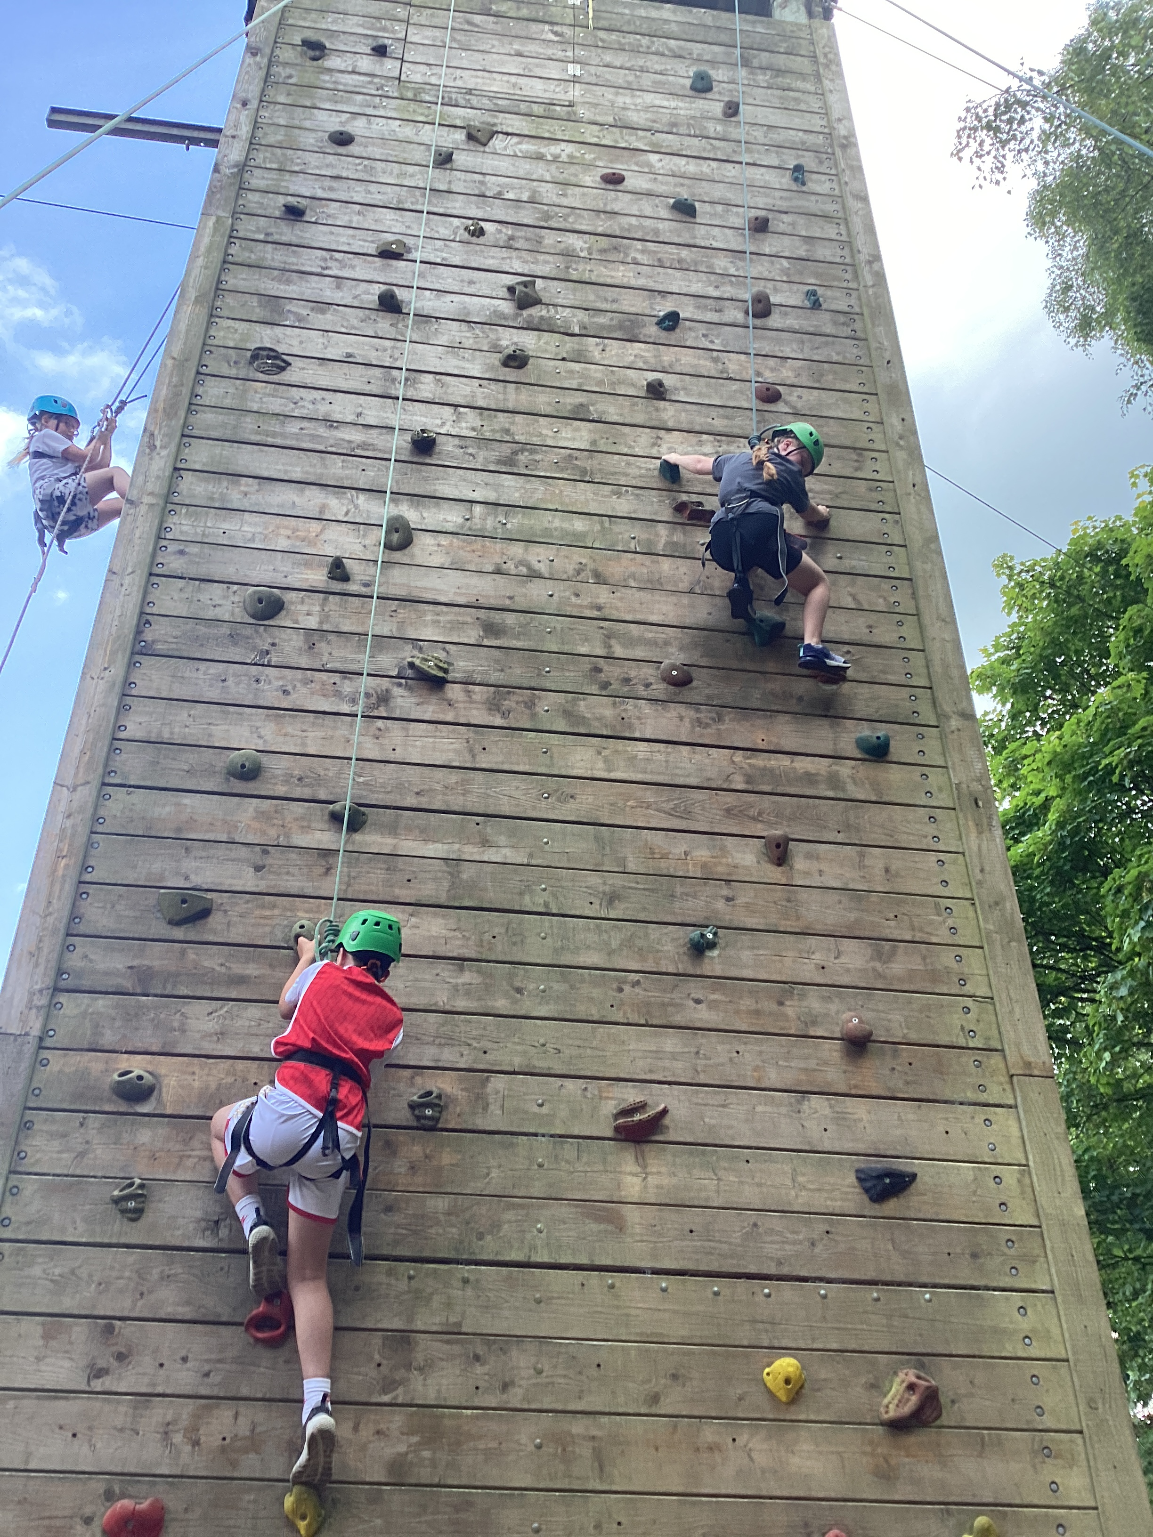
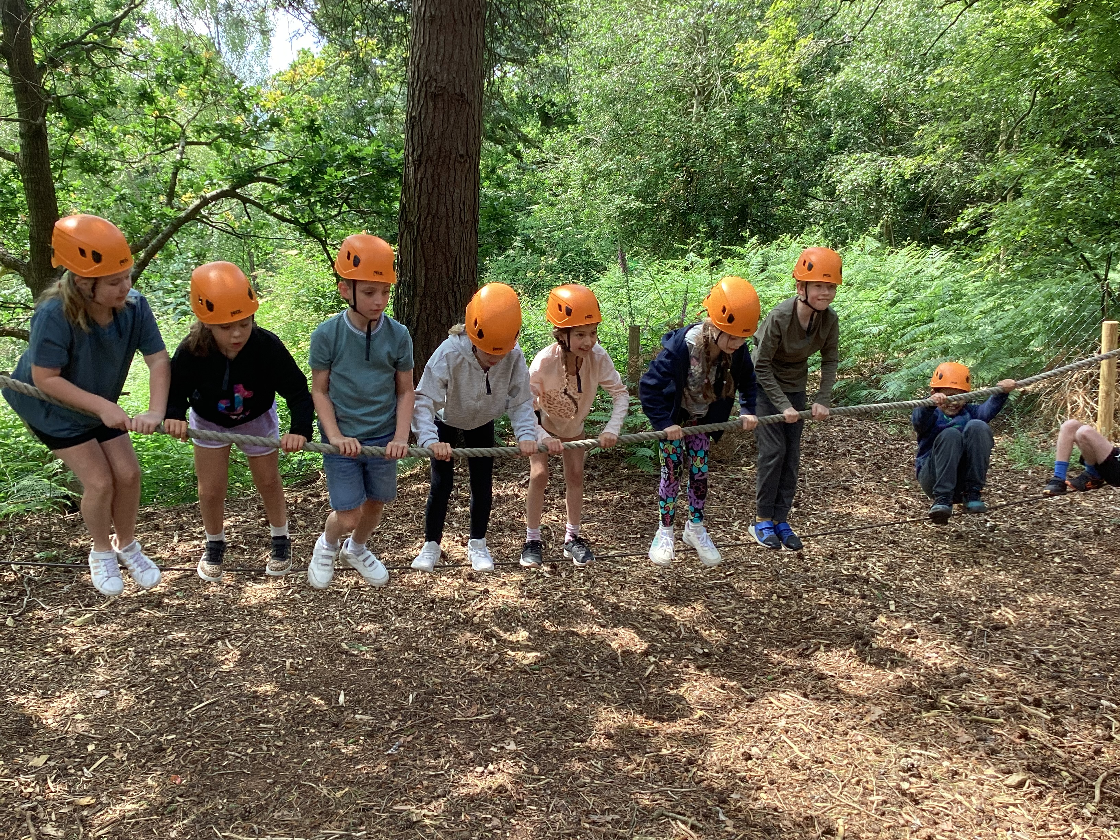
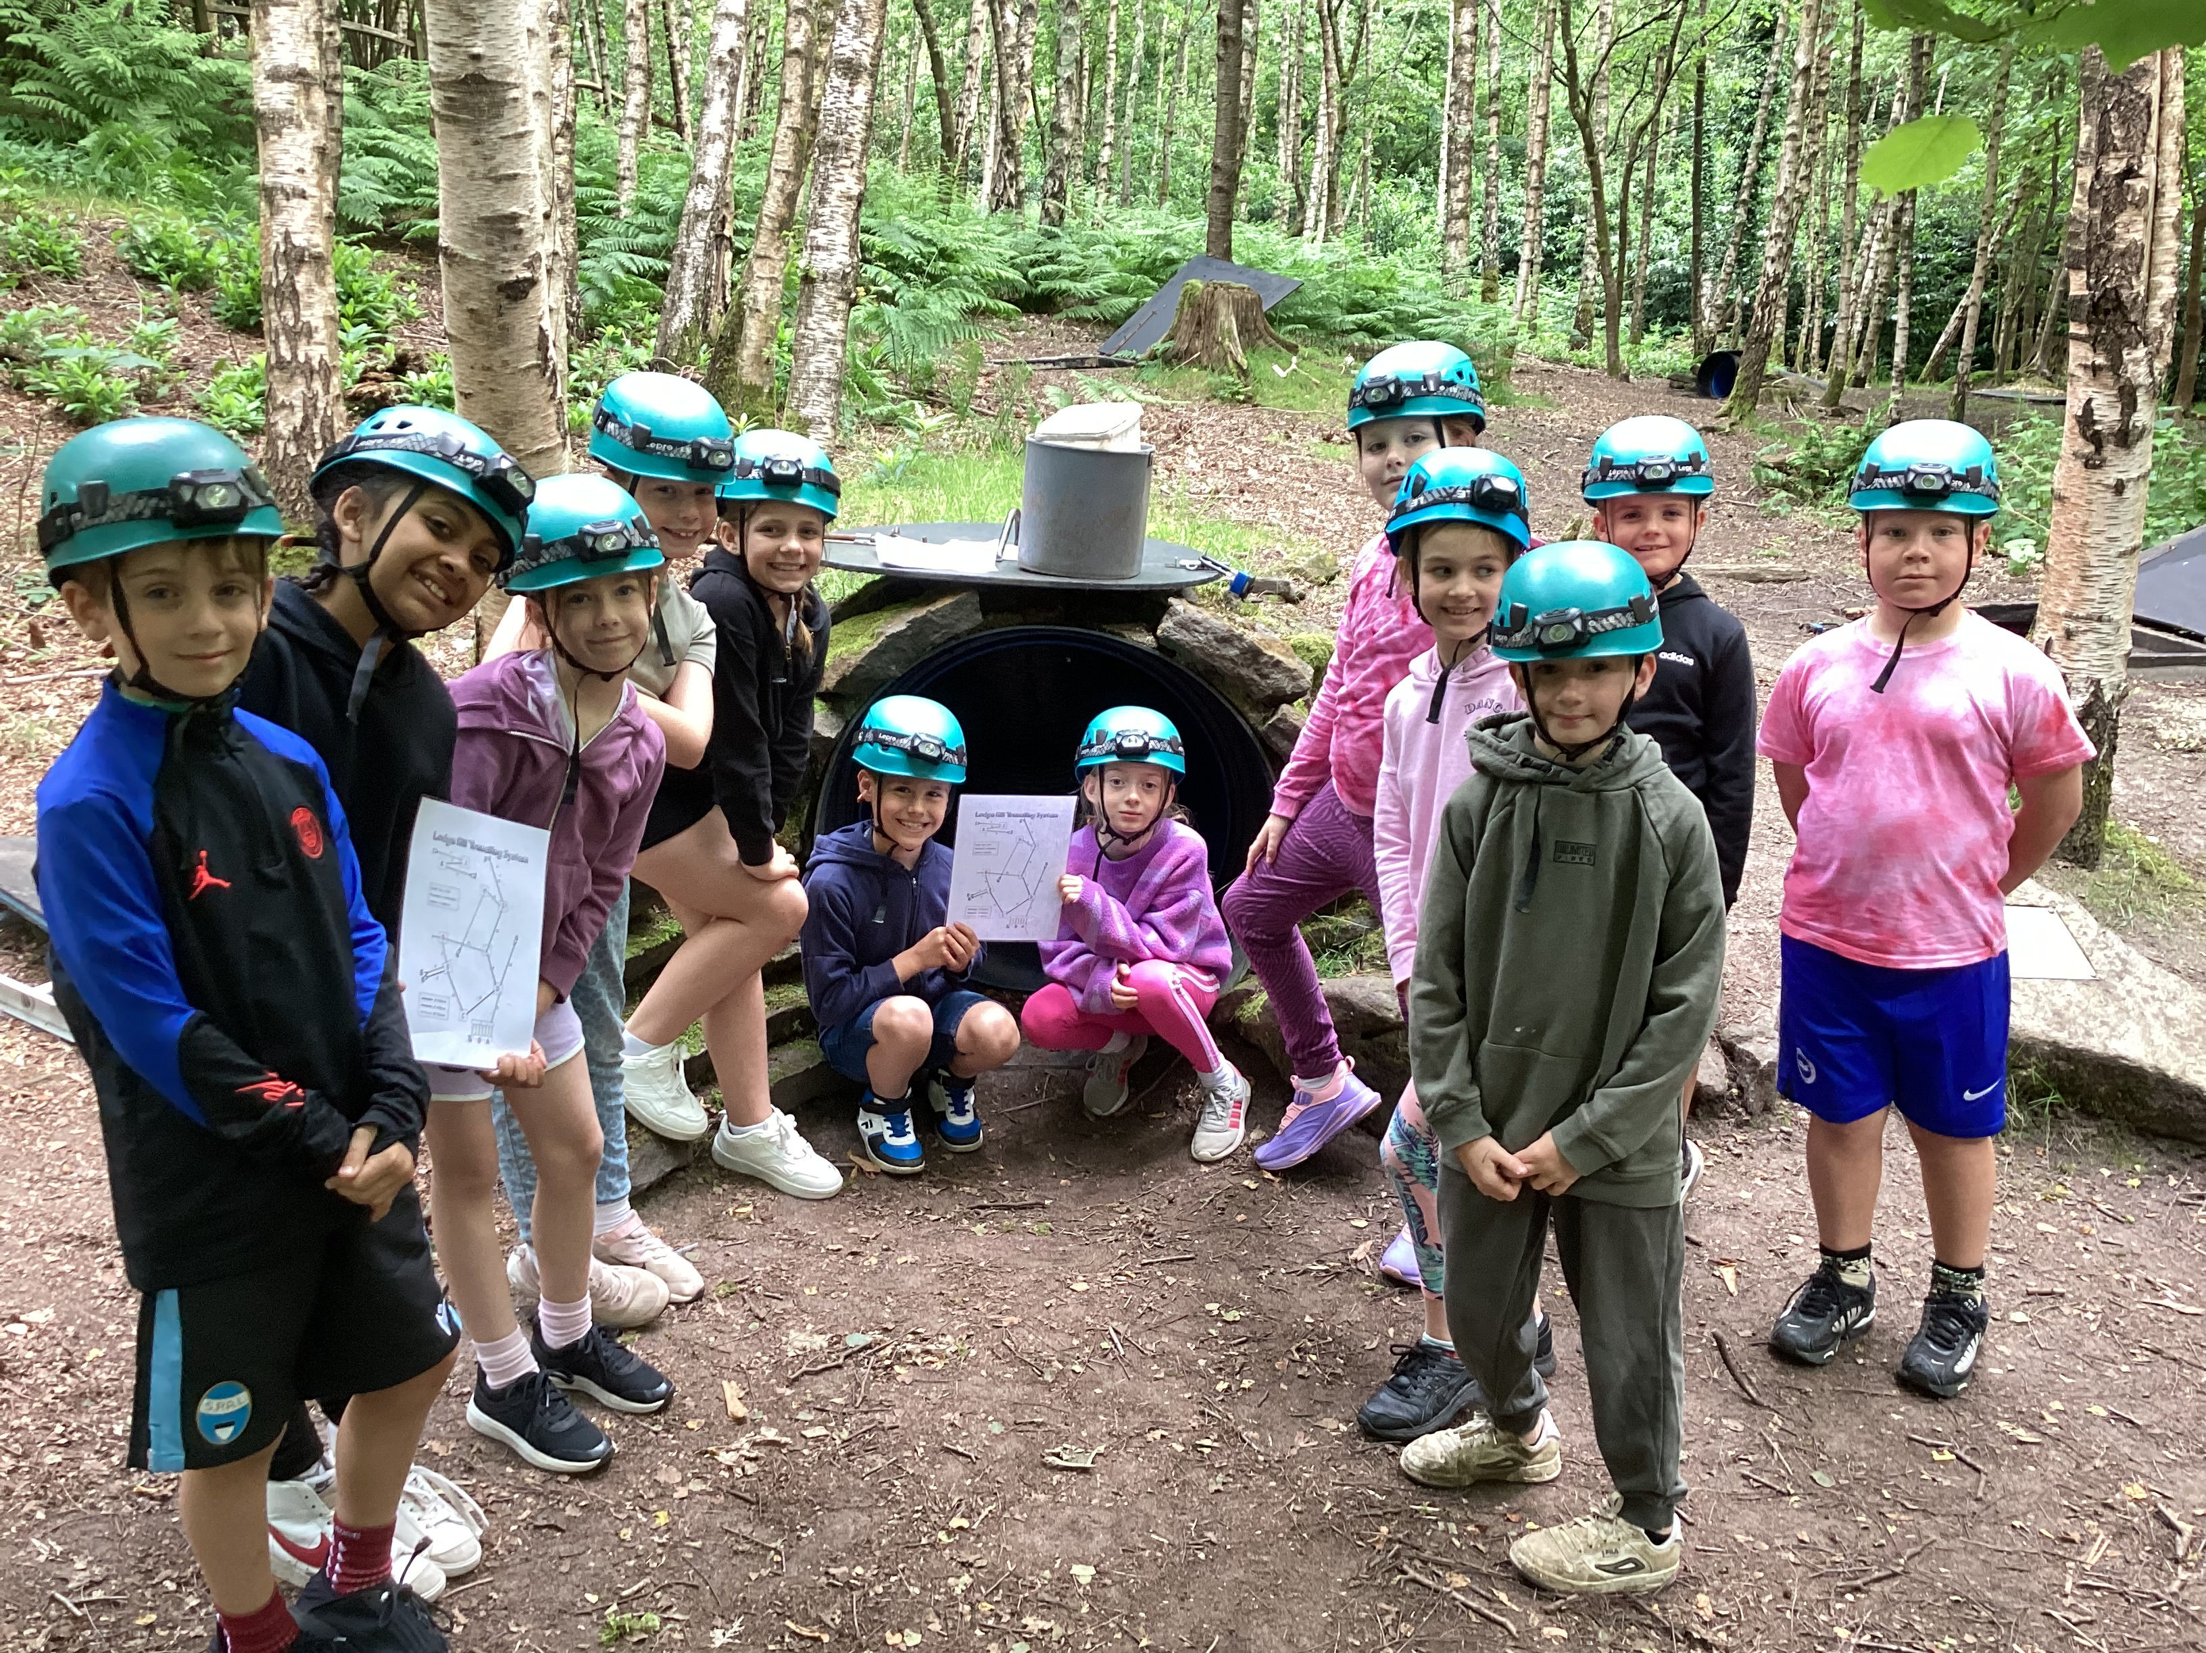

Southway Junior School
June 2024
Newsletter
Learning and Achieving Together
Lodge Hill Year 4
Year 4 had a fantastic time at Lodge Hill last week - who knew we could fit so many activities across 2 days! The children thoroughly enjoyed everything they got up to, from abseiling to zip lining, they all loved trying something they had never done before. Many children conquered their fear of heights by reaching the top of the climbing wall and abseiling back down, whilst others overcame being afraid of the dark by crawling through tunnels so small the teachers couldn't fit through! It was a fantastic few days away, and all the children represented the school brilliantly, we can't wait to visit again soon!
We are looking to recruit a brilliant new Teaching Assistant. Please apply via our website if you would like to join the team, https://southwayjunior.eschools.co.uk/web/vacancies_1/380748
Mon 17th – Magistrates visiting Y6
Weds 19th June Sports Morning & Family Picnic (weather permitting!)
Thurs 20th – Non Uniform Day (Tombola Donations)
Fri 21st – Y6 Brighton Museum & i360 Trip
Fri 21st – Curie Class Assembly 10am
Weds 26th – Class Photos & Y6 Leavers Photos
Thurs 27th – RNLI visiting Y5
Thurs 27th – Y6 France 2024 Parents’ Meeting at 3.15pm
Fri 28th – Cake Donations & Lucky Bags in for Summer Fayre
Fri 28th – Rowling Class Assembly 10am
Sat 29th – Summer Fair from 11am-2pm
Noticeboard
Dates for your Diary
Our Summer Fair needs YOU! Can you possibly spare some time to help out on 29th June? Come along and join the fun! If you can help, please email fos@southwayjunior.co.uk or leave your details with the office
Keep our Children Safe!
Tel: 01444 233824
www.southwayjunior.co.uk
parentline@southwayjunior.co.uk
Southway Junior School

Slide 3
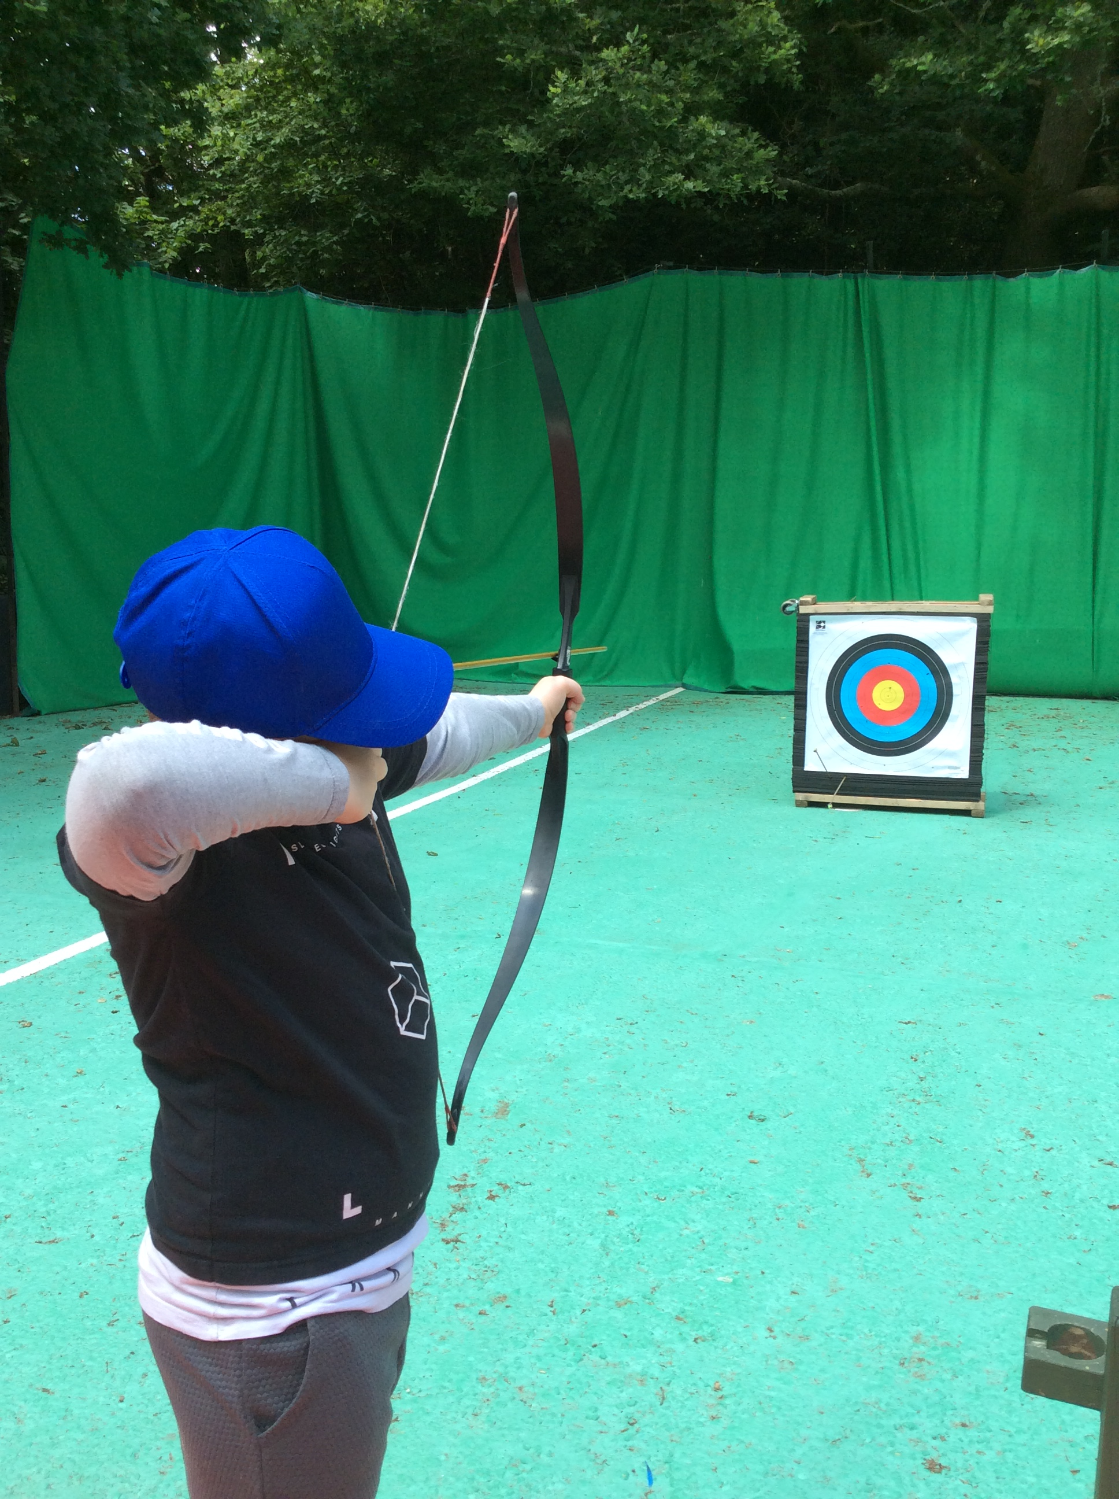
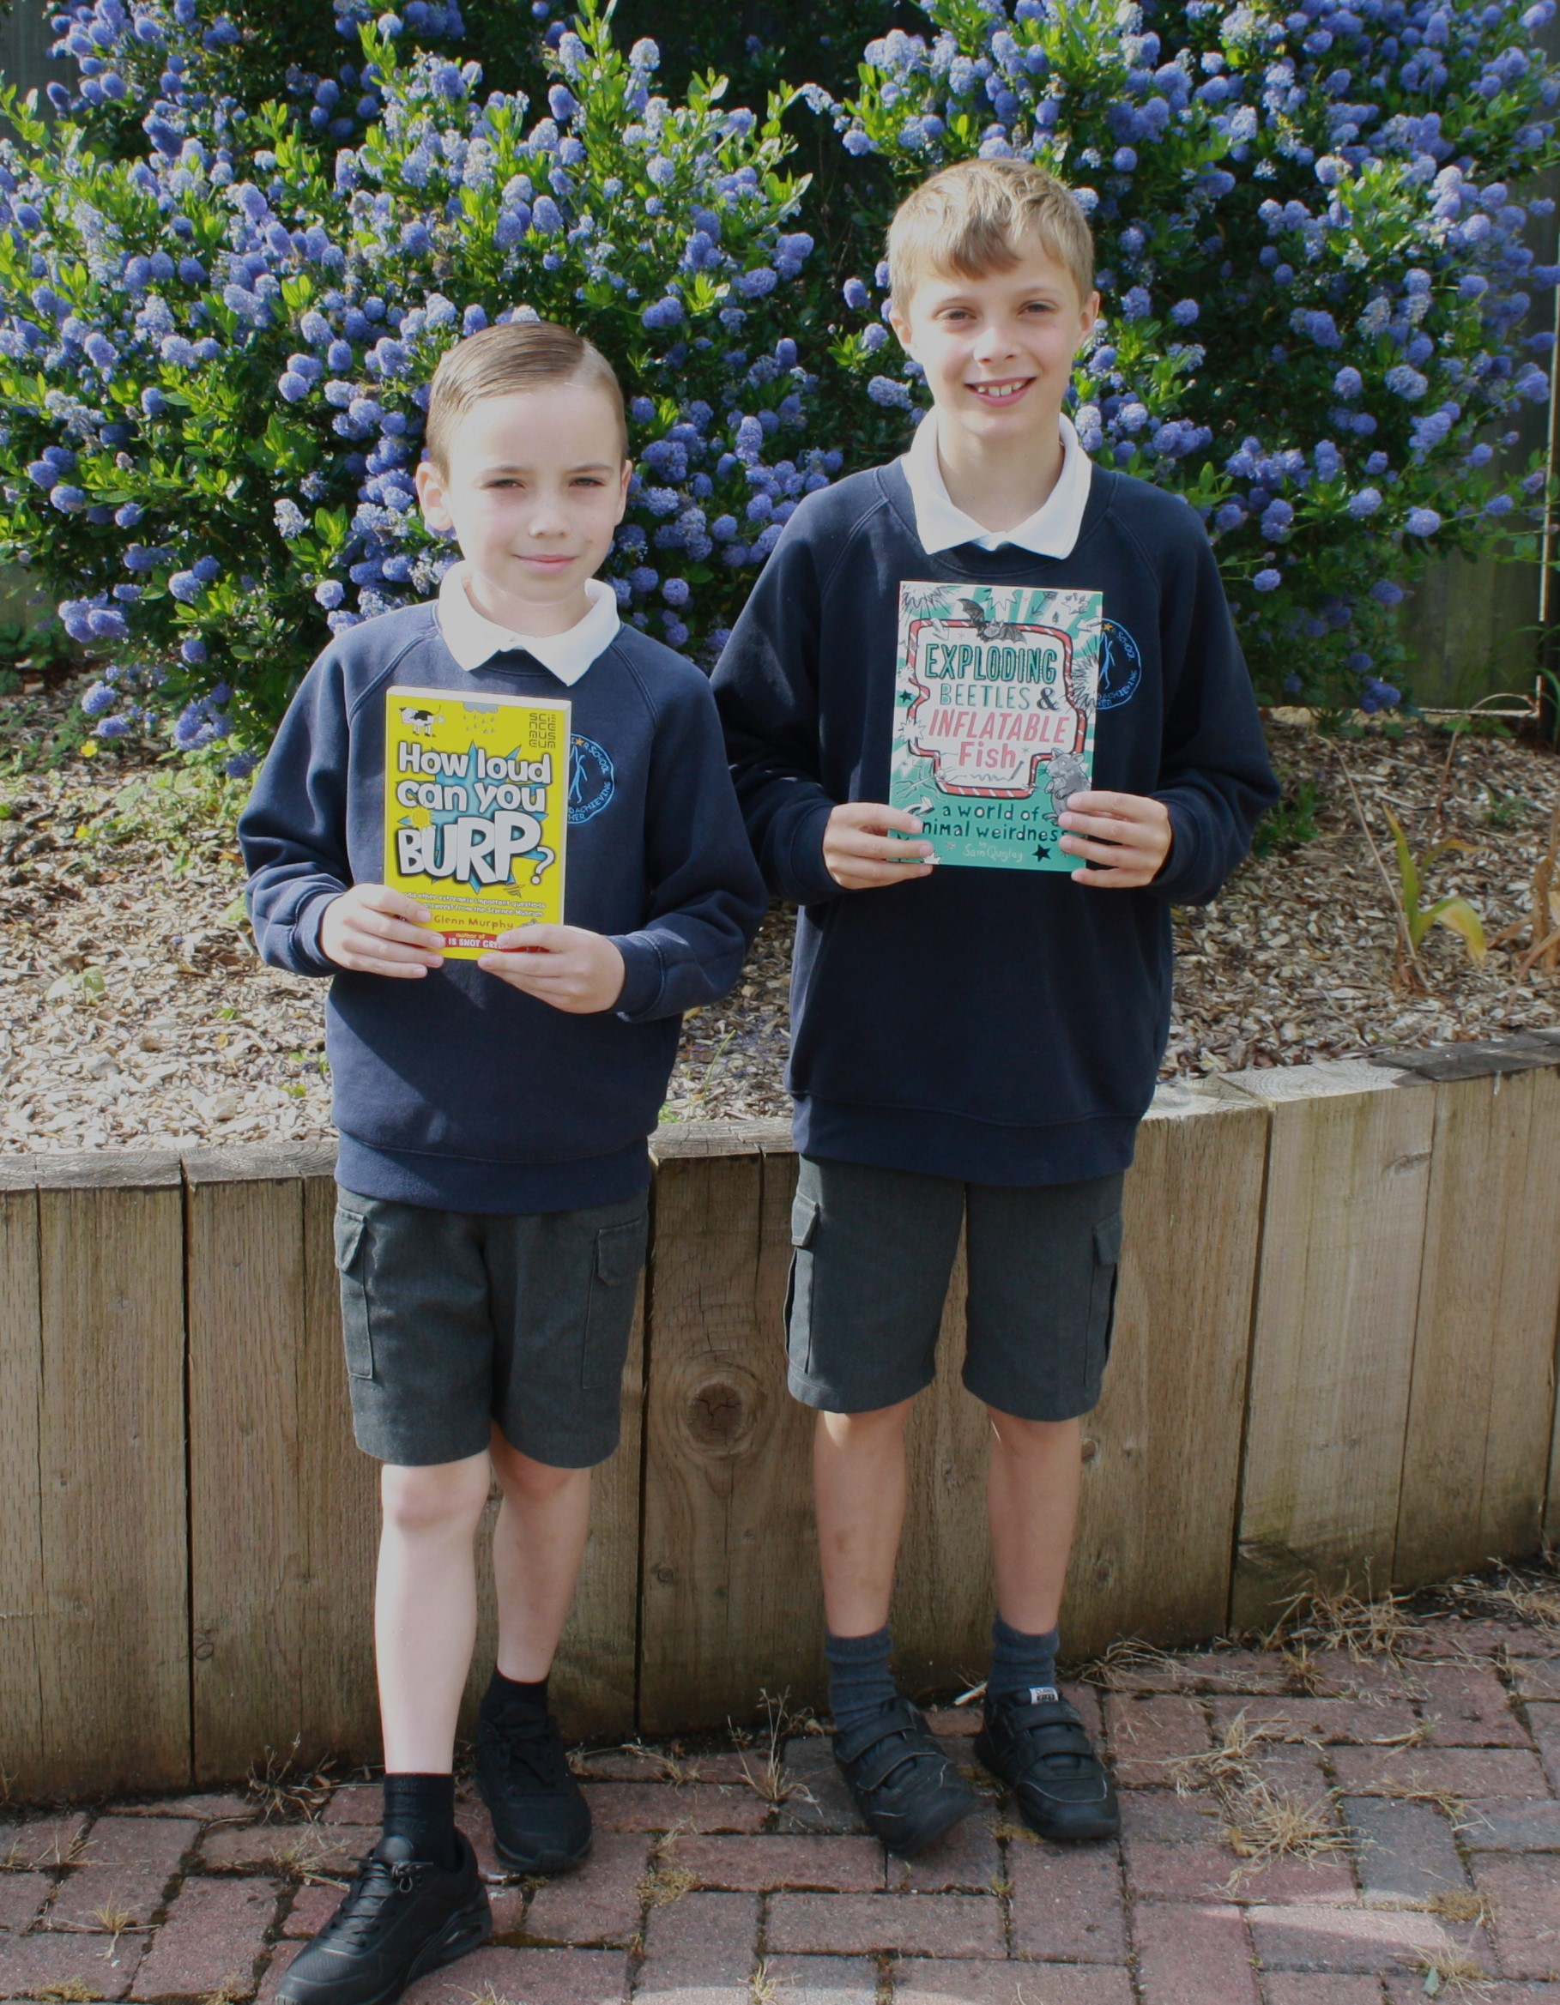
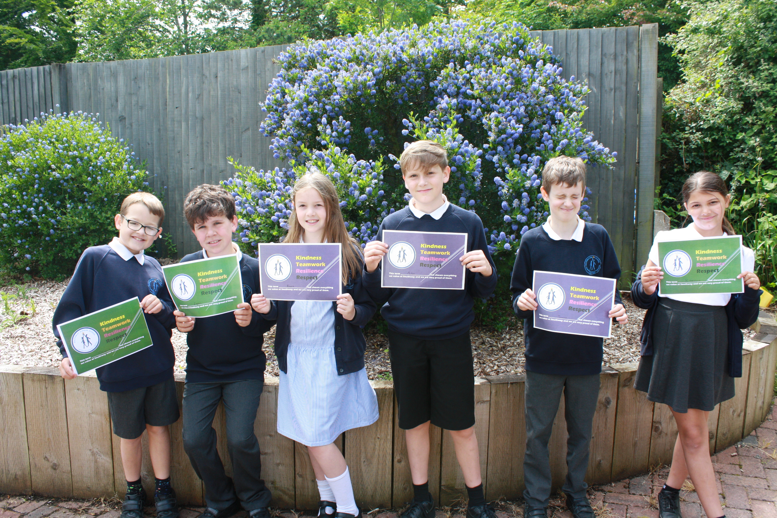
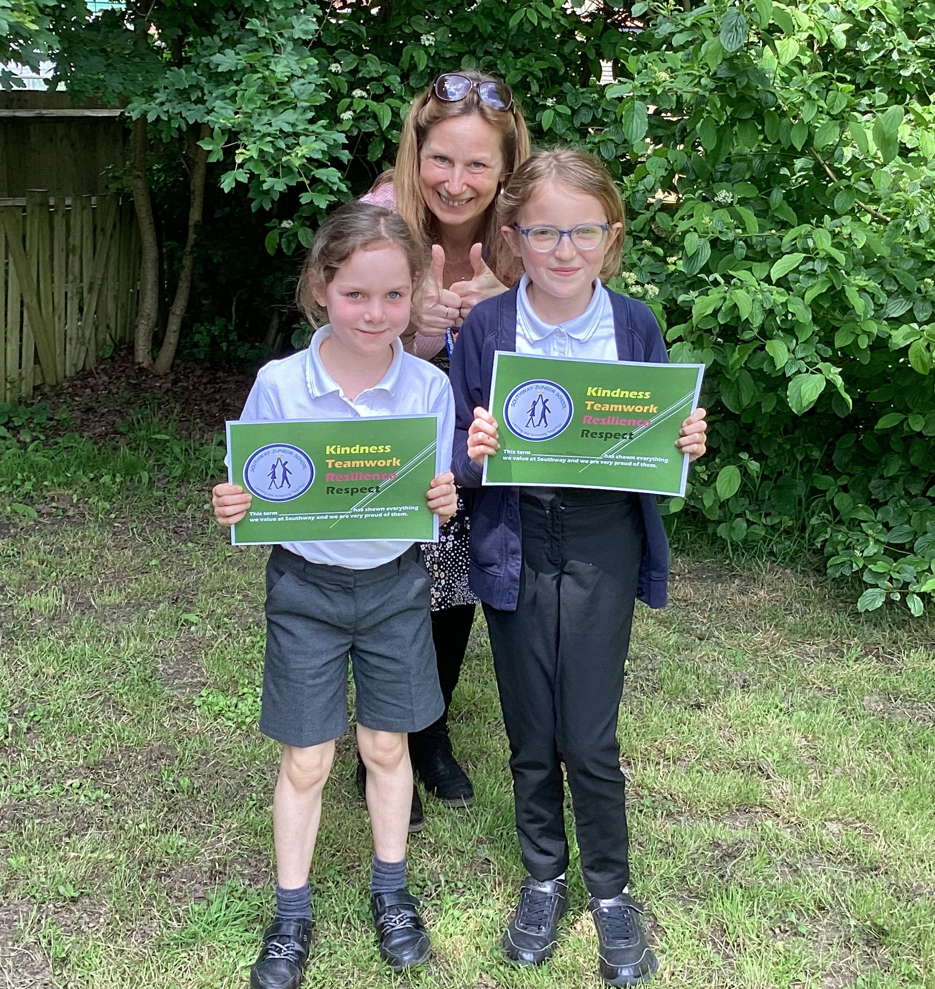
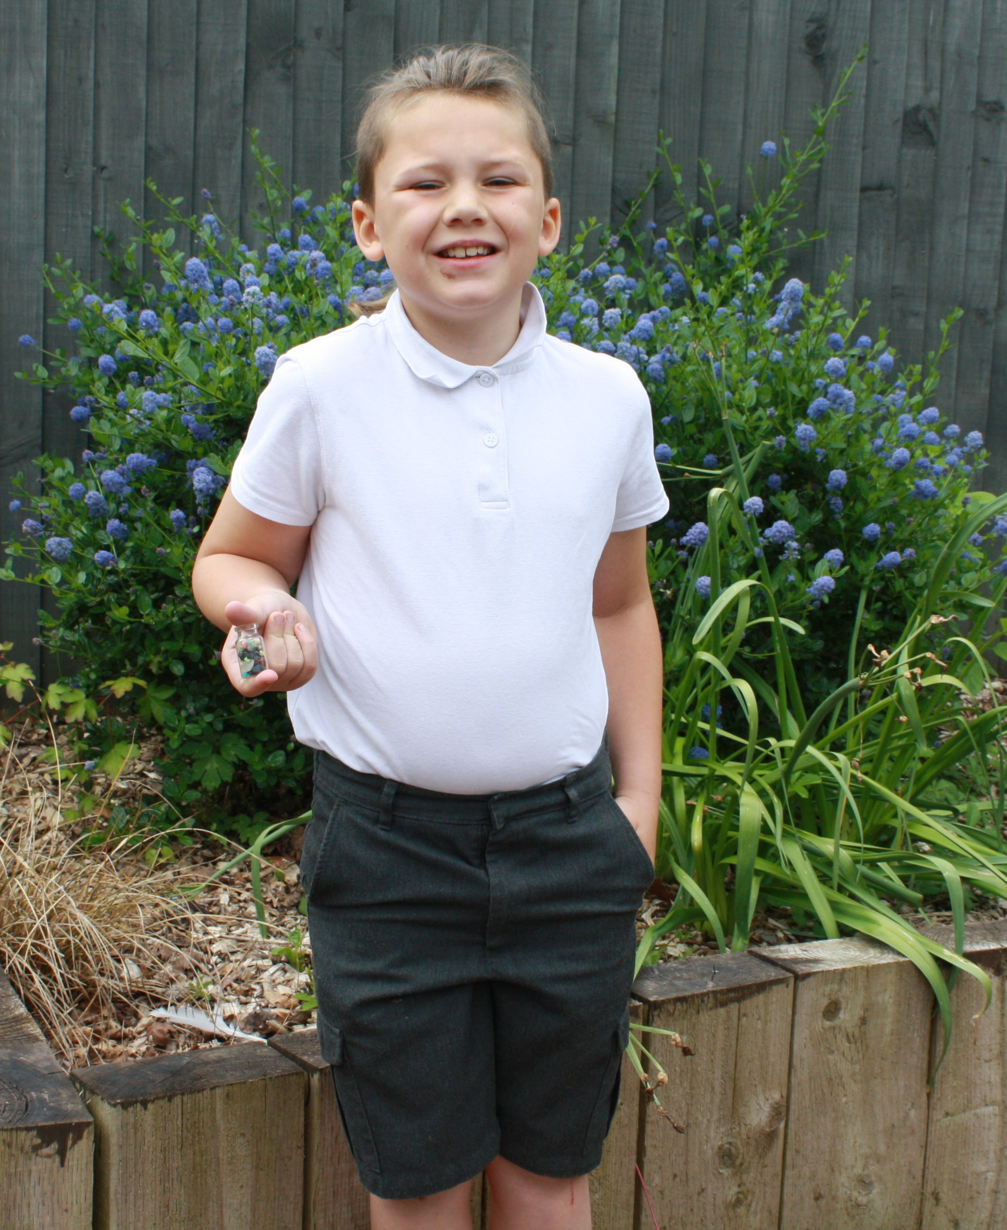
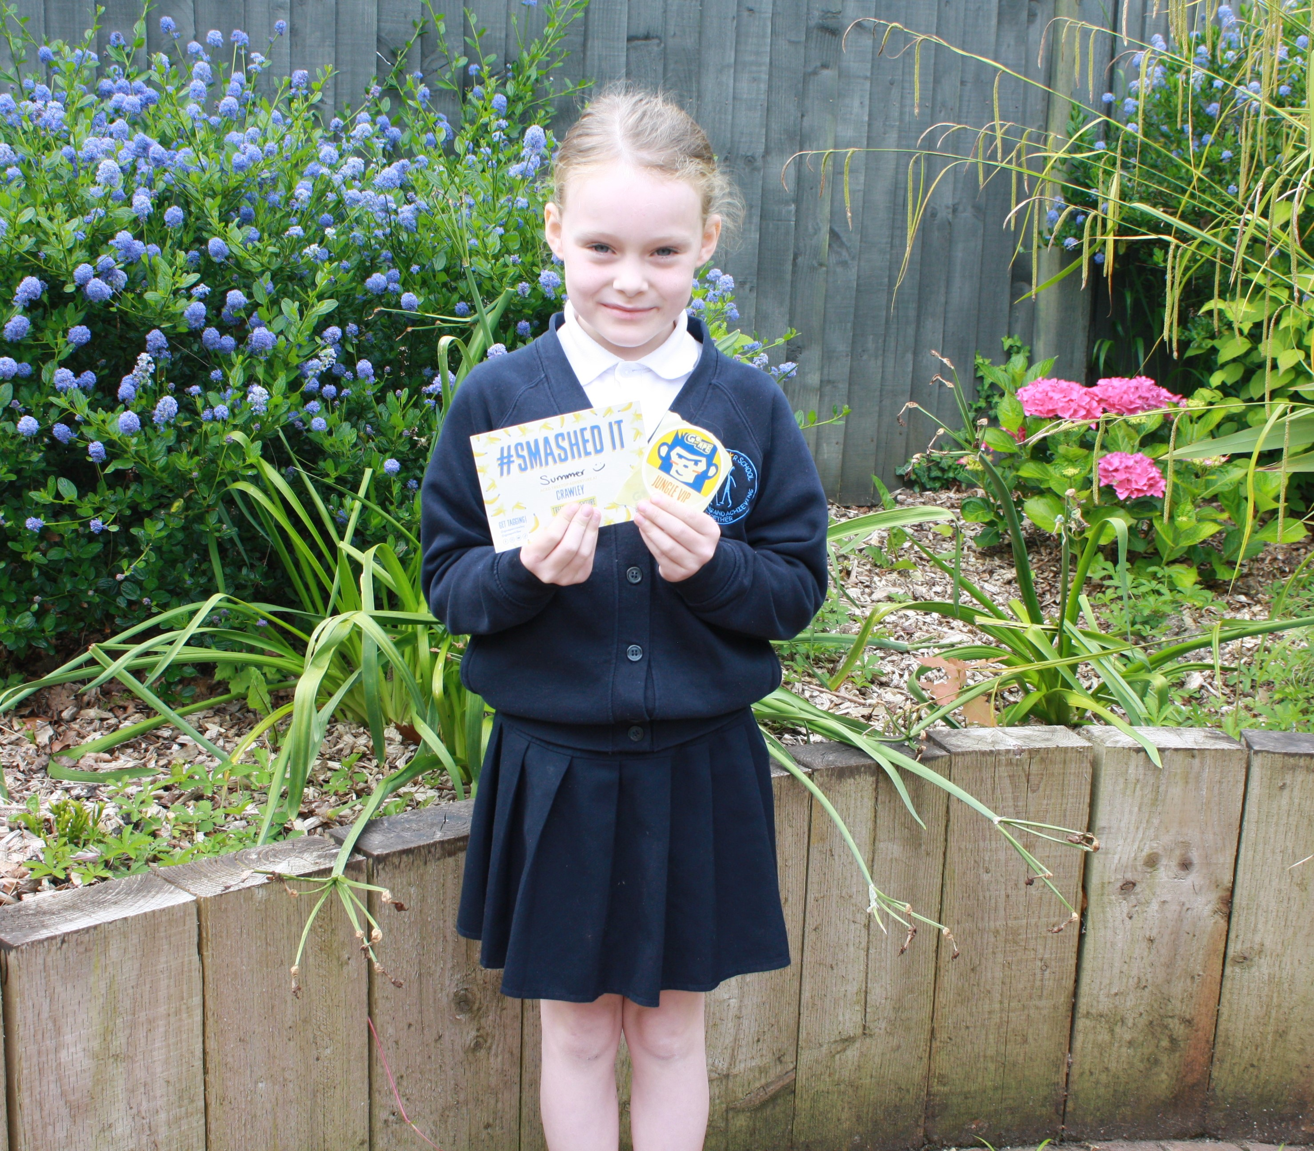
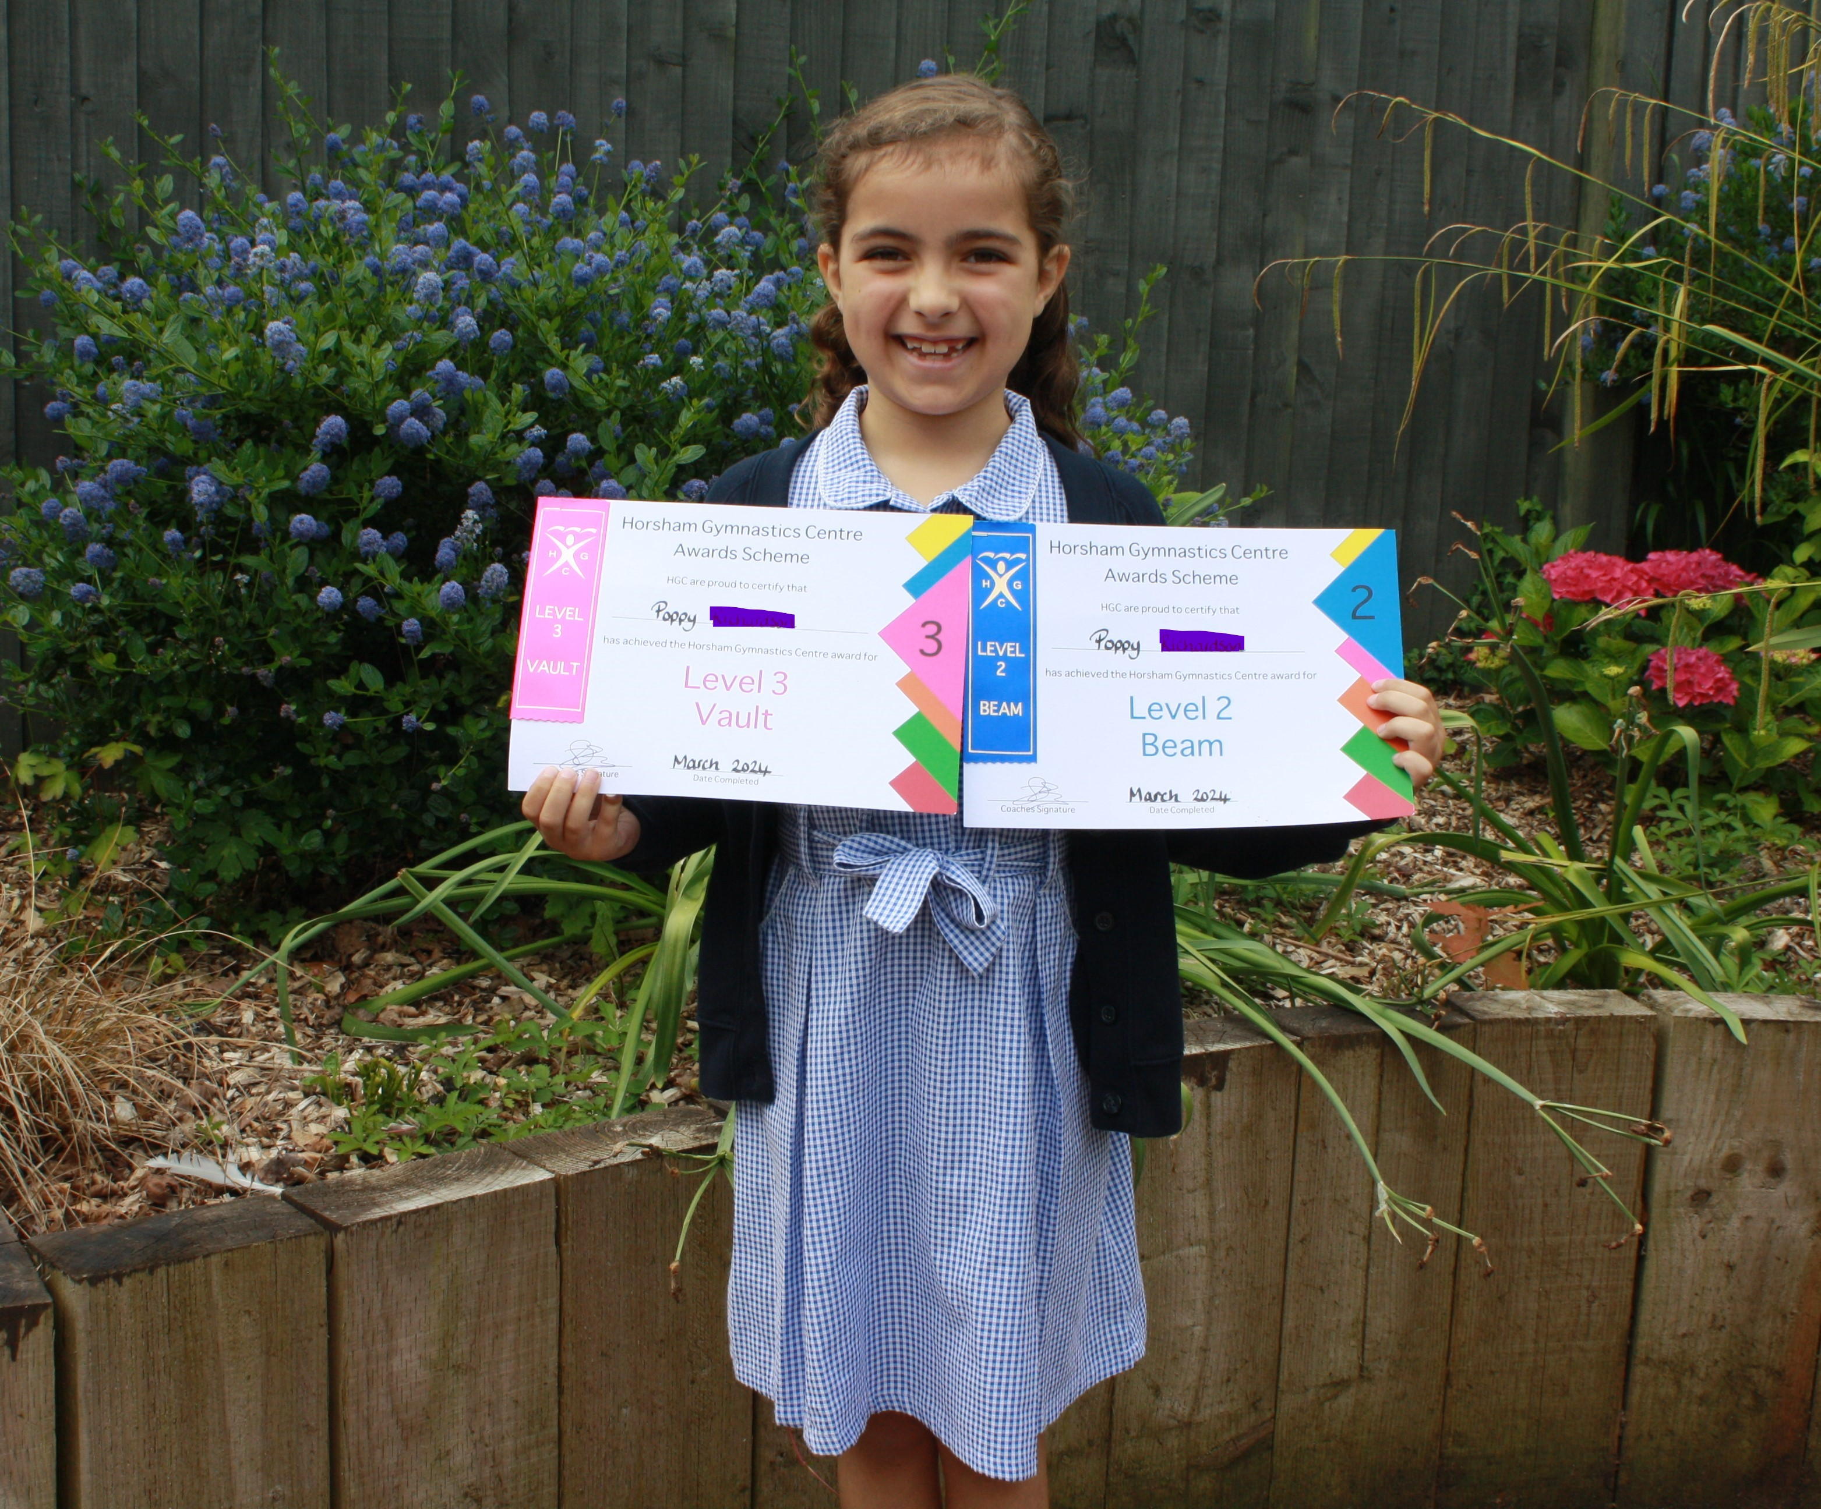
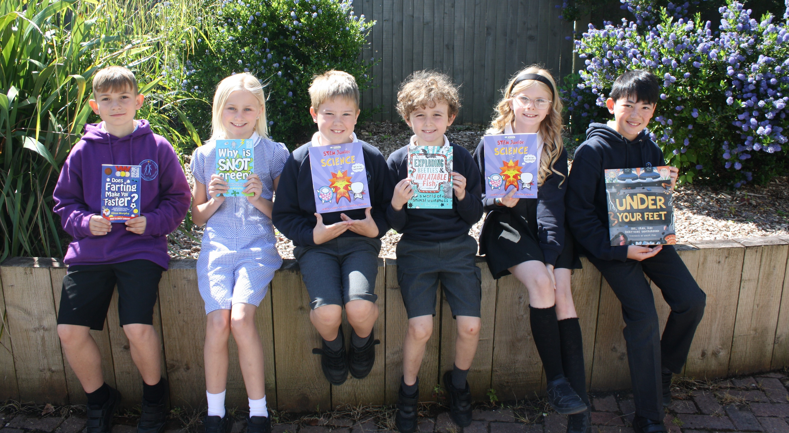
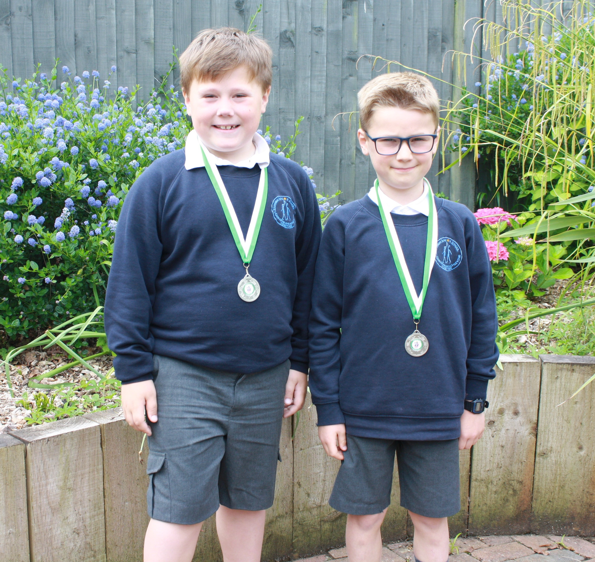
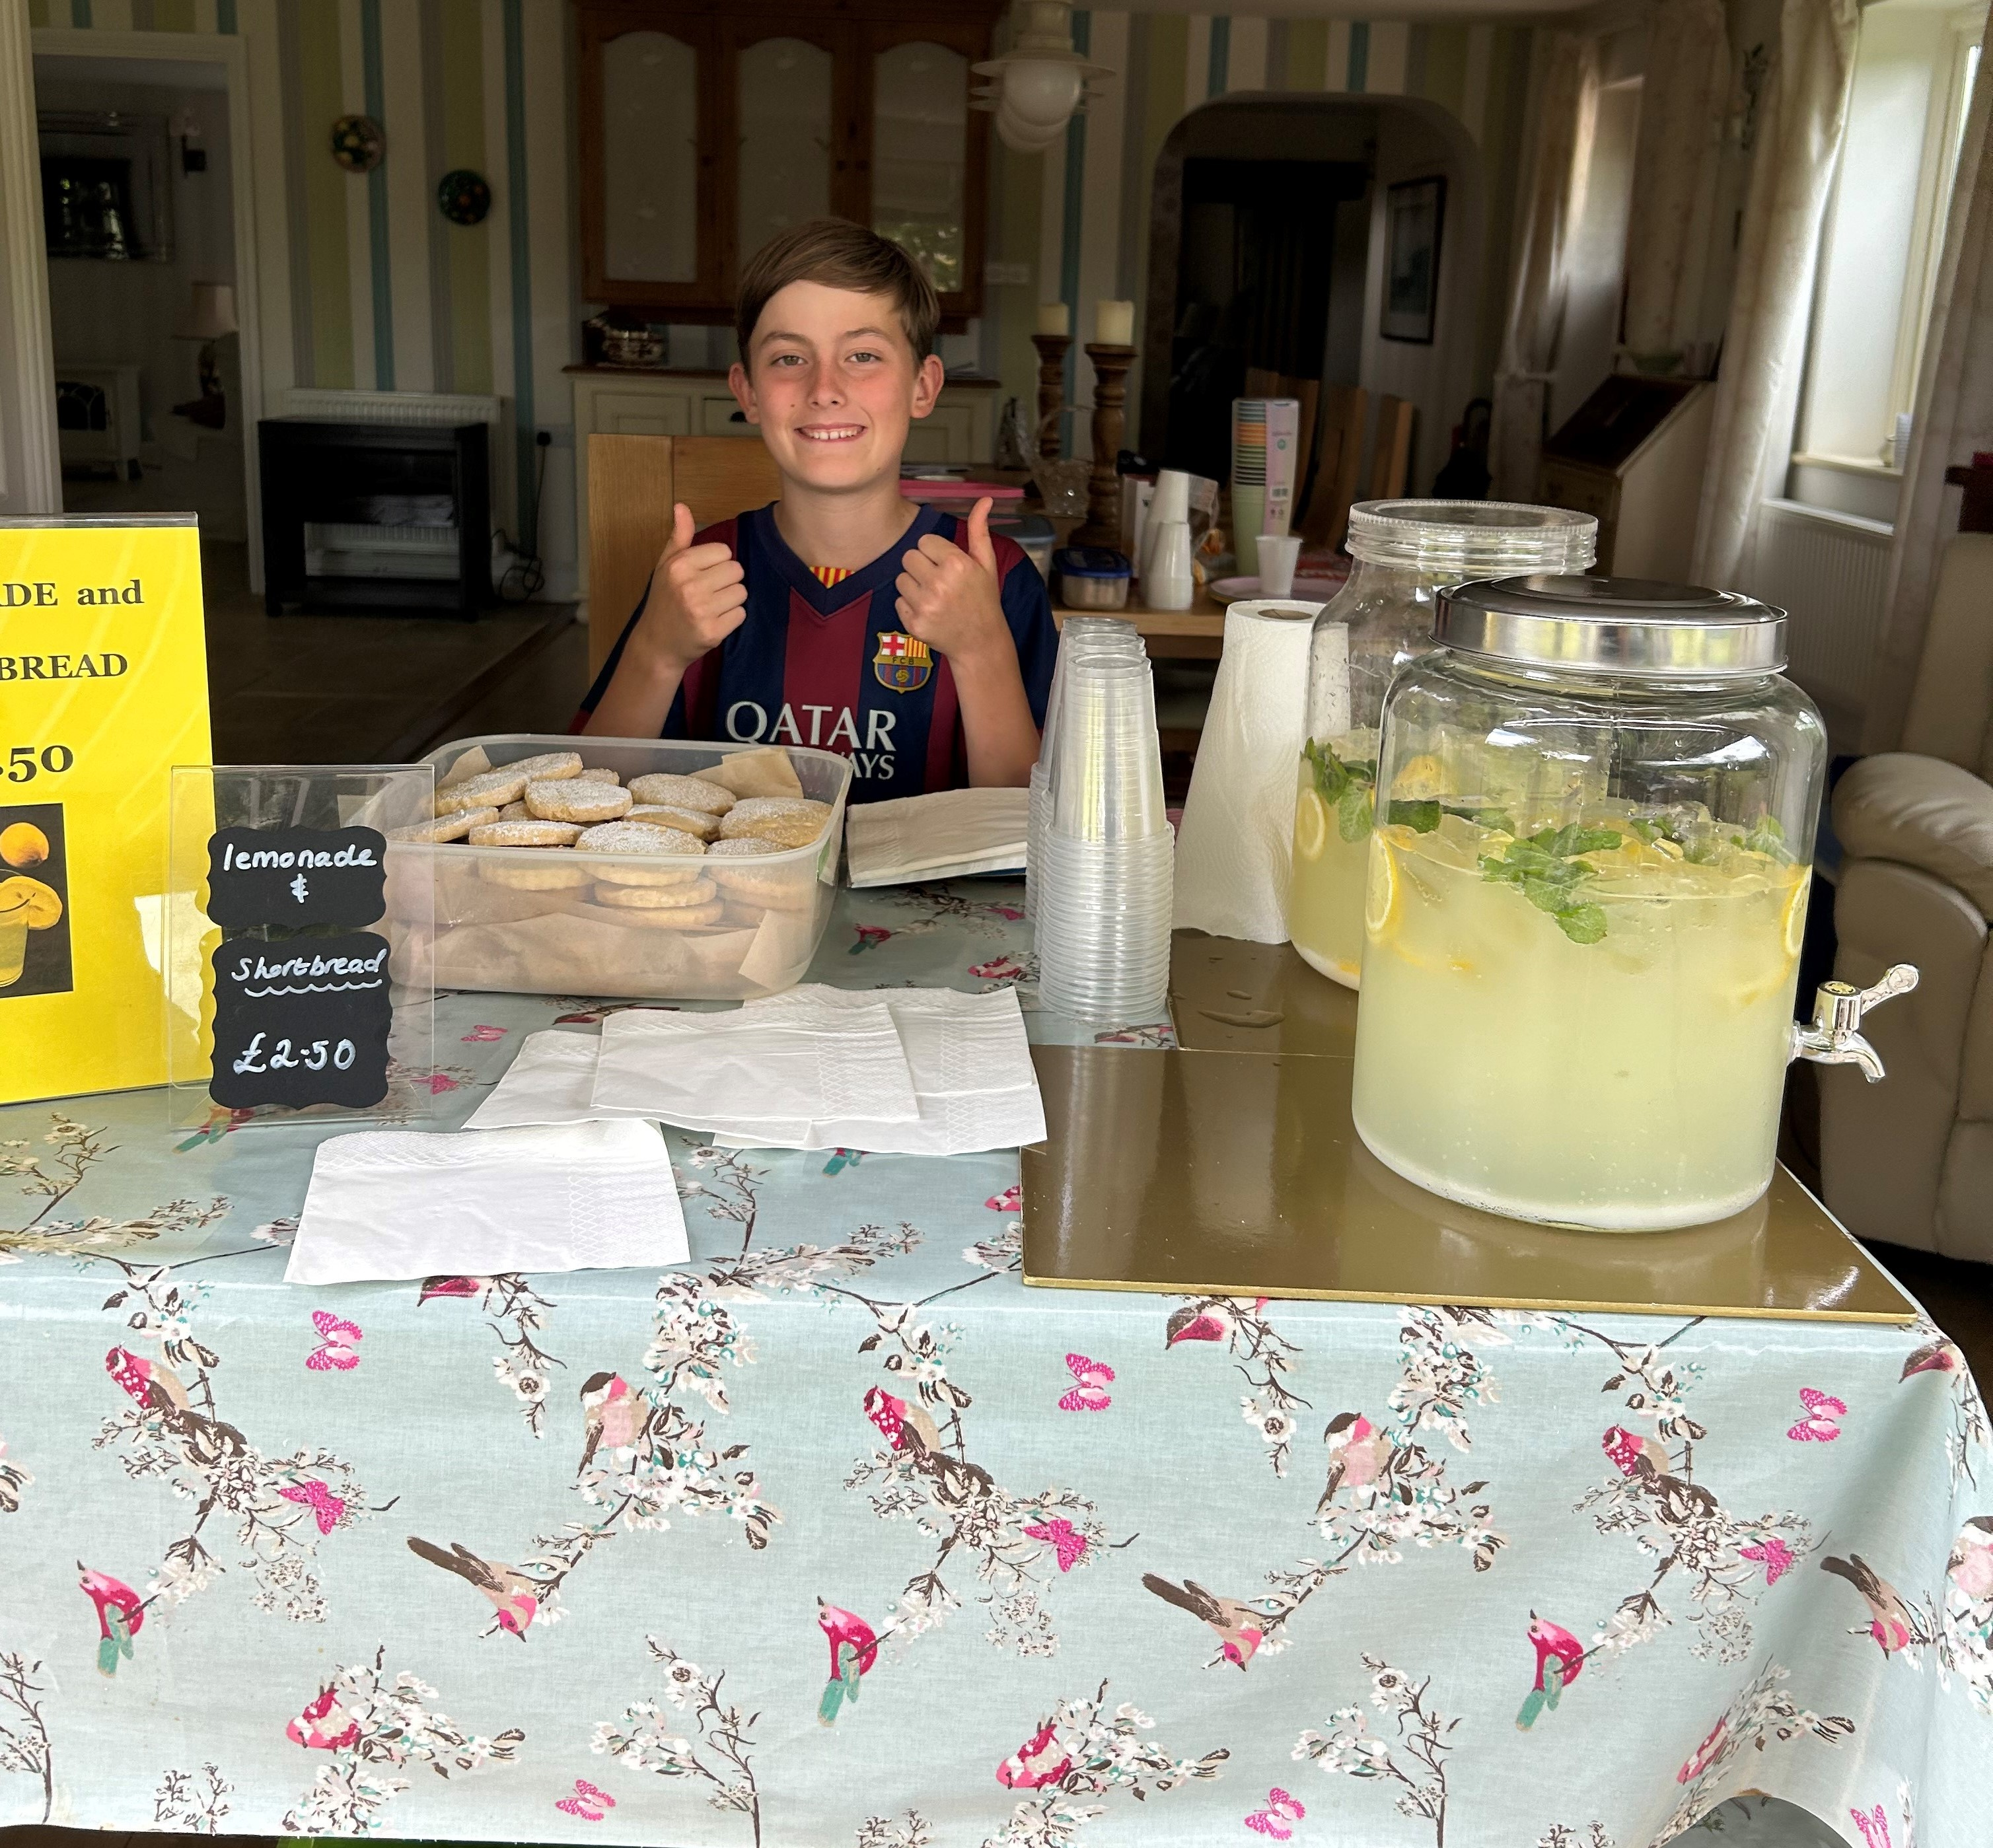
Achievements
June 2024
Sports Round Up
The children have been taking part in lots of sporting activities this week. Teams of children competed in Area Sports at The Burgess Hill Academy and we await the final scores on this locality competition. The year 5 and 6 girls took part in a Kwik cricket competition winning 3 out of 4 games which put them in second place overall. A team also took part in the Boccia and Curling festival at the Triangle. This was a new sport for some of the children and they all had fun trying something new.
These children have been busy winning prizes in the Science Quiz, earning their Southway Values Certificates, doing gymnastics, visiting ‘Go Ape’, playing football & raising money for St Peter & St James’ Hospice!

